Slide 1
EU rules for animal health:
Animal Health Law
BTSF Regional workshop on Animal Health:
disease preparedness, vaccination and One Health approach
Bangkok, Thailand
4-8 March 2024
Žilvinas Ilevičius,
DG SANTE
Unit G2 – Animal Health

Slide 2
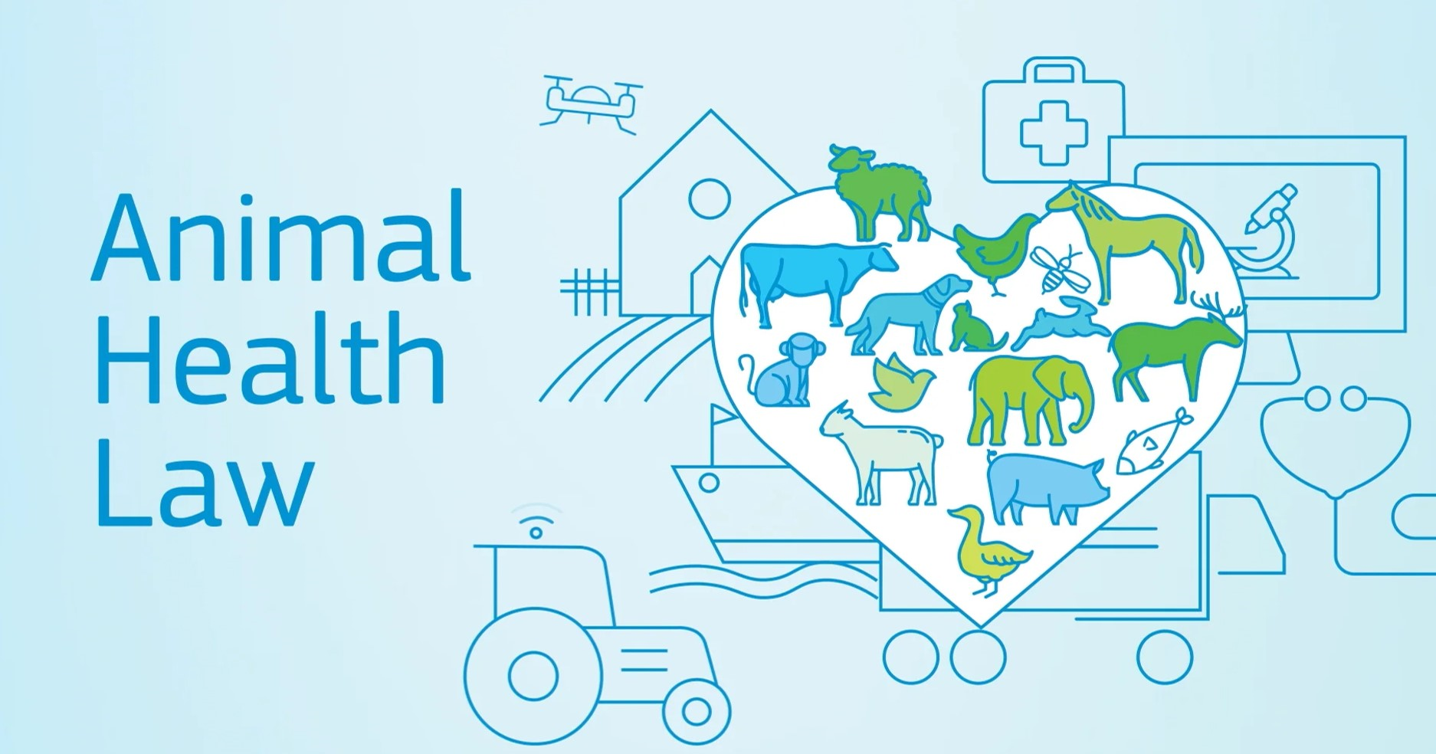
Introduction
Animal Health Law and the process
Why a new EU animal health law and what is it all about?

Slide 3
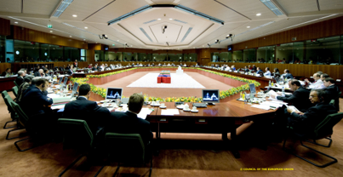
AHL: new EU legislative framework for animal health
Regulation (EU) 2016/429 on transmissible animal diseases (‘Animal Health Law’) (AHL)
  Adopted by the European Parliament and the Council in March 2016
  Is supplemented by additional implementing rules (delegated and implementing acts)
  Based on the assessment carried out in 2006 and the animal health strategy ‘Prevention is better than cure’ (2008), impact assessments and several consultations.
  Entered into application on 21 April 2021
Introducing single EU animal health policy

Slide 4
New EU legislative framework for animal health
As from 21 April 2021 the EU legislative framework for animal health has changed: a complete new set of EU animal health legislation replacing old rules
There are many similarities, but also many differences
Past rules
Risk-based approach
+ transparency + coherency + prevention+ flexibility + gained experience
+ new EFSA opinions
+ OIE standards
New harmonized framework for animal health in the Union

Slide 5
AHL: what is about?
Principles and rules for transmissible animal diseases in:
  Kept and wild animals and their products
  Terrestrial, aquatic and other animals (e.g. reptiles)
Animal health rules for:
  Disease prevention
  Disease surveillance, control and eradication
  Intra-EU movements and entry into the EU of animals and their products
  Emergency measures
Supplementing rules needed to ensure complete implementation

Slide 6
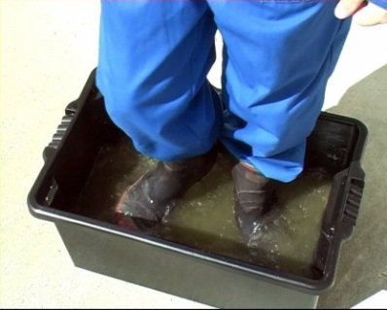
AHL: important new elements
Responsibilities of keepers, operators, veterinarians, competent authorities, etc.
More risk based approach including prioritisation and categorisation of diseases for EU intervention
One health approach
More prevention
  biosecurity
  surveillance
  knowledge on animal health
  use of vaccines
  emerging diseases
Easy and safe trade

Slide 7
AHL and OCR (Official controls regulation)
To note:
  no official controls in the AHL
  for official controls AHL relies on OCR
DA/IA Disease notification surveillance control, …
DA List of diseases
IA disease categorisation and species
AHL
DA/IA registration, approval, animal ID
DA/IA movement within the Union
DA/IA entry into the Union
Delegation of tasks to natural and legal persons
[Veterinary] checks: intra EU and borders
Laboratories (including EURLs and National RLs)
Sampling and diagnostic methods (“cascade”)
IMSOC (TRACES)
Etc…
OCR

Slide 8
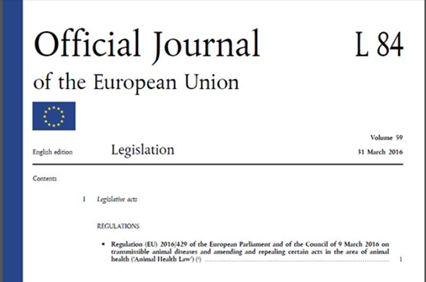

AHL structure and content

Slide 9

Animal Health Law legal framework
ANIMAL HEALTH LAW
Regulation (EU) 2016/429
Part I
Part II
Part III
Part IV
Part V
DR
List of diseases
DR surveillance, eradication & disease free status
DR Prevention & control of Cat A, B & C diseases
Part IV.I
Part IV.II
DR Entry into the EU (T/ A/ G/ TPAO/ APAO)
DR Registration & approval establishments & traceability (T)
DR Approval establishments & intra EU movements (G)
DR Rules for aquaculture animal establishments & transporters of aquatic animals (A)
IR
Categories of diseases
IR
Disease notification/ reporting
DR
Use of vet medicinal products for disease control
IR
List of Third Countries
IR
Registration & identification horses
IR
Operators application for approval (G) & Traceability (G) (marking of straws)
DR Movement of aquatic animal (A) and their products (APAO)
IR
Listing Union Surveillance Programmes & Compartments
DR Management of vaccine banks
IR
Entry into the EU Certificates
IR
Registration & identification (T except horses)
IR
Listing of existing disease free and eradication programmes (MSs & zones)
IR
Rules for vaccine banks
IR
Derogation from registration & for record keeping by certain transporters (A)
DR Intra EU movements (T)
T | Terrestrial animals & hatching eggs
TPAO | Terrestrial products of animal origin
A | Aquatic animals
APAO | Aquatic products of animal origin |  | Delegated Regulation (DR)
G | Germinal products |  | Implementing Regulation (IR)
IR
Contingency plans
IR
Recognition of existing national measures (A)
DR
Intra EU movements (TPAO)
IR intra EU animal health Certificates (T/ A/ G/ TPAO/ APAO)

Slide 10
Structure of the AHL
Part I – General rules
Part II – disease notification, reporting, surveillance, eradication programmes, disease freedom
Part III – Disease awareness, preparedness, control
Part IV
Title 1 – registration , approval, traceability and movements (terrestrial)
Title 2 – registration , approval, traceability and movements (aquatic)
Title 3 – other animals and their products
Part V Entry into EU
Part VI – non-commercial movements of pets
Part VII – Emergency measures
Parts VIII/IX – Common and transitional provisions

Slide 11
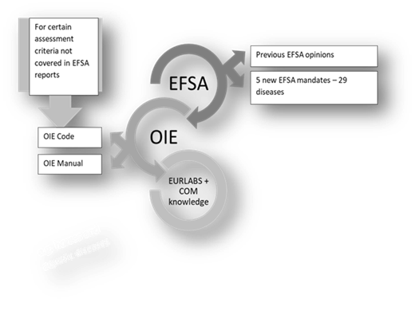
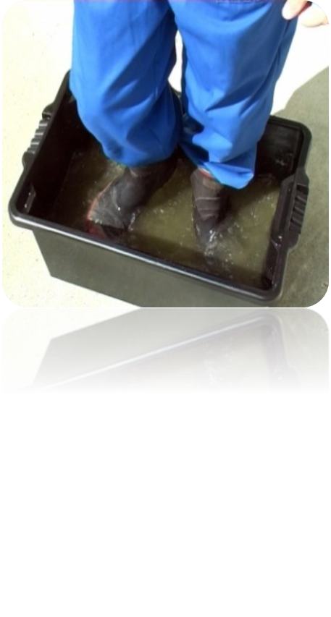
General rules
Scope, definitions
Listed diseases and emerging diseases
Listed species
Responsibilities/actors/delegation
Animal health laboratories

Slide 12
Responsibilities for animal health
Operators:
  health of their animals, biosecurity, etc.
  knowledge on animal health
    Animal diseases, biosecurity, interaction with animal welfare, good husbandry practices and antimicrobial resistance
  more preventive behaviour, better biosecurity
    Contribute to better overall husbandry
    Result with healthier animals and possible lower use of veterinary medicines
Veterinarians to play an active role in:
  raising animal health awareness, awareness on interaction between animal health, animal welfare and human health and on resistance to treatments (incl. AMR)
Competent Authorities to ensure:
  resources, personnel, laboratories, etc.

Slide 13
EU list of Animal diseases
EU intervention limited to listed and emerging diseases
Listed diseases prioritised and categorised (Reg (EU) 2018/1882):
List of diseases – 63 diseases
Article 5(1) (most important diseases) – FMD, CSF, ASF, HPAI, AHS
Article 5(2) – Annex II (amended by Regulation (EU) 2018/1629)
Category A: immediate eradication (normally not present in the EU)
Category B: compulsory eradication throughout the Union
Category C: optional eradication in Member States
Category D: measures to prevent from spreading through movements between Member States or entry into the Union
Category E: notification and surveillance within the Union

Slide 14


WOAH list vs. EU list
?
WOAH list:
Broader list
Different purposes
Listing criteria: WOAH
EU list:
Shorter list
Sources from the WOAH
Internal EU management (priorities)
The rest to deal with by MS
Listing criteria: EU

Slide 15
Laboratories and EU Animal Health laboratory network
Biosecurity, biosafety and bio-containment obligation of all laboratories, facilities and other handling disease agents, vaccines etc.
Requirements for movements of disease agents
Network of official laboratories in animal health consists of:
EU_RL
NRL
Official Labs

Slide 16

Surveillance, eradication, disease freedom
Disease notification and reporting
Surveillance
Eradication programmes
Disease-free status
Notification of animal diseases (in MSs) and
EU notification and reporting system (incl. ADIS)
Surveillance (responsibilities):
    Obligation of operators for surveillance (incl. Animal Health Visits)
    Obligations of competent authorities
    Union surveillance programmes
Compulsory and optional eradication programmes (for Cat B and C diseases)
Measures under programmes and contents
Disease free status (Cat B and C diseases)
  Countries
  Zones
  Compartments (n.b. only rules for aquatic compartments developed)
  Maintenance, suspension, withdrawal and restoration
For terrestrial and aquatic animals

Slide 17
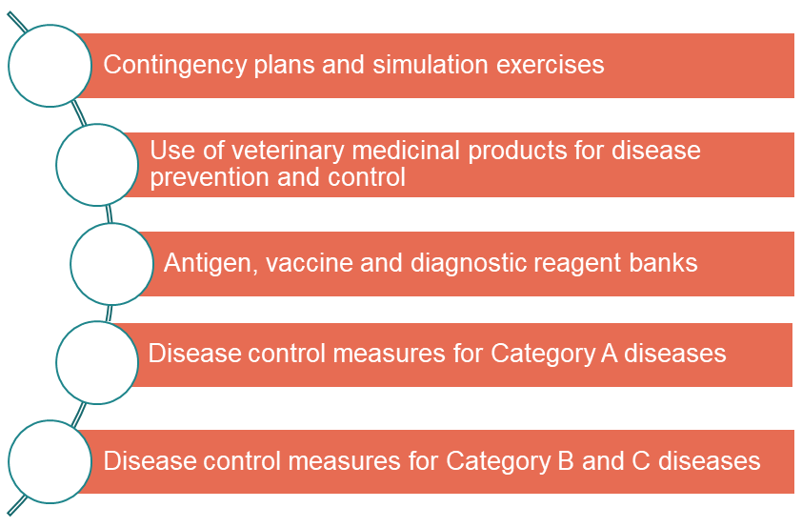

Disease awareness, preparedness and control
Contingency plans and simulation exercises
The use of VMPs for disease prevention and control of animal diseases
EU antigen, vaccine and diagnostic reagent banks for cat A diseases
  Establishment of the banks
  Access to the banks
  Confidentiality
National antigen, vaccine and diagnostic reagent banks for cat A diseases
Disease control measures for Cat A, B and C diseases
  Measures in the affected establishments (suspicion and confirmation)
  Establishment of restricted zones
  Measures in the restricted zones
For terrestrial and aquatic animals

Slide 18
Disease awareness, preparedness and control: some additional rules
Delegated Regulation (EU) 2020/687 on disease control measures for category A, B and C diseases
Delegated Regulation (EU) 2023/361 on the use of veterinary medicines for the prevention and control of animal diseases (e.g. vaccination)
Delegated Regulation (EU) 2022/139 and Implementing Regulation (EU) 2022/140 on EU vaccine banks
Implementing Regulation (EU) 2021/605 on special disease control measures for ASF

Slide 19
Registration, approval, traceability and movements
Establishments registration, approval, traceability, movement requirements
Terrestrial animals, germinal products and products of animal origin
Aquatic animals and products of animal origin from aquatic animals
Other animals, germinal products and products of animal origin

Slide 20







Registration, approval, traceability and movements
Terrestrial animals, germinal products and POA
Aquatic animals and POA from aquatic animals
Establishments: Registration, approval, records, registers
Traceability (incl. Animal Identification and registration)
Movement of kept terrestrial animals
Production, processing and distribution of PAO
Movement of wild terrestrial animals
Movement of Germinal Products
National measures
Establishments: Registration, approval, records, registers, traceability
Movement of aquatic animals
Production, processing and distribution of POA from aquatic animals
National measures

Slide 21





Animal Health Requirements for entry into Union
Conditions for entry into EU of animals, germinal products and products of animal origin
Entry into EU of certain goods other than animals, GP and PAO
Export from the EU

Slide 22

Entry into EU of animals, germinal products and products of animal origin and export
Animal health requirements for entry into Union
  List of third countries and territories
  Approval and listing of establishments in third countries and territories
  Animal health requirements for entry into the EU of species and categories of animals, germinal products and products of animal origin
  Animal health certificates, declarations and other documents
  Derogations and special rules
Export from the Union (Article 243)
  Main objective: the export should not hamper animal health in third countries and territories, and their health statuses

Slide 23
Animal health requrements for entry into the Union: interlinked acts
Part V AHL
Reg (EU) 2020/692 on animal health requirements for entry into the Union
Reg (EU) 2021/404 with lists of third countries
Reg (EU) 2020/2235, 2020/2236, 2021/403 with animal health certificates
Part I
Surveillance of diseases
Part III
Control measures
Part IV
I&R
Intra EU movements
Part II
Listing and categorization

Slide 24
Animal Health Law legal framework

Slide 25
More information material:
https://ec.europa.eu/food/animals/animal-health/animal-health-law_en
https://ec.europa.eu/food/animals/animal-health/animal-health-law/delegated-and-implementing-acts_en
https://ec.europa.eu/food/animals/animal-health/animal-health-law/btsf-training-events_en
Notes:
https://vimeo.com/705693234

Slide 26


Thank you for your attention
Questions?
For more information:
https://ec.europa.eu/food/animals/animal-health/animal-health-law_en
© European Union 2020

