Slide 1
The EU import provisions
BTSF Bangkok 4-8 March 2024
Prof. Andrea DIONISI
DG SANTE

Slide 2
Main rules
Food and feed requirements
Animal health requirements
Residue Monitoring plans
Import conditions
Listing of trade partners
Listing of establishments
Controls at EU borders

Slide 3
Integrated official controls
OCR
Regulation (EU) 2017/625 – Official Control Regulation
Public health
Public health law and certificates – Regulation (EU) 2019/624, 2019/625, 2020/2235, 2020/2236, 2021/403
Date of application: various
Contaminants, residues, AMR
AHL
Regulation (EU) 2016/429 – Animal Health Law
Date of application: 21.04.2021
Date of application: 14.12.2019
Commission Delegated Regulation (EU) 2022/931 on contaminants and Commission Implementing Regulation (EU) 2022/932
Commission Decision 2011/163/EU of 16 March 2011 on the approval of plans submitted by third countries, as amended*
*COMMISSION IMPLEMENTING DECISION (EU) 2022/1390 of 9 August 2022
Notes:
Regulation (EU) 2017/625 on official controls and other official activities performed to ensure the application of food and feed law, rules on animal health and welfare, plant health and plant protection products ('Official Controls Regulation') was adopted in March 2017 and entered into force on 27 April 2017. It entered into application on 14 December 2019, unless otherwise provided for in Article 167(2) to (4) thereof.
Regulation (EU) 2017/625 of the European Parliament and of the Council of 15 March 2017 on official controls and other official activities performed to ensure the application of food and feed law, rules on animal health and welfare, plant health and plant protection products, amending Regulations (EC) No 999/2001, (EC) No 396/2005, (EC) No 1069/2009, (EC) No 1107/2009, (EU) No 1151/2012, (EU) No 652/2014, (EU) 2016/429 and (EU) 2016/2031 of the European Parliament and of the Council, Council Regulations (EC) No 1/2005 and (EC) No 1099/2009 and Council Directives 98/58/EC, 1999/74/EC, 2007/43/EC, 2008/119/EC and 2008/120/EC, and repealing Regulations (EC) No 854/2004 and (EC) No 882/2004 of the European Parliament and of the Council, Council Directives 89/608/EEC, 89/662/EEC, 90/425/EEC, 91/496/EEC, 96/23/EC, 96/93/EC and 97/78/EC and Council Decision 92/438/EEC (Official Controls Regulation) (OJ L 095 7.4.2017, p. 1.).
Regulation (EU) 2017/625 constitutes the basic act governing the performance of official controls for the verification of compliance with the Union agri-food chain rules, including where those rules are applicable to animals and goods entering the Union from third countries. It repealed and replaced Regulation (EC) No 882/2004 on official controls and other legislation that previously governed official controls and enforcement action along the Union agri-food chain, including Council Directive 97/78/EC and Regulation (EC) 854/2004. The aim is to provide for a single and harmonised legislative framework for the organisation of official controls.
Regulation (EC) No 882/2004 of the European Parliament and of the Council of 29 April 2004 on official controls performed to ensure the verification of compliance with food and feed law, animal health and animal welfare rules (OJ L 165, 30.4.2004, p. 1).
Council Directive 97/78/EC of 18 December 1997 laying down the principles governing the organisation of veterinary checks on products entering the Community from third countries (OJ L 24, 30.1.1998, p. 9).
Regulation (EC) No 854/2004 of the European Parliament and of the Council of 29 April 2004 laying down specific rules for the organisation of official controls on products of animal origin intended for human consumption (OJ L 139, 30.4.2004, p. 206).

Slide 4
Animal Health Law
Large number of legal acts streamlined into a single law
Focus on key priorities: preventing and eradication of diseases
Clarification of responsibilities farmer, veterinarians and others dealing with animals
Further involvement of new technologies for surveillance of pathogens, electronic identification and registration of animals
Better and early detection and control of animal diseases including emerging risks
More flexibility to adjust rules to local circumstances
Better legal basis for monitoring animal health pathogens to resistant antimicrobial agents

Slide 5
AHL Tertiary legislation respect to BCP control
Del. Reg. (EU) 2020/692
Rules for entry into the Union, and the movement and handling after entry of consignments of certain animals, germinal products and products of animal origin
Important definitions e.g. listed third countries territory and zones, animal species, container, means of transport, casings
Part IV: AH requirements for the entry into the Union of products
Part VI: Special rules for transits and re-entry into the Union
Repeals: Reg. (EU) 206/2010; Reg. (EU) 139/2013; Reg. (EU) 605/2010; Reg. (EU) 798/2008; Dec. 2007/777/EC
Impl. Reg. (EU) 2021/404:
laying down laying down the lists of third countries, territories or zones thereof from which the entry into the Union of animals, germinal products and products of animal origin is permitted in accordance with Reg. (EU) 2016/429

Slide 6
Hygiene package
Hygiene package
REGULATION (EC) 852/2004
REGULATION (EC) 853/2004
REGULATION. (EU) 2017/625
General rules
FBO
Specific rules
Official controls
CA
(OCR)
Reg. (EU) 2019/624 (meat, LBMs)
Reg. (EU) 2019/625 (import)
Reg. (EU) 2021/405 (list of TCs)
Reg. (EU) 2019/627 (OCs)
Reg. (EU) 2020/2235 (model official certificates)
IAs + DAs

Slide 7
General Food law
Article 11
IMPORTED FOOD
EU REQUIREMENTS
EQUIVALENT CONDITIONS
Food and feed imported into the Community for placing on the market within the Community shall comply with the relevant requirements of food law or conditions recognised by the Community to be at least equivalent thereto or, where a specific agreement exists between the Community and the exporting country, with requirements contained therein.
GENERAL OBLIGATION ON FOOD TRADE

Slide 8
General Food law
Article 12, food exported from the Union
Food and feed exported or re-exported from the Community ….shall comply with the relevant requirements of food law, unless otherwise requested by the authorities of the importing country/ laws in the importing country.
Except in the case where foods are injurious to health or feeds are unsafe, food and feed can only be exported or re-exported if the competent authorities of the country of destination have expressly agreed, after having been fully informed of the reasons for which and the circumstances in which the food or feed concerned could not be placed on the market in the Community.

Slide 9
General Food law
Without prejudice to more specific provisions of food law, the labelling, advertising and presentation of food or feed, including their shape, appearance or packaging, the packaging materials used, the manner in which they are arranged and the setting in which they are displayed, and the information which is made available about them through whatever medium, shall not mislead consumers.

Slide 10
Regulation (EC) 853/2004
Food business operators shall ensure that importation takes place only if:
(i) the third country of dispatch appears on a list, of third countries from which imports of that product are permitted;
(ii) the establishment from which that product was dispatched, and in which it was obtained or prepared, appears on a list, when applicable,
(ii) in the case of fresh meat, minced meat, meat preparations, meat products and MSM, the product was manufactured from meat obtained in slaughterhouses and cutting plants appearing on lists or in approved EU establishments,
and
(iv) in the case of LBMs, echinoderms, tunicates and marine gastropods, the production area appears on a list;

Slide 11
Checks on BCPs
Hygiene package
OCR & related rules
Fundamental import principles
Authorised country/region
Approved monitoring plan if required
Approved establishment
Valid health certificate or document
e.g. Regulation (EU) 2019/2130, establishing detailed rules on documentary checks, identity checks and physical checks at border control posts
11

Slide 12
IMPORT CONTROLS
‘High risk’ ‘Low risk’
Animals, products of animal origin, germinal products, animal by-products, plants, plant products and certain feed and food of non-animal origin*
=
control at designated BCP of first arrival
Animals and goods which inherent risks do not require systematic border controls
=
control at appropriate place within the customs territory of the Union
Always documentary checks; risk-based identity and physical checks
(harmonised frequencies)
Articles 47-64
Regular, risk-based controls with appropriate frequency (established by Member States)
Articles 44-46

Slide 13
IMPORT CONTROLS
Official controls on animals and goods entering the Union shall be organised on a risk basis.
100% documentary checks
Harmonised frequency of identity checks and physical checks
Basic principle: (nearly) all checks at EU borders
One CHED (‘Common Health Entry Document’)
IMSOC (integrates TRACES, RASFF, EUROPHYT and AAC)
Closer cooperation of all border control authorities

Slide 14
Import checks
DOC. CHECKS
Imports from authorised countries
Approved establishments
IDENTITY CHECKS
Identification mark
PHYSICAL CHECKS
Health mark Reg.(EU)2019/627
e.g. Temperature requirements for fishery products, minced meat and meat preparations
Documents
e.g. Limits for certain residues in gelatine

Slide 15
IMSOC
Information Management System for Official Controls
= integration of existing IT systems
TRACES
IMSOC
iRASFF
imports / exports / certification
Rapid Alert System for Food and Feed (RASFF)
Administrative Assistance and Cooperation (AAC)
Food Fraud Network (FFN)
EUROPHYT
ADIS
Plant Health (outbreaks)
Animal Health (outbreaks)

Slide 16
IMPORT CONTROLS
Animals
Products of animal origin, germinal products, animal by-products, hay and straw and composite products
Plants, plant products, and other objects as referred to Reg.(EU) 2016/2031 → Phytosanitary control
Goods subject to a temporary increase of official controls at their entry into the Union
Animals and goods which are subject to an emergency measure,

Slide 17
IMPORT CONTROLS
Measures to be taken in cases of non-compliant consignments entering the Union
Possible options: Destruction, re-dispatch or special treatment
Actions in case of consignments not presented for official control: retain or recall, placed under official detention
Measures to be taken on animals or goods entering the Union from third countries presenting a risk
Possible options: Destruction or special treatment

Slide 18
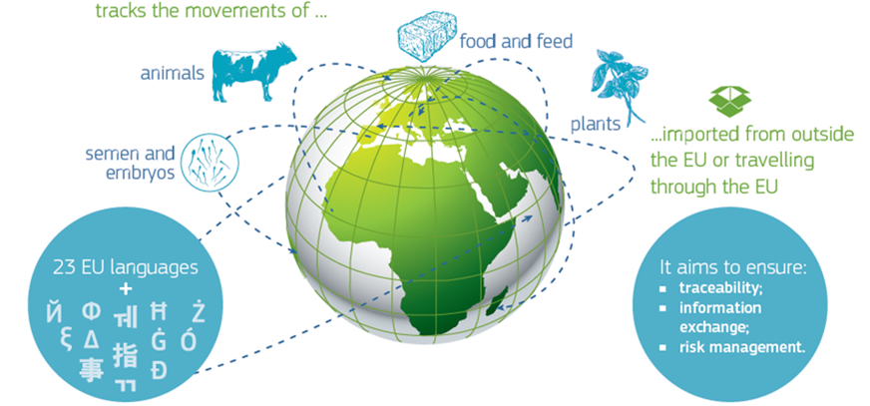
What is TRACES?
TRACES is the European Commission's online platform managed and maintained by DG SANTE and used for:
sanitary and phytosanitary certification required for:
EU imports of animals, animal products, food and feed of non-animal origin and plants;
intra-EU trade in live animals and certain animal products.
EU exports of live animals, certain animal products and plants
border clearance of:
live animals,
animal products,
food and feed of non-animal origin,
plants;
other certificates & documents of partner DGs

Slide 19
Use of TRACES by non-EU countries
EU Import module:
Available since 2006 and used on a voluntary basis by 60 non-EU countries to issue the Official health certificate to the EU;
For consignments of (1) animals, (2) animal products & (3) food and feed of non-animal origin subject to special conditions for their entry into the Union;
About 161 000 import certificates have been issued in TRACES in 2022 (37% in electronic format) – 81% were cloned into CHED.

Slide 20
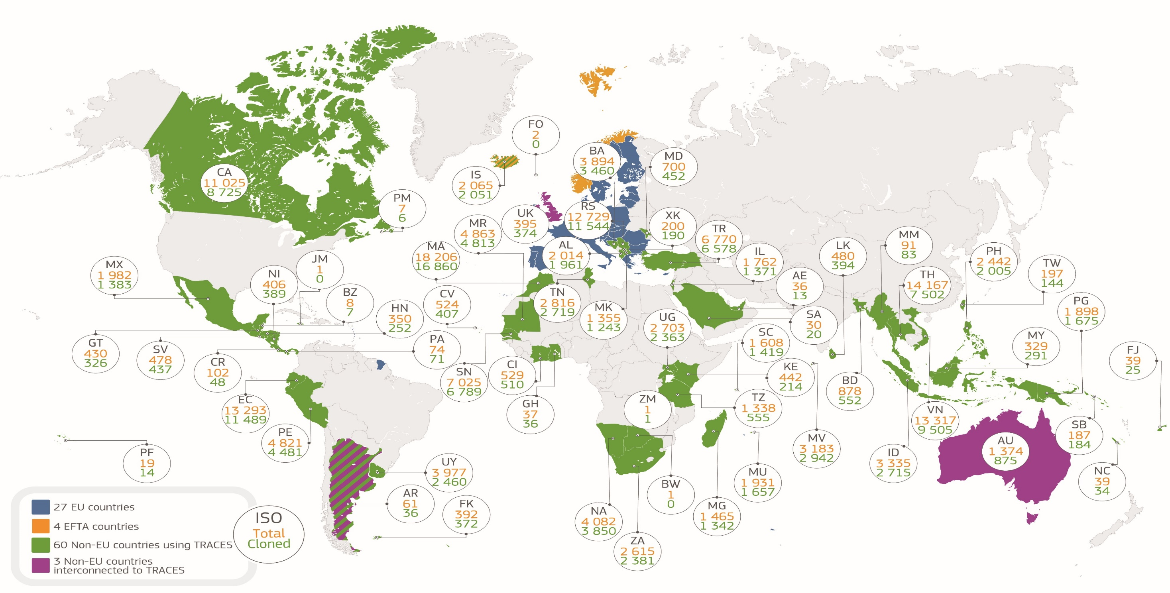
TRACES Worldwide presence – veterinary domain

Slide 21
EU Export module
Used for the issuance of export certificates for consignments exported from EU to certain non-EU trade partners
TRACES offers only negotiated export certificates: certificates that have been agreed between EU and certain non-EU countries
E-certification capacity enabled since October 2022
More than 68 000 certificates have been issued in TRACES in 2022

Slide 22
Electronic certification
E-certification functionality available in TRACES since December 2019
Available free of charge for all authorities using TRACES
All EU countries equipped to digitally sign CHEDs and INTRA certificates
15 non-EU countries are equipped to digitally sign their SPS certificates in TRACES (i.e. EU Import & Phyto) – several others either in process of enrolment or have expressed interest to enrol
50% of total documents issued in TRACES in 2022 were issued electronically (more than 2 million)

Slide 23
Useful links
TRACES – link to the TRACES platform;
TRACES – Europa website page – information about TRACES;
TRACES Documentation website – the portal to access the TRACES modules’ users manuals and documentation;
Publications – Establishments’ lists – lists of approved establishments

