Slide 1
Biosecurity to prevent incursion of avian influenza virus in a poultry farm.
Practical exercise on planning, designing and implementing a
biosecurity plan for the prevention of avian influenza.
Tutor Name : Luis Romero and Krzysztof Jażdżewski
Bangkok, Thailand / 4-8 March 2024

Slide 2
Important information about the farm
The farm (establishment) consist of 2 sheds with 23 000 chicken broilers in each of them.
There is an obligation to establish preventive and biosecurity measures against avian flu viruses due to the increased risk in the area.
The location of the farm is in an open area. 900 m from the farm to the west there is a fish-ponds complex. Around the farm the maize for grain is cultivated. Some waterfowl are seen in the winter time around the farm..
On the farm are as well: 3 silos for feed, the house of owners, the store for own corn grain kept in bulk, the open shed for machinery and an own well. The small garden pond is near by the straw store. Behind the first poultry shed there is a small old tire dump.
There are 2 employees working in the family field and with the animals. Every 6 weeks the ready to eat feed is deliver. Ones a month the dead animals are collected and disposed in a rendering plant.
During the autumn and winter the west wind is predominant which decrease the air temp. up to 5º C and migratory birds move to the area.
You are the official veterinarian who must assist the owner for the design of a biosecurity plan specific for this farm. How could you help the farmer in this task?

Slide 3
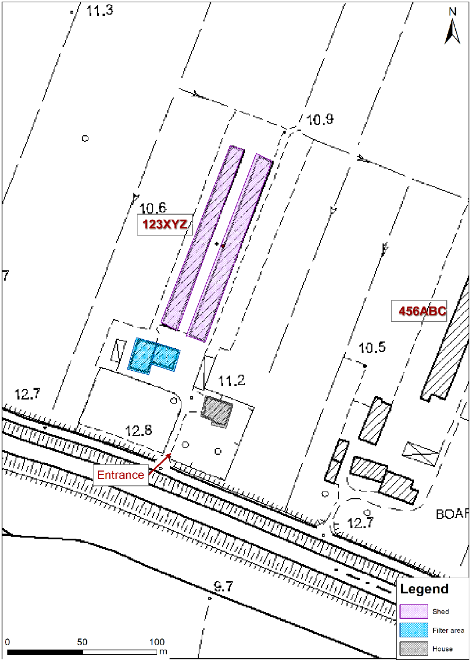
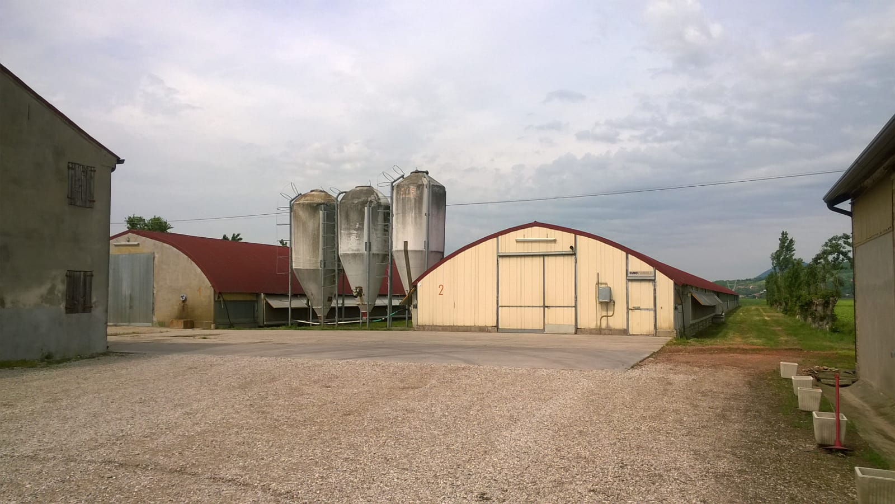
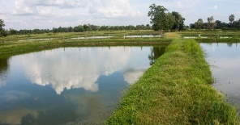
Layout of the farm
Straw for bedding
Machinery open shed
Laying hen farm
parking
Type of production Number of birds at the unit/holding | Broilers, males and females 46.000 birds/production cycle in two sheds

Slide 4
Groups composition
4 Groups composed by 9 participants each one.
One participant per group will play the role of reporter.
Each group will discuss about the 5 tasks (90 min).
The reporter of each group will present in plenary session the conclusions of one of the assigned tasks (10 min/group).

Slide 5
Group tasks
1.- Describe how you would carry out the risk assessment to identify the most important risk factors for the possible entrance of the virus, please list the identified risk factors in priority order. (GROUP 1)
2.- Describe recommended preventive measures applicable to this farm taking into account both physical and management measures – please follow these steps: create a table where you put all necessary measures for each risk factor identified in task 1 (in priority order!), discuss how they could be implemented in the farm, and use the table to draft a biosecurity plan for this farm to reduce the risk of introduction of influenza. (GROUP 2)
3.- Considering the cost, easiness, and the priorities to reduce risk of such measures, schedule a feasible timeline to the implementation of each measure measures. How could you help the farmer in the processs of implementation of the plan. (GROUP 3)

Slide 6
Group tasks
4.- Describe a proper protocol of cleaning and disinfection. – what steps should be part of the process. Calculate how much agent is needed to disinfect 1000 m² floor in the poultry sched (the packaging is a 5kg powder for making a solution, the solution for prophylactic disinfection is 1%; it has to be used 300 ml/m²). (GROUP 4)
5.- Prepare an example of protocol to keep the necessary records for the proper monitoring of the implementation of the biosecurity plan, please describe the information to be included in each of them. (EACH GROUP)

Slide 7
Calculate how much active substance is needed to disinfect
1000 m2 floor in the poultry premise.
the packaging contains 5 kg powder;
the solution for effective disinfection is 1%;
it has to be used 300 ml/m2.

Slide 8
Answers
300 ml is 0,3 L - 0,3 x 1000 = 300 L of solution
1% solution is 1 kg of active substance in 100 L of water 1:100
300 L of 1% solution - we have to use 3 kg of active substance.
To cover the walls and ceiling of the bulding the area has to be multiply by 2,5.

Slide 9
17 Avenue André Marie Ampère, Induspal Lons
64140 Lons – France
Phone : +33 5 59 72 43 23
https://thetrainingplace.eu
Avenue de Tervuren 36
1040 Brussels – Belgium
Phone: +32 2 736 22 77
https://aesagroup.eu/
Notes:
Update/add/delete parts of the copy right notice where appropriate.
More information: https://myintracomm.ec.europa.eu/corp/intellectual-property/Documents/2019_Reuse-guidelines%28CC-BY%29.pdf

