Slide 1
REGIONAL TRAINING WORKSHOP ON “ANIMAL HEALTH: DISEASE PREPAREDNESS, VACCINATION AND ONE HEALTH APPROACH’’
Bangkok, Thailand / 04-08 February 2024

Slide 2
A practical experience of surveillance (HPAI)
Stefano Marangon
Bangkok, Thailand / 04-08 February 2024

Slide 3
AI surveillance in the EU
Commission Delegated Regulation (EU) 2020/689
(in line with WOAH standards)
AI surveillance in poultry and wild birds must be implemented:
In all European Union Member States
In accordance with guidelines set out in Annex II to this Regulation

Slide 4
AI surveillance in the EU
Objectives
Early detection of HPAI in poultry
Early detection of HPAI in wild birds, providing for:
  Early warning for HPAI introduction in poultry
  Information for HPAI risk assessment
Detection of HPAI in poultry species which generally do not show clear clinical symptoms (e.g. Anseriformes)
Detection of circulating LPAI viruses among poultry flocks

Slide 5
AI surveillance strategies
Target population: all susceptible poultry species
Strategies: active and passive surveillance
Timing: ongoing
Approaches: either random (representative sampling) or risk-based (targeted) surveillance
Investigation: clinical, serological, virological and molecular methods

Slide 6
AI surveillance
Avian Influenza
Surveillance
Poultry (and captive birds)
Wild birds
Passive surveillance
Active surveillance
Risk Based Surveillance (RBS)
Passive surveillance → birds found dead
(Active surveillance)
RBS

Slide 7
Active or passive surveillance
Which one to choose?

Slide 8
Active and passive surveillance
Origin of data
Passive
Information on disease events is brought to the attention of Veterinary Authorities without them actively seeking data
Active
The activity is conducted for collecting information for surveillance i.e. Veterinary Authorities design and conduct the surveillance plan

Slide 9
Active or passive surveillance?
Which one to choose?
Passive
An official “suspect case” definition is available and well known among stakeholders
Clear clinical symptoms
High case-fatality rate
High level of awareness
Active
Clinical symptoms are generally not evident, episodic or short lasting
Low/null case-fatality rate
Low level awareness

Slide 10
Active or passive surveillance?
HPAI in Gallinaceous poultry?
LPAI in poultry?
HPAI in Anseriformes poultry?
HPAI in wild birds?
LPAI in wild birds?

Slide 11
Active or passive surveillance?
HPAI in Gallinaceous poultry?
Passive surveillance
LPAI in poultry?
Active surveillance
HPAI in Anseriformes poultry?
Active surveillance
HPAI in wild birds?
Passive surveillance
LPAI in wild birds?
Active surveillance

Slide 12
AI surveillance in the EU
Avian Influenza
Surveillance
Poultry (and captive birds)
Wild birds
Passive surveillance
Active surveillance
Risk Based Surveillance (RBS)
Passive surveillance → birds found dead
(Active surveillance)
RBS

Slide 13
Risk-based surveillance (RBS)
Risk-based (targeted) surveillance
Surveillance activities are driven by a risk assessment and thus they address specific geographical areas, animal populations, …….. at higher risk (with an higher frequency of infection)
Risk-based surveillance means “looking for something where it is mostly likely to be found” (FAO, 2014)
RBS methods are useful to optimise the use of surveillance resources

Slide 14
AI risk-based surveillance
Identification of risk factors for AI introduction into and spread between poultry establishments
1st Step
Definition of areas at high AI risk where to focus surveillance efforts (geographic risk assessment)
2nd Step
Identification of poultry production systems at heightened AI risk to be inspected/tested with a risk-based intensity and frequency

Slide 15
Risk factors (RF)
for AI introduction and spread
The first step to design a risk-based surveillance program is the identification geographical areas at heightened risk for AI:
List (then rank) the risk factors for the introduction and spread of AI that can be selected in a Country/Region

Slide 16
Criteria and risk factors
for AI introduction and spread
Introduction
Spread
  Migratory Season
  Biosecurity
  Bordering affected countries
  Wetlands
  Trade pattern
  Poultry density

Slide 17
Criteria and risk factors
for AI introduction and spread
  Proximity to wetlands (wintering/nesting sites for migratory birds)
  Poultry kept outdoor
  Low biosecurity levels
  Migratory seasons
  Current and past detections of AI viruses in poultry and wild birds
  Proximity to affected countries
  High poultry densities
  Trade patterns and intensity of movements
  Poultry species/production systems highly susceptible to AIV (e.g. long-lived poultry, multi-age groups)
  Presence of more than one sex or species

Slide 18
Ranking criteria and risk factors
for AI introduction
 | Group 1 | Group 2 | Group 3 | Group 4
Poultry kept outdoor | 1 | 1 | 4 | 1
Low biosecurity | 2 | 2 | 1 | 1
Migratory seasons | 4 | 5 | 2 | 4
Proximity to wetlands | 3 | 4 | 5 | 2
AI detections | 6 | 3 | 3 | 3
Proximity to affected countries | 5 | 6 | 6 | 5

Slide 19
Ranking criteria and risk factors
for AI spread
 | Group 1 | Group 2 | Group 3 | Group 4
Highly susceptible poultry species | 1 | 2 | 2 | 3
Trade patterns/intensity of movements | 3 | 3 | 3 | 1
High poultry densities | 2 | 1 | 1 | 2
Presence of more than one sex or species | 4 | 4 | 4 | 5
Multi-age poultry farms | 5 | 5 | 5 | 4

Slide 20
Selection of RF - Country level
Risk factors for AI introduction and spread can be different (and have a different weight) in diverse Countries
Differences between Countries
  Poultry production sector
    Poultry species and systems, types of premises, poultry density ……
  Environmental risk factors
    Dynamics of wild waterfowl populations, AIV persistence ……
  Data availability
    Poultry registry – Census of wild birds

Slide 21
AI risk-based surveillance
Identification of risk factors for AI introduction into and spread between poultry establishments
1st Step
Definition of areas at high AI risk where to focus surveillance efforts (geographic risk assessment)
2nd Step
Identification of poultry production systems at heightened AI risk to be inspected/tested with a risk-based intensity and frequency

Slide 22
Poultry production system at heightened HPAI risk

Slide 23
AI risk – Poultry systems
Poultry production systems
laying hens
turkeys
broilers
breeders
quails
guinea fowl
ducks
geese
farmed game birds
Poultry production systems
Ducks
Layers
Breeders
Guinea fowl

Slide 24
Clinical surveillance
It aims at the detection of clinical signs (and lesions) of AI at a farm level
It includes the monitoring of production parameters such as increased mortality, drop in feed and water consumption, drop of egg production
To be implemented
  HPAI surveillance
  poultry species (e.g., Gallinaceous birds) that exhibit clear clinical symptoms and high case-fatality rates
Laboratory tests are applied to follow up suspect cases

Slide 25
Laboratory surveillance
Laboratory surveillance is used to:
Target poultry species (e.g., ducks and geese) that generally do not show overt clinical symptoms
Detect LPAI viruses that can circulate undetected in poultry
Confirm the presence of AI in case of suspicions

Slide 26
Random or representative surveillance

Slide 27
Random or representative surveillance
Random or representative surveillance means the use of a sampling strategy in which every unit is chosen at random and has a known (non-zero) probability of inclusion in the sample
Random surveillance is conducted:
With aim to demonstrate the absence of AI at an acceptable level of confidence (i.e. to demonstrate freedom from AI)

Slide 28
Random or representative surveillance
Two stage sampling strategy:
A sample of poultry establishments is selected
A sample of birds kept in the selected establishment(s) are sampled and tested
Sample size - minimum number of poultry establishments to be sampled (in the area at-risk) and the number of poultry to be tested per farm

Slide 29
Random or representative surveillance
Minimum sample size (to detect at least one positive farm/animal, if infection is present):
Target population size
Expected prevalence to be detected
Pre-defined level of confidence of the survey results (≥ 95%)

Slide 30
AI surveillance – High risk areas
      Target population (e.g. duck farms)
      Number of farms (to be tested) (e.g. all commercial duck farms)
      Number of samples per farm
        Expected within farm prevalence: ≥ 5 % (CLs = 99%)
        90 samples per farm (e.g. sampling method ??????)
      Type of test virological or serological ?????
      Timing (before loading for slaughter)

Slide 31
Virological or serological testing
Which one to choose?

Slide 32
Virological or serological testing?
HPAI in Gallinaceous poultry?
LPAI in poultry?
HPAI in Anseriformes poultry?
HPAI in wild birds?
LPAI in wild birds?

Slide 33
Virological or serological testing?
HPAI in Gallinaceous poultry?
Virological testing
LPAI in poultry?
Serological testing
HPAI in Anseriformes poultry?
Virological (serological) testing
HPAI in wild birds?
Virological testing
LPAI in wild birds?
Virological testing

Slide 34
Laboratory testing methods
Samples must be virologically tested (e.g. application of molecular methods) when taken for:
early detection of HPAI in poultry
complementary surveillance for HPAI in poultry species which generally do not show significant clinical signs of HPAI
follow-up of sero-positive findings

Slide 35
Laboratory testing methods
Samples can be serologically examined when taken for:
complementary surveillance for HPAI in ducks, geese, etc. supplementing virological testing, as appropriate
detection of clusters of LPAIV. When serology is not appropriate, virological testing must be performed

Slide 36
Active surveillance – High risk areas
      Target population (e.g. ducks and geese)
      Number of farms (e.g. all commercial duck/goose flocks tested)
      Number of samples per farm
        Expected within farm prevalence: ≥ 5 % (CLs = 99%)
        90 samples per farm (e.g. blood samples)
      Type of test (e.g. ELISA)
      Timing (before loading for slaughter)

Slide 37
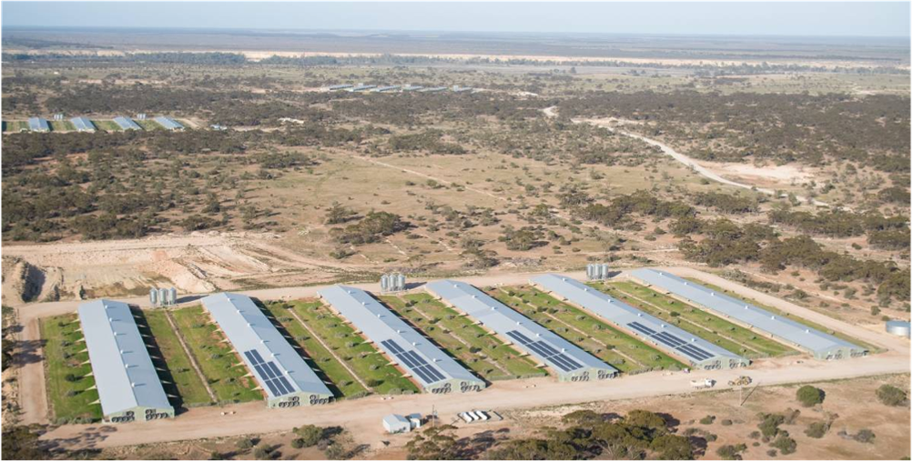
What to do if a farm has several sheds?
Which is the epidemiological unit?

Slide 38
What to do if a farm has several sheds?
Poultry sheds distributed in three locations
If the three sites are managed by different workers, with dedicated equipment and systematic application of high biosecurity standards, etc. → three epidemiological units → 90 samples in each location
If not → one epidemiological unit → 90 samples shall be distributed in the three sites → at least 30 samples in each location

Slide 39
AI surveillance – Early detection
AI surveillance should include:
Early warning system throughout the poultry chain for reporting suspicious cases → suspected cases must be investigated
Implementation, when relevant, of regular and frequent clinical inspection and testing of high-risk groups of poultry (e.g., adjacent to an AI infected country or zone, poultry in close proximity to waterfowl, live bird markets)
An effective surveillance system will periodically identify suspicious cases
To demonstrate freedom from AI → documentation on the occurrence of suspicious cases and how they are investigated and dealt with

Slide 40
Summarizing…….
RBS approaches largely vary according to different Risk Factors (and sampling/testing schemes)
Each country must identify its own list of risk factors to design a risk-based surveillance program for AI
Surveillance strategies employed for demonstrating freedom from HPAI should be adapted to the local situation

Slide 41

Thank you
HaDEA
Health and Digital Executive Agency
Covent Garden 2
Place Rogier
1210 Brussels
https://hadea.ec.europa.eu/
17 Avenue André Marie Ampère, Induspal Lons
64140 Lons
France
Phone : +33 (0)5 59 72 43 23
https://thetrainingplace.eu/
© European Union 2020
Unless otherwise noted the reuse of this presentation is not authorised. For any use or reproduction of elements that are owned by the EU, permission may need to be sought directly from the respective right holders. All statements and references in this presentation come from of the Training coordinator and tutors and do not represent the official position of the European Commission.
Slide xx: element concerned, source: e.g. Fotolia.com; Slide xx: element concerned, source: e.g. iStock.com
Notes:
Update/add/delete parts of the copy right notice where appropriate.
More information: https://myintracomm.ec.europa.eu/corp/intellectual-property/Documents/2019_Reuse-guidelines%28CC-BY%29.pdf

