Slide 1
REGIONAL WORKSHOP ON ANIMAL HEALTH:
DISEASE PREPAREDNESS, VACCINATION AND ONE HEALTH APPROACH
Traceability of terrestrial animal movement and certification
Dr Marius Masiulis
BANGKOK, THAILAND / 4-8 MARCH 2024

Slide 2
Summary
EU terrestrial animal traceability system;
Animal identification and registration;
TRACES NT (New technology) - EU online tool to assist certification and ensure traceability.

Slide 3
EU traceability relies on
Animal (individual or group) identification systems
Registration of establishments and record keeping
Registration of transporters and movements
Databases to centralise all above information
Animal Identification
https://food.ec.europa.eu/animals/identification_en

Slide 4
Basic objectives of traceability system
The localization and tracing of animals for veterinary purposes, which is of crucial importance for the control of infectious animal diseases.
The system comprises the means to identify kept terrestrial animals individually or in groups (e.g. ear tags, leg rings, electronic identifiers), documents for identifying and tracing those animals, registers to be kept in establishments and central databases, computerised information systems and more, as necessary.
Animal traceability is supported by online system called TRACES NT.

Slide 5
EU animal identification websites with specific requirements
Bovine animal identification
https://food.ec.europa.eu/animals/identification/bovine-animals_en
Ovine and caprine identification
https://food.ec.europa.eu/animals/identification/ovine-caprine-animals_en
Porcine identification
https://food.ec.europa.eu/animals/identification/porcine-animals_en
Equine identification
https://food.ec.europa.eu/animals/identification/equine-animals_en

Slide 6
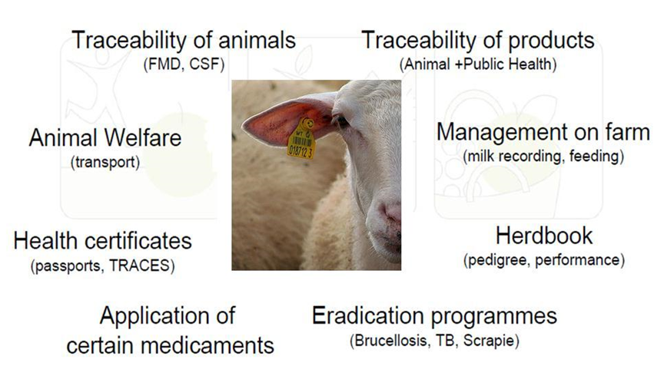
Traceability and identification
an ID tag may serve different purposes

Slide 7
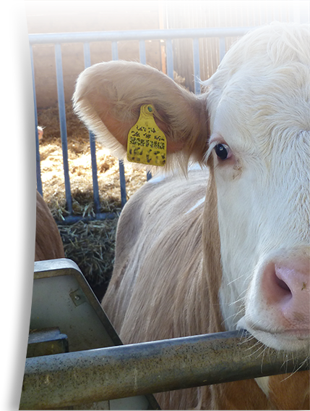
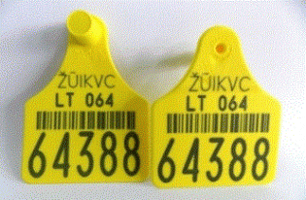
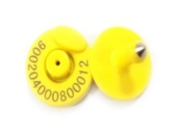
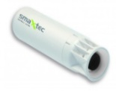
Bovine animals
Individual identification
Double ear tags for each animal with an individual number (Individual identification).
Maintaining a record in each establishment (farm, market, dealers, etc.).
Individual bovine-passports (birth, movement, death registered centrally). Voluntary at national level, compulsory for movement between MS.
Computerised database at national level for establishments and movements.
Optional electronic identification.
OR
OR

Slide 8
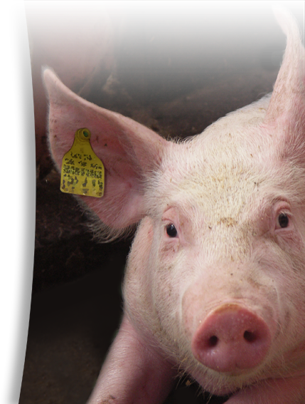
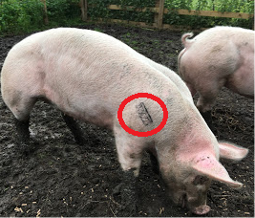
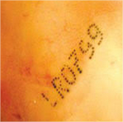
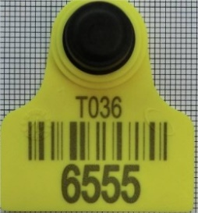
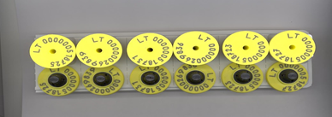
Porcine animals
Up-to-date list of all establishments (any place in which animals are held, kept or handled) specifying the keepers of the animals.
Ear tags and/or tattoos with establishment number (batch or group identification) – before movement. MS can use individual identification of certain animals if they decide so.
Maintaining a record in each establishments.
A central register or computerised database of all establishments and movements of batches of animals at national level.

Slide 9
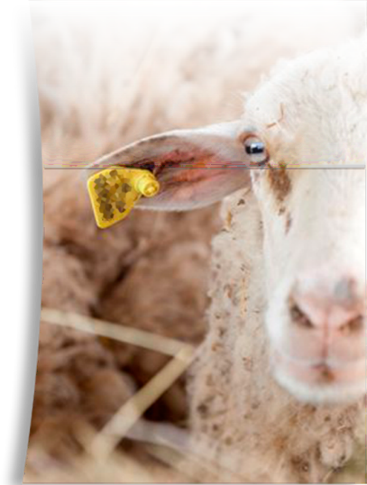
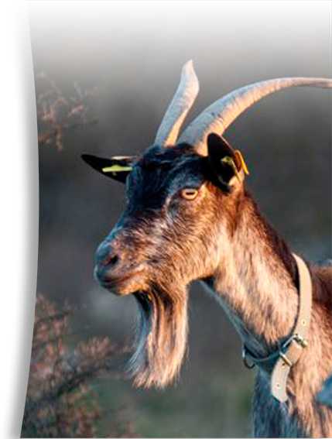
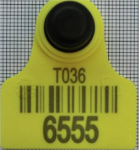
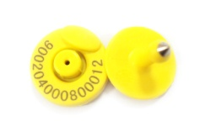
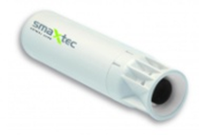
OR
Ovine and Caprine animals
individual traceability
Double identifiers: 1 electronic identifier: a ruminal bolus or an electronic ear tag + 1 visible identifier: double conventional ear tag, tattoo or mark
Maintaining a record in each establishment (farm, market, dealer, etc.)
A central register or computerised database of all establishments and movements of animals at national level.
EU countries with populations of less than 600.000 sheep and goats or less than 160.000 goats can make electronic ID voluntary for animals not entering intra-EU trade. However, this does not exempt them from individual traceability and applying two conventional ear tags.

Slide 10
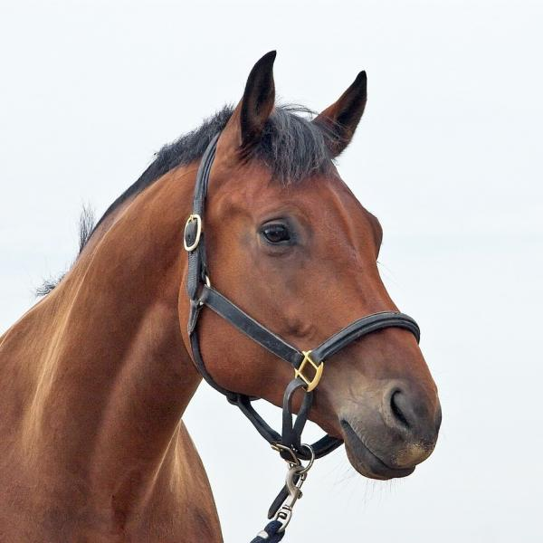
Equine animals
A single lifetime identification document (including a narrative and a diagrammatical description) passport
A method to ensure an unequivocal link between the identification document and the animal (transponder, alternative methods like DNA profile and retinal scan)
Databases maintained by the (passport) issuing bodies recording under a unique identification number the identification details relating to the animal
A central database at national level.

Slide 11
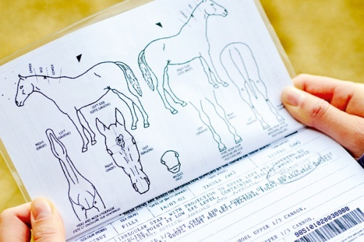
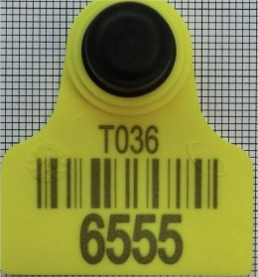
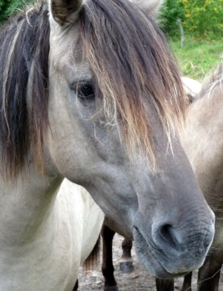
Basic rule
Alternative method- permitted by MS
Equine kept for meat production- permitted by MS
Unequivocal link

Slide 12
Establishments registration
Establishments compulsory record - keeping
Species, categories, number of animals and if applicable identification record;
Movements of animals (establishment of origin/destination, date);
Deaths;
Biosecurity measures, surveillance, treatments, test results;
Results of any animal health visit/ inspection;
Report movements to national database.
Should be verified by veterinary authority through official visit to the establishment.
The operator shall inform competent authority about his activity!
Provide competent authority:
name and address of the operator;
Location of the establishment and description of facilities;
Categories, species and numbers of kept animals or germinal products and capacity of the establishment;
Obligation to inform authority of any significant change in the premise.

Slide 13
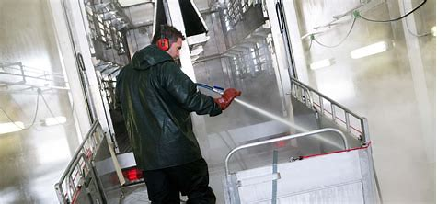
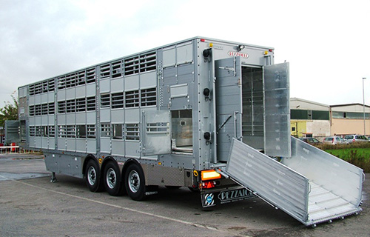
Transporters
Compulsory registration of transporters of kept ungulates
Transporter/company shall Inform the veterinary authority of their activity;
Provide following information:
- name and address of the transporter;
- categories, species and number of kept ungulates to be transported;
- type of transport; means of transport.
- notify any changes to above-mentioned conditions.
Record – keeping for transporters
Establishments visited by them;
Categories, species and number of animals transported;
Cleaning, disinfection, disinfestations of vehicles;
- Details of the documents accompanying animals during transport.

Slide 14
EU Member States obligation to establish and maintain national central databases for terrestrial animals
The system must be designed in a manner that:
- Ensures efficient application of disease prevention and control;
- Facilitates traceability of kept terrestrial animals and their movements within and between MS and movements from non-EU countries;

Slide 15
TRACES NT
TRACES =Trade Control and Expert System
TRACES is the European Commission's online platform for sanitary and phytosanitary certification required for the importation of animals, animal products, food and feed of non-animal origin and plants into the European Union, and the intra-EU trade and EU exports of animals and certain animal products.
TRACES is an informatic tool to assist traceability and certification
The main objective of TRACES is to streamline the certification process and all linked entry procedures, and to offer a fully digitized and paperless workflow.

Slide 16
TRACES official network + operators
BIP
BIP
LVU
BIP
TRACES NT official levels
CCA: Central Competent Authority
BCP: Border Control Post
LVU: Local Veterinary Unit
LVU
LVU
CCA
CCA
CCA
BIP
LVU
LVU
BIP
CCA
EC
CCA
CCA
CCA
CCA
LVU
LVU
BIP
LVU
BIP
BIP

Slide 17
TRACES NT
EU Online certification system

Slide 18
TRACES NT: Main characteristics
WEB based system (in line with the Commission’s digital strategy, Shaping Europe's Digital Future)
Workflow between private and public entities
Centralized system
Interoperability (Customs Nomenclature)
Multilingualism (34 languages).
Statistics automation
Free of charge, registration and a web connected computer is the only need to use TRACES NT.
In use by an increasing number of non-EU countries, currently 90 countries and more than 55.000 users.
EU Objective: to increase the number of non-EU Countries using TRACES

Slide 19
TRACES NT is an efficient tool to facilitate
Traceability (possibility to trace back and forth all the movements of animals, animal products, food and feed of non-animal origin and plants)
Information exchange (facilitates the exchange of data, information and documents between all involved trading parties and control authorities and therefore simplifies and speeds up the administrative procedures.)
Cooperation and coordination between the competent authorities of EU countries and non-EU countries, but also between the traders themselves and their competent authorities.
Risk management (contributes to the reduction of the impact of disease outbreaks and allows for a quick response to counter certain serious risks along the agri-food chain).
The integrated statistical tool allows the extraction of valuable data in relation to imports into the EU, exports from the EU and intra-Union trade.

Slide 20
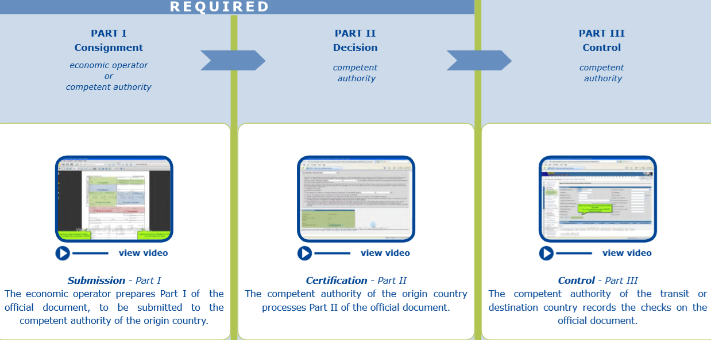
User friendly online certification in three steps

Slide 21
All certificates and forms accessible online

Slide 22
TRACES NT: All advantages
Standardized application of legal requirements and procedures.
Cooperation and communication between services and operators from different countries and continents.
Speed up of LVU/BCP administrative procedures and work simplification for official services.
Higher security and speed of data transmission allowing timely follow up of import/export processes for users.
Reduction of fraud….. and of course, save paper and trees!
Do you want to know more advantages and benefit of using TRACES NT?
How does TRACES work (europa.eu)

Slide 23
TRACES NT: any benefits for you?
Simplify administrative procedures and contribute to the efficient performance of official controls by the different responsible authorities;
Accommodate the different practical arrangements for official controls, including for the effective follow-up to such controls in their territory;
Provide a tool for the collection of information and for monitoring and reporting on the performance of official controls or the outcome of official controls;
Facilitate international cooperation and exchange of information between competent authorities, including decisions taken on consignments;
Enhance cooperation and exchange of information between authorities and operators in relation to the arrival of animals and goods;
Help trace operators’ past records and identify possible violations to the rules including those perpetrated through fraudulent or deceptive practices;
Support the fight against criminal activities along the agri-food chain shared between different competent authorities.

Slide 24
TRACES NT video
http://ec.europa.eu/avservices/play.cfm?ref=I091404&videolang=EN
Users' opinion
https://audiovisual.ec.europa.eu/en/video/I-204087?lg=INT%2FEN

Slide 25
Keep in touch
ec.europa.eu/
europeancommission
europa.eu/
@EuropeanCommission
@EU_Commission
EUTube
@EuropeanCommission
EU Spotify
European Commission
Notes:
Delete/update as appropriate

Slide 26
17 Avenue André Marie Ampère, Induspal Lons
64140 Lons – France
Phone : +33 5 59 72 43 23
https://thetrainingplace.eu
Avenue de Tervuren 36
1040 Brussels – Belgium
Phone: +32 2 736 22 77
https://aesagroup.eu/
Notes:
Update/add/delete parts of the copy right notice where appropriate.
More information: https://myintracomm.ec.europa.eu/corp/intellectual-property/Documents/2019_Reuse-guidelines%28CC-BY%29.pdf

