Slide 1
REGIONAL WORKSHOP ON ANIMAL HEALTH:
DISEASE PREPAREDNESS, VACCINATION AND ONE HEALTH APPROACH
Practical experience of Surveillance on ASF
Dr Marius Masiulis
BANGKOK, THAILAND / 4-8 MARCH 2024

Slide 2
Definitions
Disease surveillance: the systematic ongoing collection, collation, and analysis of information related to animal health and the timely dissemination of information so that action can be taken.
Monitoring: intermittent performance and analysis of routine measurements and observations, aimed at detecting changes in the health status of a population.
Surveillance to detect a disease i.e. ASF and take actions
Monitoring to follow up an activity: i.e. Rabies vaccination efficiency

Slide 3
Why do we sample?
Purpose of surveillance
No Disease present | Disease Present
Early detection | Find cases
Proove freedom | Measure frequency (monitor)

Slide 4
Which animals to sample?
ASF is a disease that kills its host;
It is easy to spot a sick or dead pig;
Healthy-looking pigs don’t have ASF unless they are incubating;
Healthy Animals | Sick animals | Dead animals
@Mark Hovari
0
1
2
3
4

Slide 5
Aim of surveillance
Early detection (very first cases);
Estimate trends over time possibly through a correct prevalence;
Set/adjust goals and targets based on trends and prevalence;
Assess whether goals and targets are reached.

Slide 6
Surveillance: design
Population;
Timing and temporal validity of the surveillance data;
Case definition;
Epidemiological unit;
Clustering;
Diagnostic tests;
Analytical methodologies;
Scope of the surveillance system;
Follow up actions.

Slide 7
How to know where ASF is…
Passive surveillance
Passive disease reporting (reporting of sick or dead pigs)
Slaughtering for own consumption / Slaughterhouse surveillance (Clinical examination of pigs, ASF lesions)
Wild boar surveillance (finding and sampling of dead wild boar carcasses)
Active surveillance
Risk-based disease surveys (Surveillance is based on known risk factors)
Opportunistic sampling (farm visit for other purposes, but sampling of sick/dead pigs)

Slide 8
FMD
Prevalence: 100%
Lethality: 2%
Contagiousity: +++
100 infected; 2 dead
Infected
dead
ASF
P: 10%
L: 90%
Contagiousity: +
CSF
P: 50%
L: 50%
Contagiousity: ++
10 infected; 9 dead
50 infected; 25 dead
Slide by Klaus Depner

Slide 9
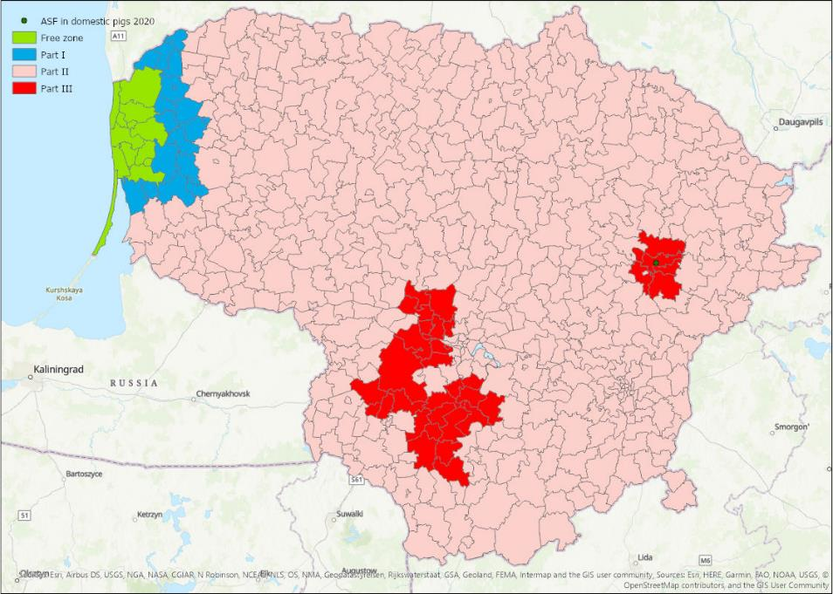
8555 PIGS KEPT

Slide 10
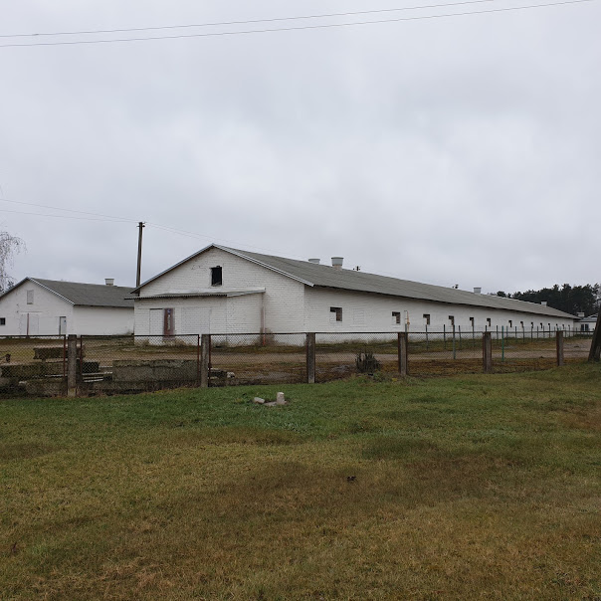
Commercial pig farm
Territory fenced
Close cycle farm
Comply with national biosecurity requirements

Slide 11
Information about the farm
Regular veterinary inspections carried out
Twice a year the farm was inspected by a group of inspectors
Inspectors carrying out inspections were rotated
Passive surveillance in place

Slide 12
Surveillance activities
A restricted area II, where ASF is present in wild boars
Samples of the dead pigs were delivered on the weakly basis in the framework of passive surveillance
Before the weekend, 3 pigs died, they were sampled
After the weekend, 6 pigs were found dead in the same stable

Slide 13
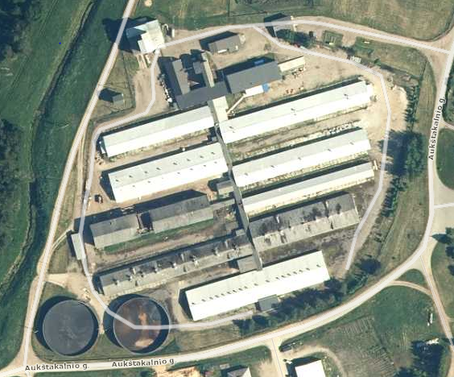
Commercial pig farm

Slide 14
Commercial pig farm
What kind of samples would you take in that farm for early detection of ASF?
How many samples and from which barns?
Will you test them by ELISA, by PCR, or both?
2000
500
1500
2000
1500
1000

Slide 15
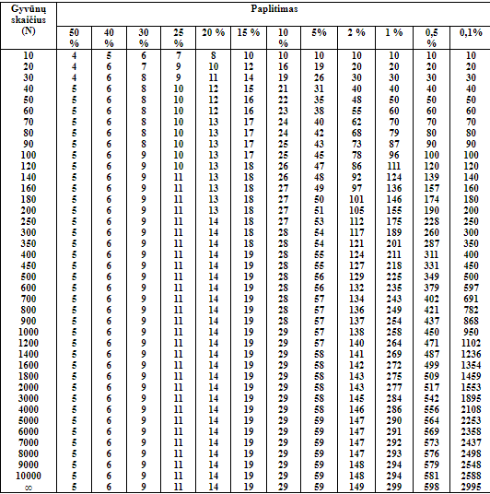
Active with passive surveillance –
which one is better?
Active surveillance
When sampling and testing a defined number of animals, there is 95% probability to detected at least ONE POSITIVE ANIMAL if the prevalence of the infection in the sampled population is at least …
Passive surveillance
Out of 398 found dead wild boars 325 were positive to ASF (82%).
Out of 24 thousand hunted wild boars 343 were positive (1,4%).
Passive/active=82/1.4=57
The probability to detect an ASF positive animal is 57 times higher in dead animals than in hunted animals…

Slide 16
Surveillance in the ASF infected country
continuous surveillance by means of testing with pathogen identification tests for African swine fever is carried out in the establishment of dispatch:
…(ii) with negative results each week on at least the first two dead kept porcine animals over the age of 60 days or, in the absence of such dead animals over the age of 60 days, on any dead kept porcine animals after weaning, in each epidemiological unit; and
(iii) at least during the monitoring period for African swine fever (15 days) before the movement of the consignment from the establishment of dispatch; or
(iv) if necessary, following the instructions of the competent authority where there are no dead kept porcine animals in the establishment during that monitoring period for African swine fever.

Slide 17
Keep in touch
ec.europa.eu/
europeancommission
europa.eu/
@EuropeanCommission
@EU_Commission
EUTube
@EuropeanCommission
EU Spotify
European Commission
Notes:
Delete/update as appropriate

Slide 18
17 Avenue André Marie Ampère, Induspal Lons
64140 Lons – France
Phone : +33 5 59 72 43 23
https://thetrainingplace.eu
Avenue de Tervuren 36
1040 Brussels – Belgium
Phone: +32 2 736 22 77
https://aesagroup.eu/
Notes:
Update/add/delete parts of the copy right notice where appropriate.
More information: https://myintracomm.ec.europa.eu/corp/intellectual-property/Documents/2019_Reuse-guidelines%28CC-BY%29.pdf

