Slide 1
NOTIFICATIONS AND EXCHANGE OF INFORMATION AT EU AND INTERNATIONAL LEVEL
LUIS JOSÉ ROMERO GONZÁLEZ
Based on a presentation of Tsviatko Alexandrov
Bangkok, Thailand / 4-8 March 2024

Slide 2
Content
Dissemination of information
Listing of disease and categorization
Notification procedures and systems
Disease notification
EC and EU Member States meetings and Committees

Slide 3
Objective: Dissemination of information
Transparency:
Ensure transparency in the global animal disease situation
Collaboration:
Share disease specific information
Safe international trade: in animals and animal products based on rules on food safety and animal and plant health standards
“Sanitary and phytosanitary measures”

Slide 4
WOAH - Information on animal health
“We work to improve animal health and welfare across the globe.
By collecting, analysing and disseminating veterinary scientific information,
we encourage international solidarity in the control of animal health risks.”

Slide 5
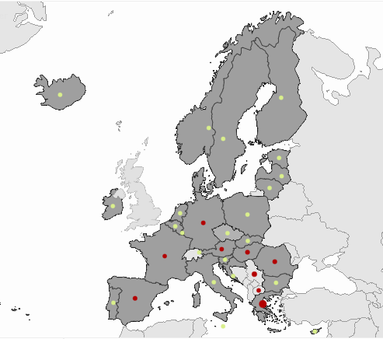
Public health
European Centre for Disease Prevention and Control (ECDC)
ECDC collecting data from the Member States through
The European Surveillance System (TESSy).

Slide 6
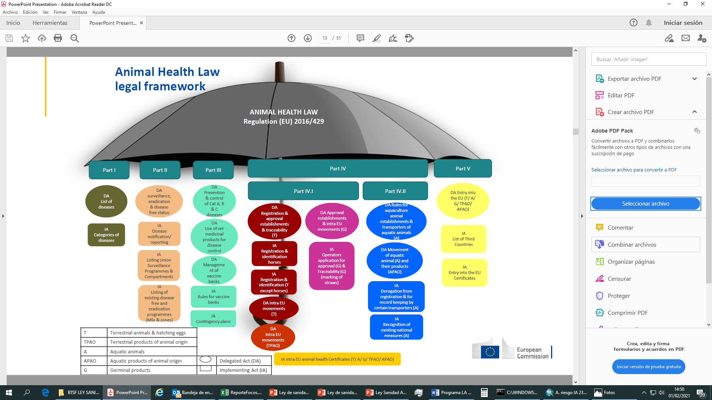

Slide 7
Criteria for categorisation - Article 9
CATEGORY A | Diseases that do not normally occur in the Union and for which immediate eradication measures must be taken as soon as they are detected
CATEGORY B | Diseases which must be controlled in all Member States with the goal of eradicating them throughout the Union
CATEGORY C | Diseases which are of relevance to some Member States and for which measures are needed to prevent them from spreading to parts of the Union that are officially disease-free or that have eradication programmes for the listed disease concerned
CATEGORY D | Diseases for which measures are needed to prevent them from spreading on account of their movements between Member States or entry into the Union
CATEGORY E | Diseases for which there is a need for surveillance within the Union

Slide 8
Categorisation of diseases and listing of animal species and groups of animal species
Examples (terrestrial) from CIR (EU) 2018/1882 :
DISEASE NAME | DISEASE CATEGORY | LISTED SPECIES
 |  | ANIMAL SPECIES | VECTORS
Infection with Rift Valley fever virus | A+D+E | Perissodactyla, Antilocapridae, Bovidae, Camelidae, Cervidae, Giraffidae, Hippopotamidaae, Moschidae, Proboscidea | Culicidae
Infection with Mycobacterium tuberculosis complex (M. bovis, M. caprae and M. tuberculosis) | B+D+E | Bison spp, Bos spp, Bubalus spp
 | D+E | Artiodactyla others than Bison spp, Bos spp, Bubalus spp
 | E | Mammalia (terrestrial)
Infection with rabies virus | B+D+E | Carnivora, Bovidae, Suidae, Equidae, Cervidae, Camelidae
 | E | Chiroptera

Slide 9
WOAH list versus EU list
WOAH listing criteria
Different purposes
WOAH list of diseases
EU list of diseases
Considers WOAH
EU listing criteria and animal health management priorities
MS have to deal with both WOAH listed diseases and EU listed diseases

Slide 10
Union Notification and Union reporting of diseases
AHL Part II
Notification within Member States (Art. 18)
Union notification and Union reporting (Art. 19)
Notification and reporting regions (Art. 21)
Computerised information system for Union notification and Union reporting (Art. 22)
CIR (EU) 2020/2002
(immediate) Union notification
list of diseases, deadlines, information
Union reporting
Category E diseases, deadlines, information
Submission, results of eradication programmes, Union surveillance programmes
Application “disease-free” status
List of notification and reporting regions
ADIS notification and reporting information system
* national legislation
Notification within MS
Rules on notification and reporting (operator – CA)
National notification and reporting system
Information transfer to the COM
Additional / stricter national rules (AHL Art 269)

Slide 11
Notification systems for EU-MS
WAHIS (WOAH): World Animal Health Information System
ADIS (EU) Animal Disease Information System
TRACES (EU) TRAde Control and Expert System (intra-Union movements, entry into the EU)
RASFF (EU) Rapid Alert System for Food and Feed
EUROPHYT Notification System for Plant Health Interceptions

Slide 12
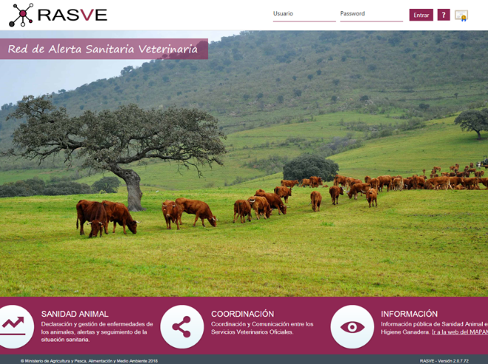
MS national notification systems Example Spain
R.A.S.V.E.
Private
Access
Web Services
Outbreak notification module
Alert module
Surveillance/control Program module
Communication module
SITRAN
TRACES
ADIS
…
Objective: Transfer standard information between the veterinary authorities at regional, central and EU level. As much automatic as possible.
2005-2021 connected with ADNS. Now working web service to connect with ADIS!

Slide 13
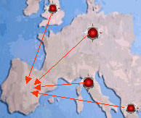
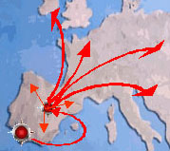
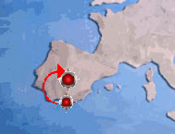
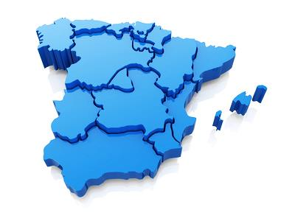
RASVE: Outbreak notification module Example Spain
MAPA
EU
Data Base
ADIS Europe
Rest of EU
countries
CCAA
EU Outbreak coded information sent to RASVE
EU notified outbreaks
Outbreak decoded information sent to Regional and Central Authoriies
Automatic and immediate process under supervission

Slide 14
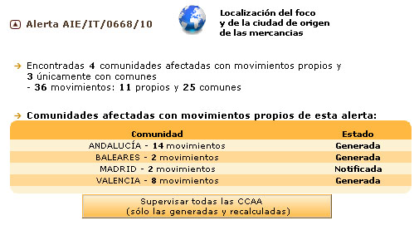
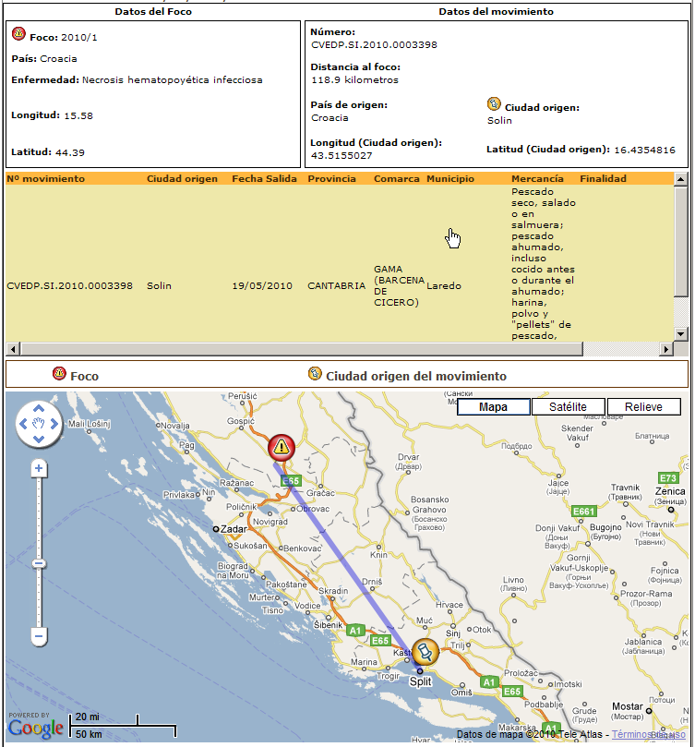
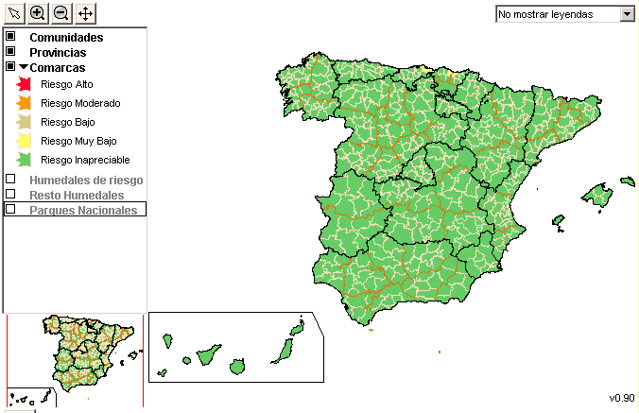
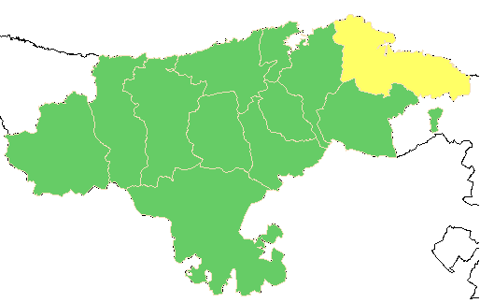
RASVE Alert module (Spain)
Risk assessment and information diffusion

Slide 15
Notifications carried out by EU-MS
Primary outbreak:
within 24 hours via WAHIS, ADIS
Reports (six months reports WOAH, yearly reports EU)
Info Notes to EU-Commission, Letters to Non-EU countries,
other tools….
Secondary outbreak:
Follow up reports in WAHIS
weekly notifications in ADIS
Reports, other tools (see primary outbreaks)….

Slide 16
Computerised information system for Union notification and Union reporting of diseases - ADIS
The ADIS platform allows the MS to fulfil the legal obligations in terms of Union notification
Legal requirements:
Commission Implementing Regulation (EU) 2020/2002:
Union notification and Union reporting of listed diseases,

Slide 17
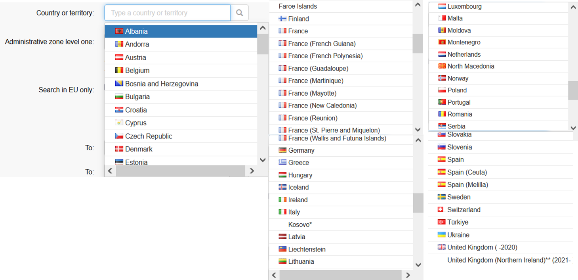
MS and Third countries ADIS access

Slide 18
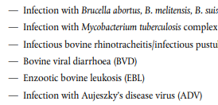
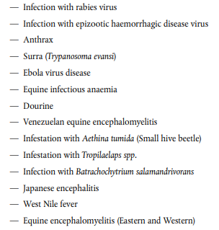
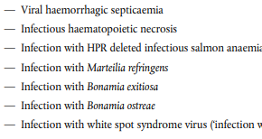
More than 50 diseases to be notified in 24 hours or on a weekly base
Kept and wild animals / terrestrial and aquatic animals
Primary and secondary outbreaks

Slide 19
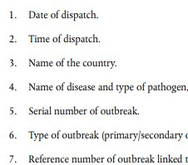
Information to be provided

Slide 20
Information to be provided
Geographical location: coordinates, administrative unit: district, commune,
Type of outbreak: primary or secondary
Date of suspicion and confirmation
Species and number animals: susceptible, infected, died/ killed/ slaughtered
Origin of infection, findings of the epidemiological investigation
Diagnostic tests used; Name of the official laboratory
Control measures undertaken
Date of completion of preliminary cleaning and disinfection

Slide 21
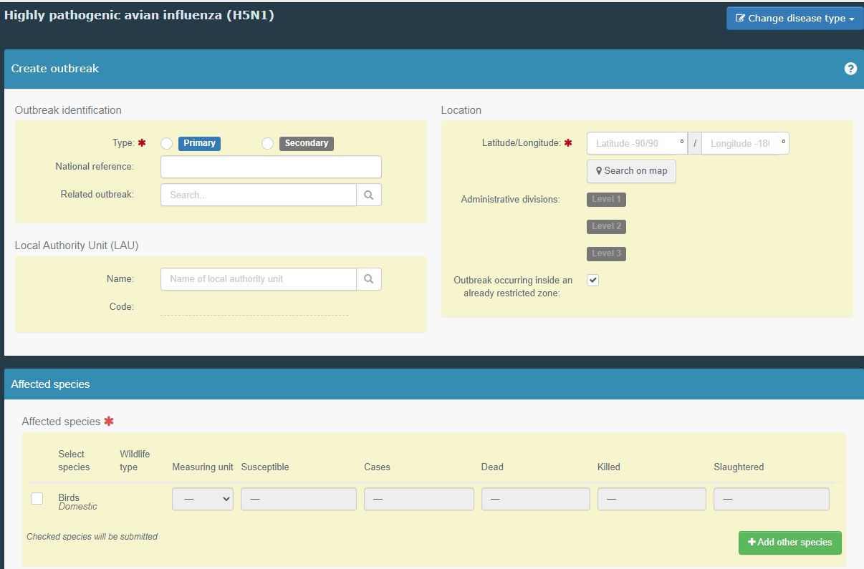
ADIS Notification outbreak H5N1

Slide 22
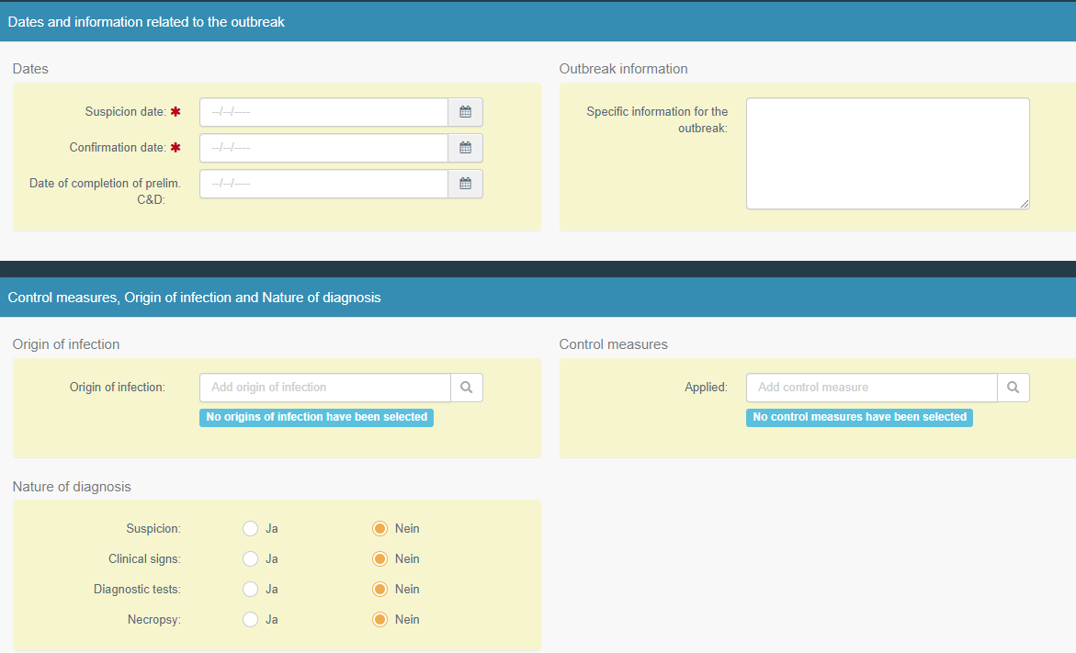
ADIS Notification outbreak H5N1

Slide 23
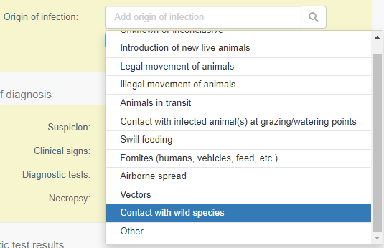
ADIS Origin of infection

Slide 24
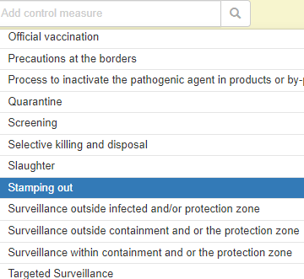
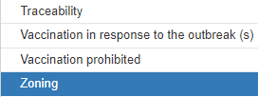
ADIS Control measures

Slide 25
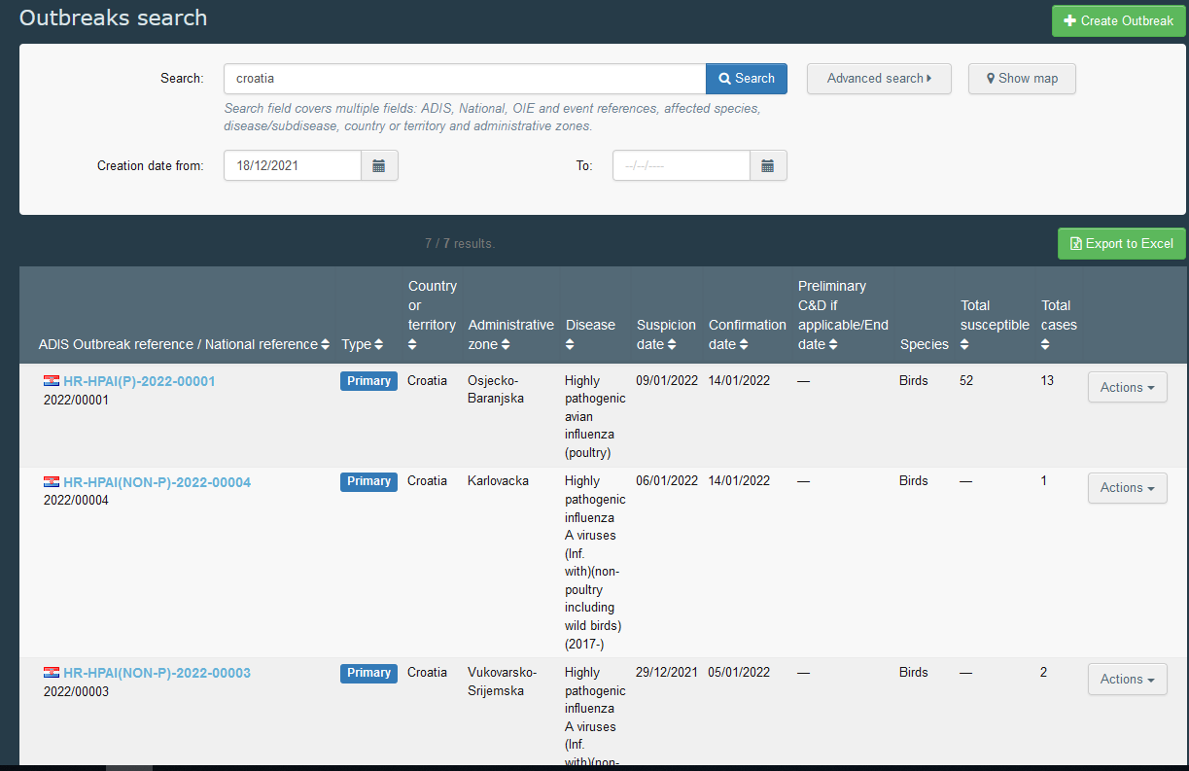
ADIS -Advanced search - outbreaks
List
Excel (data extraction)

Slide 26
ADIS outbreak notifications and weekly notification emails

Slide 27
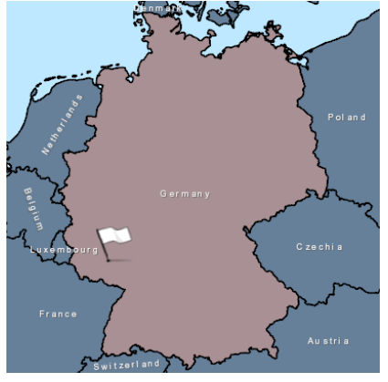
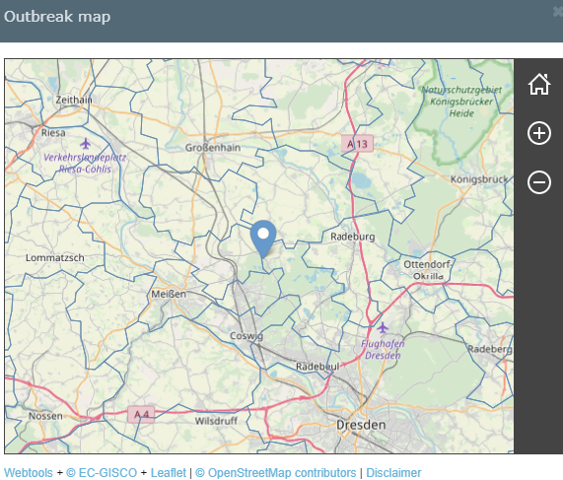
ADIS -Outbreak mapping

Slide 28
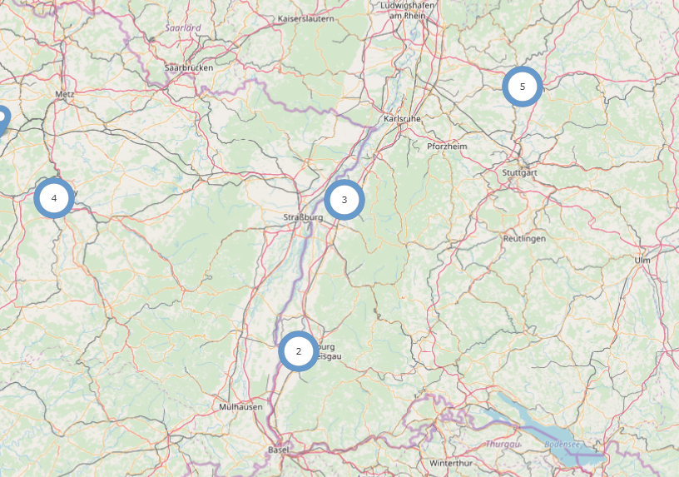
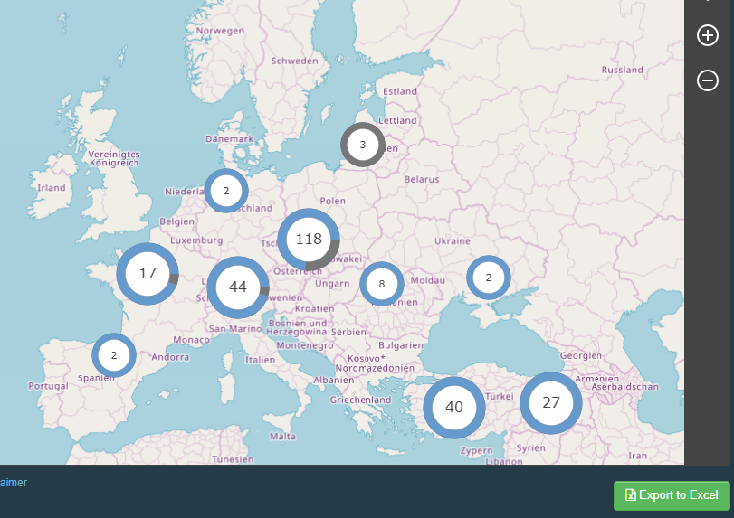
ADIS -Advanced search: Maps

Slide 29
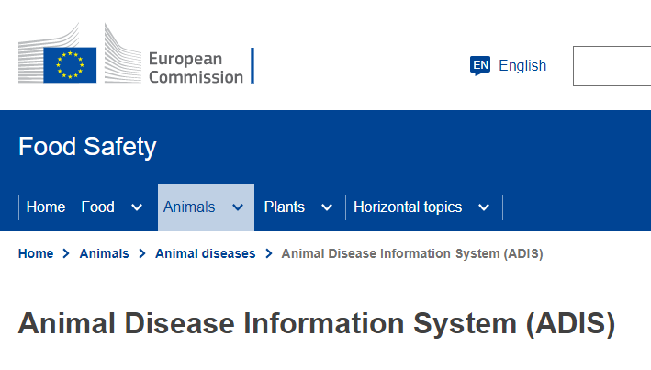
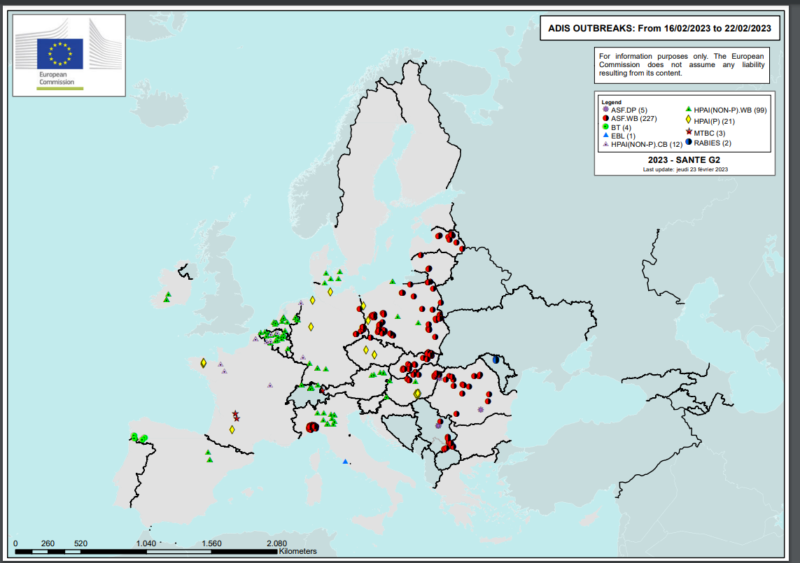
EU ADIS Website
Summary reports and maps
https://food.ec.europa.eu/animals/animal-diseases/animal-disease-information-system-adis_en

Slide 30
Computerised information system for Union notification and Union reporting of diseases - ADIS
ADIS is still under development and continuously updated!
Past Releases
module on Union reporting
detection of category E diseases
Union surveillance programmes ⇨ EFSA
results of eradication programme
Under development
Webservice (transfer outbreak data from national data base to ADIS)
future module on interoperability with WOAH-WAHIS

Slide 31
WAHIS
Access to all 182 WOAH Member Countries: submission by focal points
To ensure transparency of worldwide animal disease situation including zoonosis
Platform for collection, submission and access of animal health data provided by countries;
An official WOAH disease reporting format for clear and concise exchange of information;

Slide 32
WAHIS
Access to WAHIS allows users from Member Countries Focal Points to electronically submit notification reports:
Immediate notifications;
Follow-up reports;
Six-monthly reports;
Annual reports;
Wild annual reports.

Slide 33
Info Notes
Info Notes circulated by the EU to all trading partners on relevant EU disease events.

Slide 34
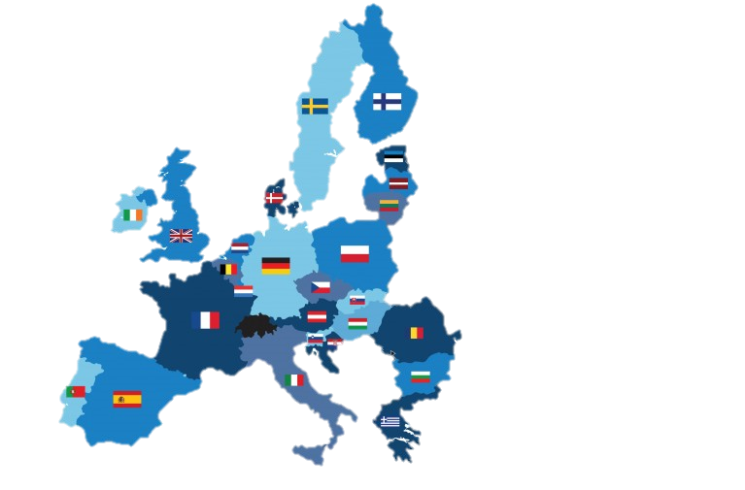
Annual reporting MS to EU
Detection of animal diseases
Surveillance programmes
Eradication programmes
e.g.
AI, ASF, BT, CSF
FMD/SPGP/PPR, LSD
Rabies
Bovine TB, Brucellosis
Other

Slide 35
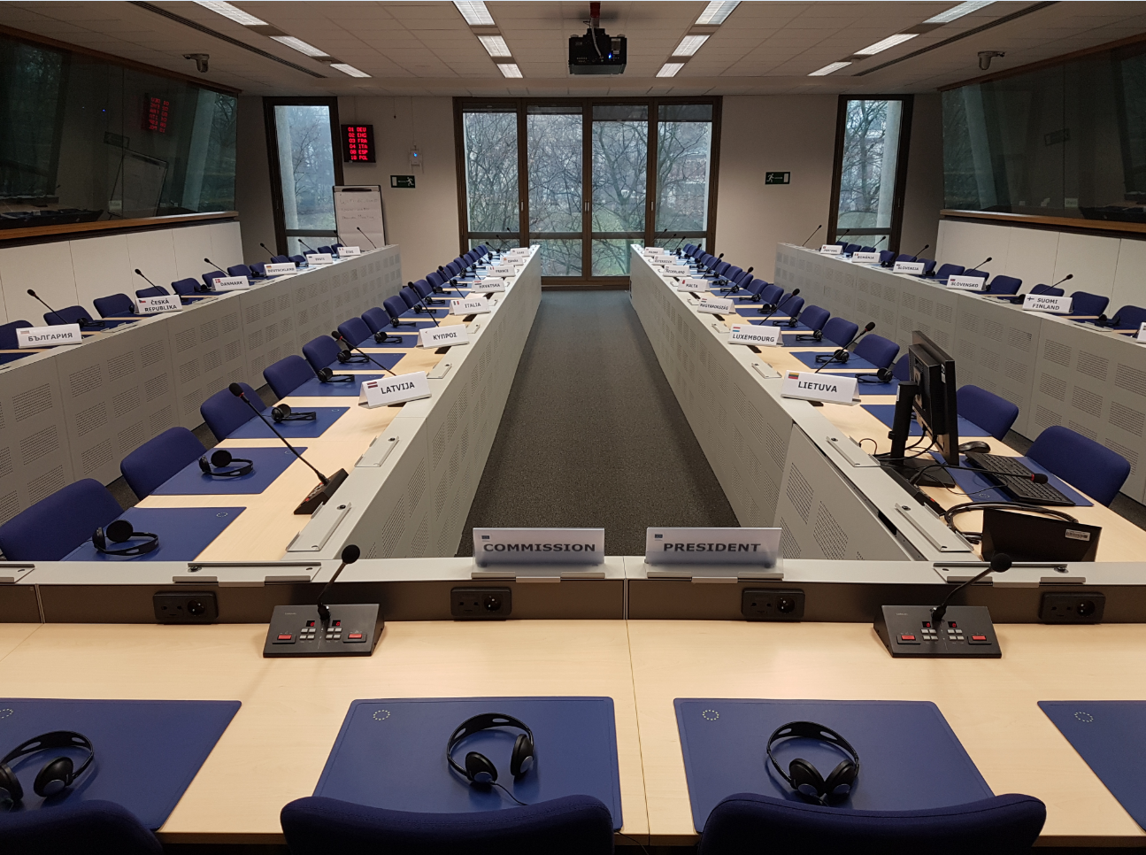
Meetings – Collaboration
Chief Veterinary Officers Meetings
Standing Committee on Plant Animals Food and Feed (SCoPAFF)
Working groups / Expert groups

Slide 36
EU Veterinary Emergency Team
It is a team composed of experts for veterinary technical assistance on control measures
The members of the team shall be appointed by the Commission from experts proposed by the Member States
Missions for support: central, regional and on the spot
Control of the disease / crises management

Slide 37
GF-TADs for Europe
The GF-TADs (Global Framework for the progressive control of Transboundary Animal Diseases) is a joint FAO/OIE initiative which combines the strengths of both organizations
Facilitating mechanism:
fight against transboundary animal diseases (TADs),
provide for capacity building and
assist in establishing programmes control of certain diseases

Slide 38
Specific GF-TADs for Europe initiatives
Regional Standing Group of Expert on African Swine Fever for Europe
Regional Standing Group of Expert on Lumpy Skin Disease for South East Europe
Regional Standing Group of Expert on Rabies for Europe
Regional Standing Group of Expert on HPAI

Slide 39
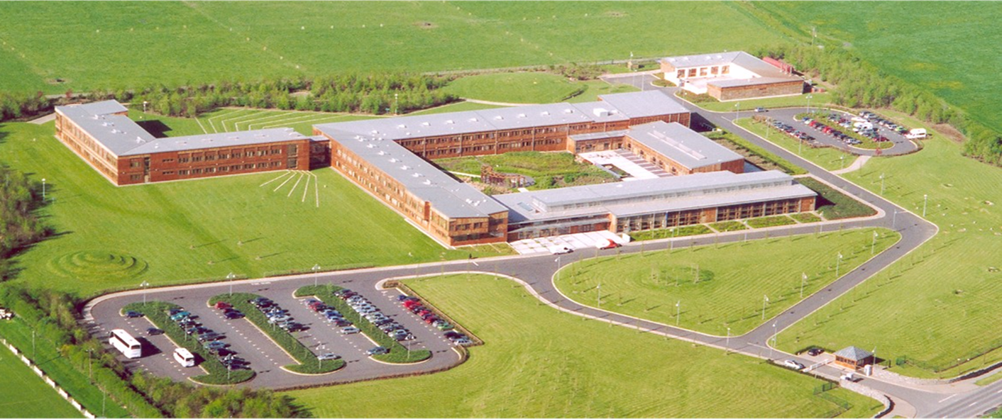
Other tools
BTSF workshop and e-learning
Sustained Technical Missions
SANTE Directorate F audits

Slide 40
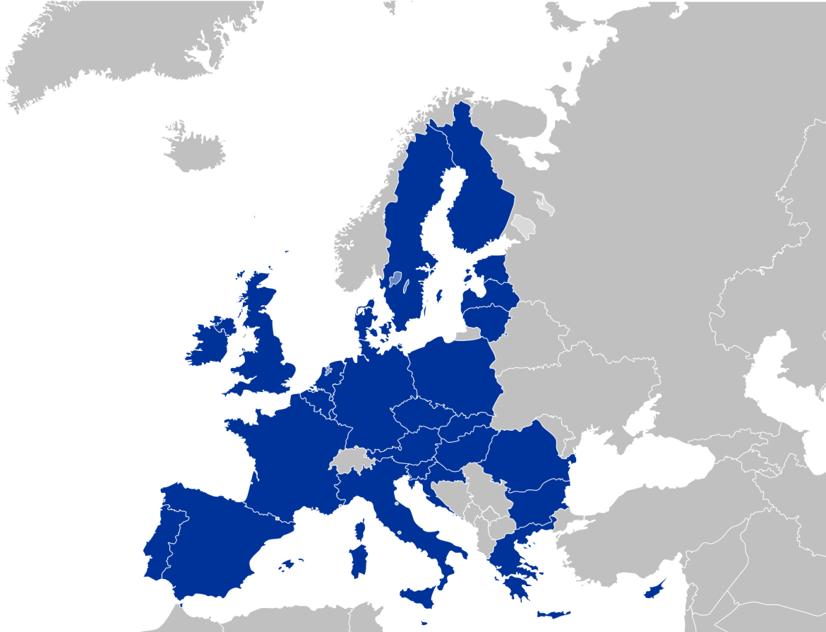
Transparency, reporting & confidence…….
WAHIS, Reports, GF – TADS…..
ADIS, WAHIS, TRACES, Reports, PAFF,
GF – TADS…..
EU - MS MS
New outbreaks reported within 24 hours

Slide 41
Keep in touch
ec.europa.eu/
europeancommission
europa.eu/
@EuropeanCommission
@EU_Commission
EUTube
@EuropeanCommission
EU Spotify
European Commission
Notes:
Delete/update as appropriate

Slide 42
17 Avenue André Marie Ampère, Induspal Lons
64140 Lons – France
Phone : +33 5 59 72 43 23
https://thetrainingplace.eu
Avenue de Tervuren 36
1040 Brussels – Belgium
Phone: +32 2 736 22 77
https://aesagroup.eu/
Notes:
Update/add/delete parts of the copy right notice where appropriate.
More information: https://myintracomm.ec.europa.eu/corp/intellectual-property/Documents/2019_Reuse-guidelines%28CC-BY%29.pdf

