Slide 1
Investigating suspect cases in different epidemiological contexts on High Pathogenic Avian Influenza.
Practical exercise on investigating suspect cases in different epidemiological contexts on avian influenza.
Tutor Names: Krzysztof Jażdżewski and Luis Romero
Bangkok, Thailand / 4-8 March 2024

Slide 2
Location of the farm (cases 1 to 3)
Breeding house
The farm consist of 4 sheds with 60,000 laying hens in each of them.
The breeding house is located at 500 m, with the same owner, but different workers.
The farm is located at 1,43 km from a water reservoir, where waterfowl are seen usually.
Production house (4 flocks)
1,43 km
Water reservoir

Slide 3
Case 1: Epidemiological link
Breeding house
Production house (4 flocks)
HPAI outbreak has been confirmed in the breeding house that supplies hens to our farm.
1,43 km
Water reservoir

Slide 4
Case 2: Laboratorial suspicious
59 serum samples have been taken one week ago following national surveillance program and 4 out of them have resulted positive by ELISA and HI (H5)

Slide 5
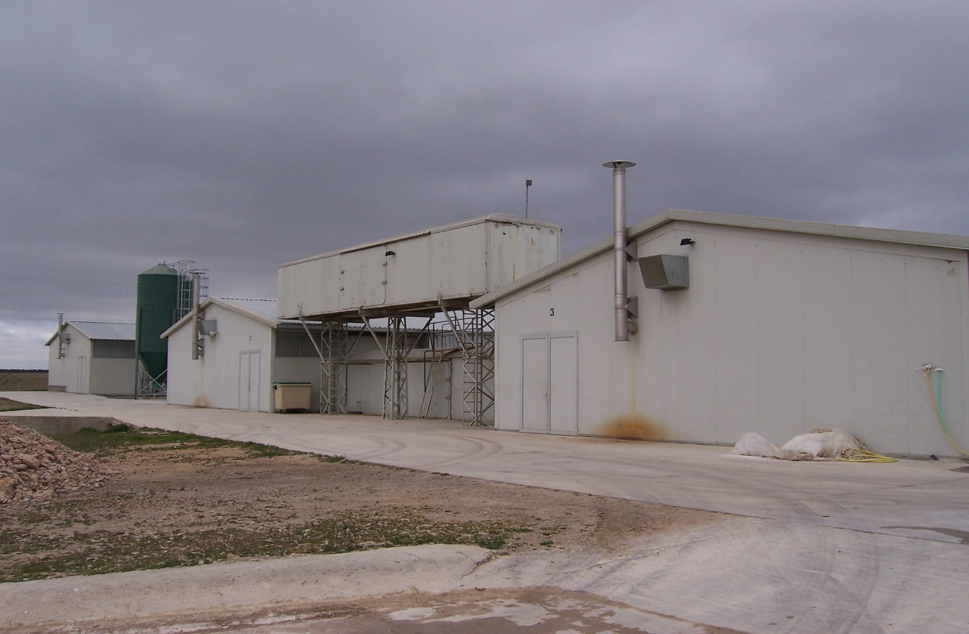
Case 3: Farm located in protection zone
HPAI outbreak has been confirmed in a broiler holding located at 2 km. Our farm is included in the Protection Zone.

Slide 6
Case 4: Own consumption (backyard) holding
Non-commercial holding with 15 laying hens, 5 ducks and 3 geese, kept outdoor close to a pond where HPAI has been detected in wild waterfowl

Slide 7
Groups composition
4 Groups composed by 9 participants each one.
One participant per group will play the role of reporter.
Each group will discuss about the 5 tasks for one case (75 min).
The reporter of each group will present in plenary session the conclusions of the assigned tasks in its assigned epidemiological situation case (10 minutes/group).

Slide 8
Group tasks
You are the official veterinarian who is going to perform the official visit to the HPAI suspected farm.
What actions would you carry out during the visit to the farm?
Would you take samples? Which samples, how many, from which animals, what analyses would you request from the laboratory?
Which additional data of the epidemiological investigation would you need?
At the end of the visit, what kind of actions would you order to the farmer to avoid the spread of the disease?
Which are the most urgent information to be shared with upper levels and identify who in your hierarchy shall be immediately informed of the outcome of the visit?

Slide 9








Keep in touch
ec.europa.eu/
europeancommission
europa.eu/
@EuropeanCommission
@EU_Commission
EUTube
@EuropeanCommission
EU Spotify
European Commission
Notes:
Delete/update as appropriate

Slide 10


17 Avenue André Marie Ampère, Induspal Lons
64140 Lons – France
Phone : +33 5 59 72 43 23
https://thetrainingplace.eu
Avenue de Tervuren 36
1040 Brussels – Belgium
Phone: +32 2 736 22 77
https://aesagroup.eu/
Notes:
Update/add/delete parts of the copy right notice where appropriate.
More information: https://myintracomm.ec.europa.eu/corp/intellectual-property/Documents/2019_Reuse-guidelines%28CC-BY%29.pdf

