Slide 1
EU MEMBER STATES EXPERIENCE ON HIGHLY PATHOGENIC AVIAN INFLUENZA VACINATION
BTSF Regional workshop on Animal Health:
disease preparedness, vaccination and One Health approach
Bangkok, Thailand
4-8 March 2024
Žilvinas Ilevičius,
EUROPEAN COMMISSION
DIRECTORATE-GENERAL FOR HEALTH AND FOOD SAFETY
Head of Unit G2 - Animal Health

Slide 2
Outline of the presentation
Preventive vaccination poultry (France- ducks)
Preventive vaccination in zoo birds
Vaccine trials

Slide 3
Preventive vaccination poultry France- ducks

Slide 6
France
Preventive vaccination of ducks
Start: October 2023

Slide 7
Vaccine used in France
VOLVAC B.E.S.T. AI ND vaccine (Boehringer Ingelheim animal Health France)
effective against the clade 2.3.4.4.b. strain of HPAI and
offers the possibility for a DIVA strategy based on NP ELISA serology.
Route of administration: subcutaneous
Use of vaccine authorised by the French Agency for Veterinary Medicinal products (ANMV) in accordance with Article 110.2 of Regulation (EU) 2019/6 https://www.anses.fr/fr/content/médicaments

Slide 10
Preventive vaccination zoo birds Netherlands, Spain, Ireland

Slide 11
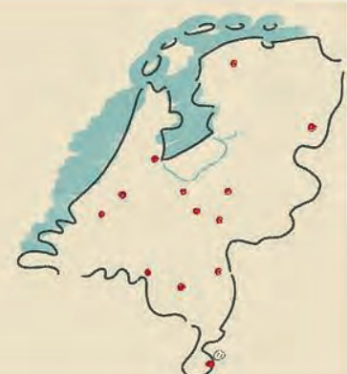
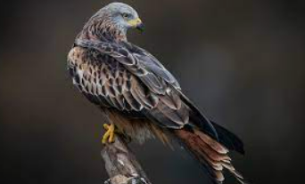
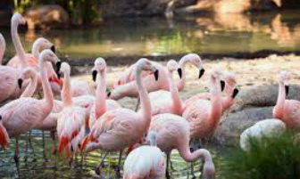
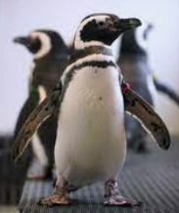
Preventive vaccination of birds in zoos (“confined establishments”)
Netherlands
Preventive vaccination programme in 13 zoos (since October 2023)
Vaccine used: Nobilis Influenza H5N2
Spain
Preventive vaccination programme in 1 zoo (since winter 2023/2024)
Vaccine used: Nobilis Influenza H5N2
Ireland
Preventive vaccination programme in 4 zoos
(since winter 2023/2024))
Vaccine used: Nobilis Influenza H5N2

Slide 12
Vaccine trials/ research (out of scope of EU Reg 2023/361)

Slide 13
Scientific research
(out of scope of Delegated Regulation (EU) 2023/361)
Hungary
field trial in geese (2022-2023)
Italy
vaccine efficacy trial in turkeys (since 2022)
Netherlands
vaccine efficacy trial in laying hens in high containment unit in lab (2022)
field trial in laying hens (September 2023-2025)

Slide 14
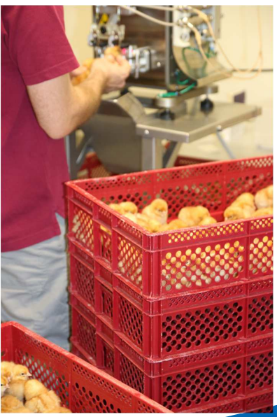
Netherlands
Vaccination in laying hens
Scientific research
2022: Lab study with 4 vaccines
2023-2025: Field study with 2 HVT-vector vaccines
Next step: possible small scale pilot
depending on outcomes field study
foreseen to start end 2024

Slide 15
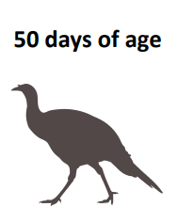
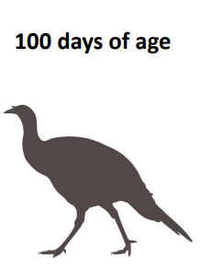
Italy
Scientific research
Vaccine trials in turkey
Testing different vaccines, in various combinations (first dose, booster)
Assessment of reduction of virus shedding and clinical and virological protection

Slide 16
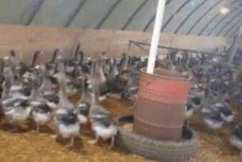
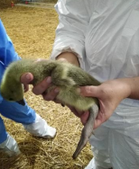
Hungary
Scientific research
Field trial in geese in 2022-2023
Field safety and efficacy tests
AI H5-vaccine (synthetic RNA)
Vaccination in the hatchery, booster at 4 weeks of age

Slide 17
Thank you
© European Union 2020
Unless otherwise noted the reuse of this presentation is authorised under the CC BY 4.0 license. For any use or reproduction of elements that are not owned by the EU, permission may need to be sought directly from the respective right holders.
Slide xx: element concerned, source: e.g. Fotolia.com; Slide xx: element concerned, source: e.g. iStock.com
Notes:
Update/add/delete parts of the copy right notice where appropriate.
More information: https://myintracomm.ec.europa.eu/corp/intellectual-property/Documents/2019_Reuse-guidelines%28CC-BY%29.pdf

