Slide 1
Bangkok 8 March 2024

Slide 2
One Health scene setter
The recent epidemics and pandemics, have made it unmistakably clear that human, animal, plant and environmental health cannot be dealt with separately, but need to be addressed in a ‘One Health’ approach.
Their interdependencies requires work in an integrated approach. Mainstreaming ‘One Health’ means that we can better prevent, predict, prepare for, detect, and respond to global health threats at global level.

Slide 3
Our mission
Protect and promote human, animal and plant health and food safety in Europe.
Notes:
Food: Biggest acquired legal positions. Above all related to internal market. Often technical legislation going from food labelling to animal welfare.
Health: Until recently mostly limited to tobacco and cross-border healthcare. COVID changed all of that

Slide 4
Public Health
Build a strong European Health Union focusing on crisis preparedness and response, a pharmaceutical strategy,
Supply affordable medicines
Prioritise communication on vaccination
Implement the new regulatory framework on medical devices
Use e-health to provide high-quality healthcare and reduce inequalities
Create a European Health Data Space
Implement the European One Health Action Plan against Antimicrobial Resistance
Public Health on Europa
Notes:
Wide range of activities from supply of medicines to vaccination and cancer
Interesting reading: State of the Health Report and ERN Networks
Huge increase for health budget – more than ten-fold to €5.1 billion, around €345 in first year

Slide 5
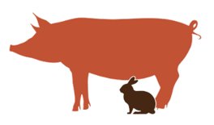
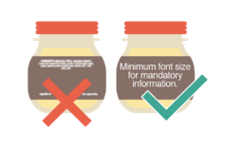
Food safety, animal and plant health
Lead on the “From Fark to Fork” strategy for a fair, healthy and environmentally-friendly food system
Reduce dependency on pesticides and stimulate the take-up of alternatives
Improve consumer information, notably on food labelling
Better enforcement of legislation on animal health and welfare
Fight food fraud
Food Safety on Europa
Notes:
Actions in these areas are important: Control the respect of the EU rules in Member States, Control the safety of food & animal feed imported from other countries,
Carry out over 200 audits per year, Promote European standards worldwide
Food safety falls under single market programme and will get around €225 million a year or just under €1.6 billion overall

Slide 6
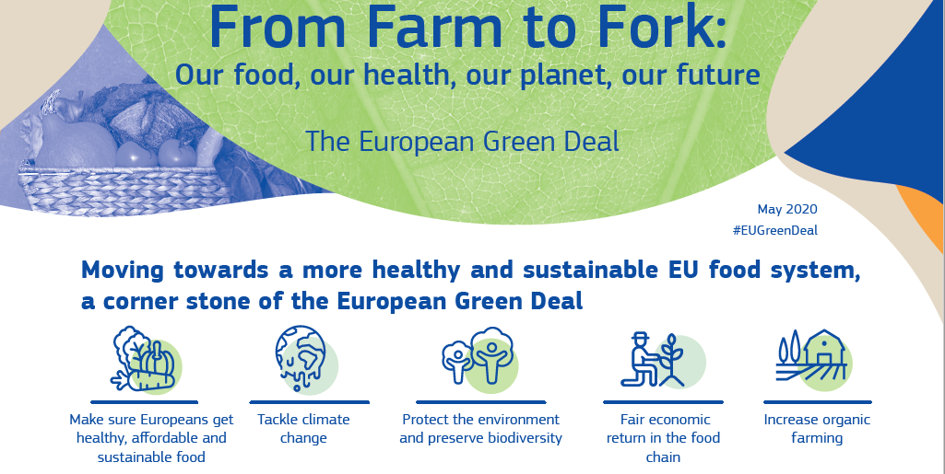
Notes:
A change is needed:
36 million people cannot afford a quality meal
20% of food is wasted
Almost half of the adult population is overweight
Food production systems generate 11% of EU greenhouse gas emissions and consume big amounts of water and energy.
The strategy supports the transition towards sustainable food systems with healthy and affordable diets, and addresses some important issues in our food systems,
Goals:
reduction by 50% of the use and risk of chemical pesticides and the use of more hazardous pesticides by 50% by 2030.
reduction of nutrient losses by at least 50% while ensuring that there is no deterioration in soil fertility. This will reduce the use of fertilisers by at least 20% by 2030.
reduction by 50% of the sales of antimicrobials for farmed animals and in aquaculture by 2030
reaching 25% of agricultural land under organic farming by 2030
Comprehensive consultation process with other DGs and citizens

Slide 7
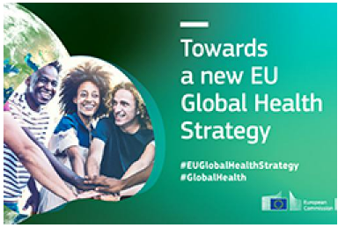
One Health
requires an international approach
European Global Health Strategy
International Agreement on Pandemic Prevention, Preparedness and Response
Participation in other international One Health initiatives

Slide 8
Operationalisation of One Health
Experience in the management of the COVID-19 pandemic cannot be forgotten
DG SANTE is looking at ways to integrate One Health in EU policies and actions
Technical work ongoing to come up with proposals for action

Slide 9
Key challenges
Operationalisation of multi-sectorial, transdisciplinary and complex concept;
Inclusion of the food/ environment/ climate change in One Health expands the mandate to a much wider field
Requires awareness raising and training
Competing priorities, and funding gaps

Slide 10
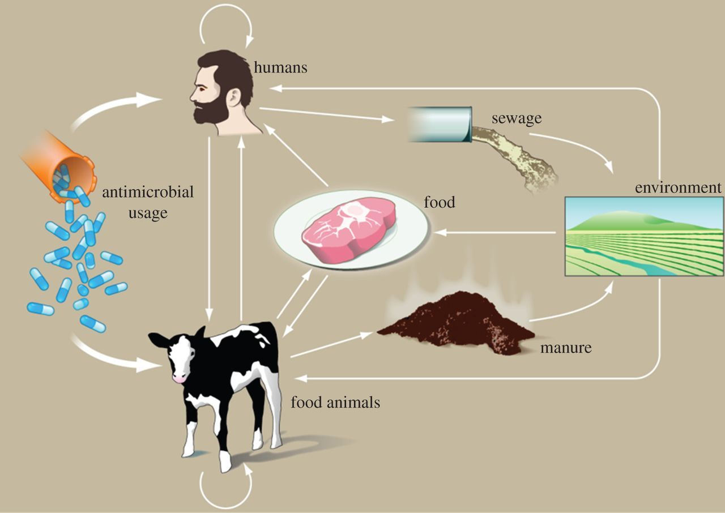
One Health approach to address AMR
M. Woolhouse et al. Philophical Transactions of Royal Society, 2014: Antimicrobial resistance in humans, livestock and the wider environment

Slide 11
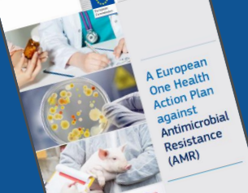
One Health approach to address AMR
EU One Health Action Plan against AMR (2017)
Council Recommendation on stepping up EU actions to combat antimicrobial resistance in a One Health Approach (2023)
AMR One Health Network​

Slide 12
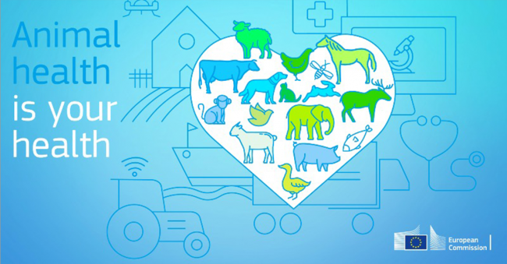
One Health approach to address AMR
Animals:
Regulation (EU) 2016/429 on transmissible animal diseases (‘Animal Health Law‘)
Commission Delegated Regulation (EU) 2023/361, supplements ‘Animal Health Law’
Humans:
2017 EU guidelines on prudent use of antimicrobials

Slide 13
Farm to Fork Strategy
Explicitly refers to One Health in relation to AMR
Overall reduction of EU sales of antimicrobials for farmed animals and in aquaculture by 50% by 2030

Slide 14
Farm to Fork Strategy
Regulation on Sustainable Use of Plant Protection Products
Framework for Sustainable Food Systems animal welfare legislation
Organic farming

Slide 15
Farm to Fork Strategy- One health
International cooperation with trade partners
Cooperation at international standards setting bodies
Cooperation in all scientific fora

Slide 16
Conclusions
One health build on
Experience in facing similar challenges (COVID-19, AMR)
learn from other initiatives at all levels, projects, experts
build on existing elements
Cooperation at international level
To be better prepared for the next pandemic
work towards overcoming silos
consider One Health in all relevant policies and decision-making

