Slide 1
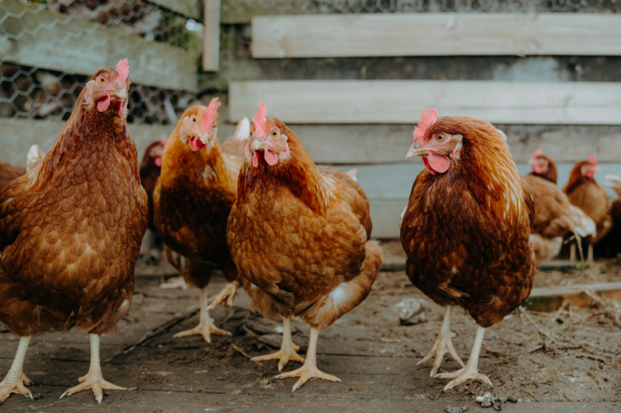
Global Role of WOAH on animal health and International Standards: Overview of zoning and compartmentlisation
Regional workshop on the animal disease preparedness, vaccination and one health approach, Bangkok, Thailand , 4-8 Mar 2024
Dr Ashish Sutar
4 Mar 2024
Bangkok,Thailand
Dr Bolortuya Purevsuren
Dr Francisco D’Alessio

Slide 2
Presentation covers : Topic 1 – Overview of WOAH
Overview of WOAH
Introduction to Animal Health Standards
Zoning and Compartmentlisation
Summary

Slide 3





Introduction to World Organisation for Animal Health (WOAH)
Timeline
1924
1945
1998
2003
2004
2022
Creation of the
Office International des Epizooties
(OIE)
Creation of the United Nations (UN)
The World Trade Organisation and OIE signed the SPS Agreement
New common name:
World Organisation
for Animal Health
(OIE)
Adoption of first animal welfare standards
New common acronym: WOAH
Our Worldwide Network
183
300+
13
Members
75+
Reference Centres of Expertise
1
Regional and Sub-regional Representations
Headquarters
in Paris, France
Official partners

Slide 4
Global role of WOAH on animal health and welfare
Who we are
We are the global authority on animal health and welfare: we work to ensure the health and welfare of animals, recognising that animal health impacts everyone’s health.
What we do
We disseminate information on animal diseases and welfare and develop science-based strategies to limit their impacts on society.
What is our impact
We are building a better future through better animal health and welfare.
Who we partner with
We collaborate with partners and Members to achieve results for animals, humans and the planet.

Slide 5
Organisational Theory of Change
Vision
Provide leadership in global animal health governance. Improve animal health care and welfare worldwide and support global goals.
Public Health
Global food security and safety
Safe and fair trade
Sustainable socioeconomic development
Mission
Coordinate animal
health and welfare
Foster transparency in the
animal disease situation
Strengthen health systems
through Veterinary Services
Key actions
Standard Setting and implementation
Developing international standards, guidelines, recommendations on the best available evidence
Coordinating global frameworks
Developing and supporting Veterinary Services implement global strategies and initiatives
Information Management
Collecting, managing, analysing and giving access to health systems-related data, including real-time information on the state of animal health worldwide
Capacity
Building
Engaging Veterinary Services through the PVS Pathway in assessment, strategic planning and capacity development
Facilitating collaboration
Communicating with and engaging WOAH stakeholders, on animal health welfare, and veterinary public health issues

Slide 6
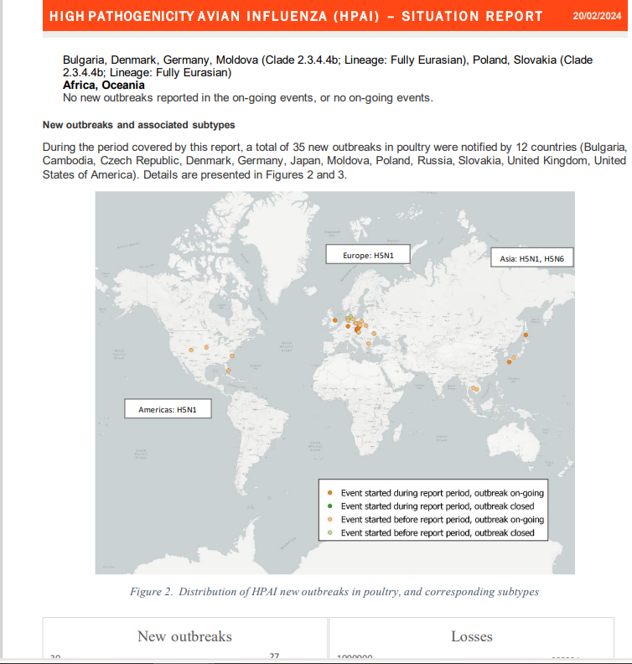
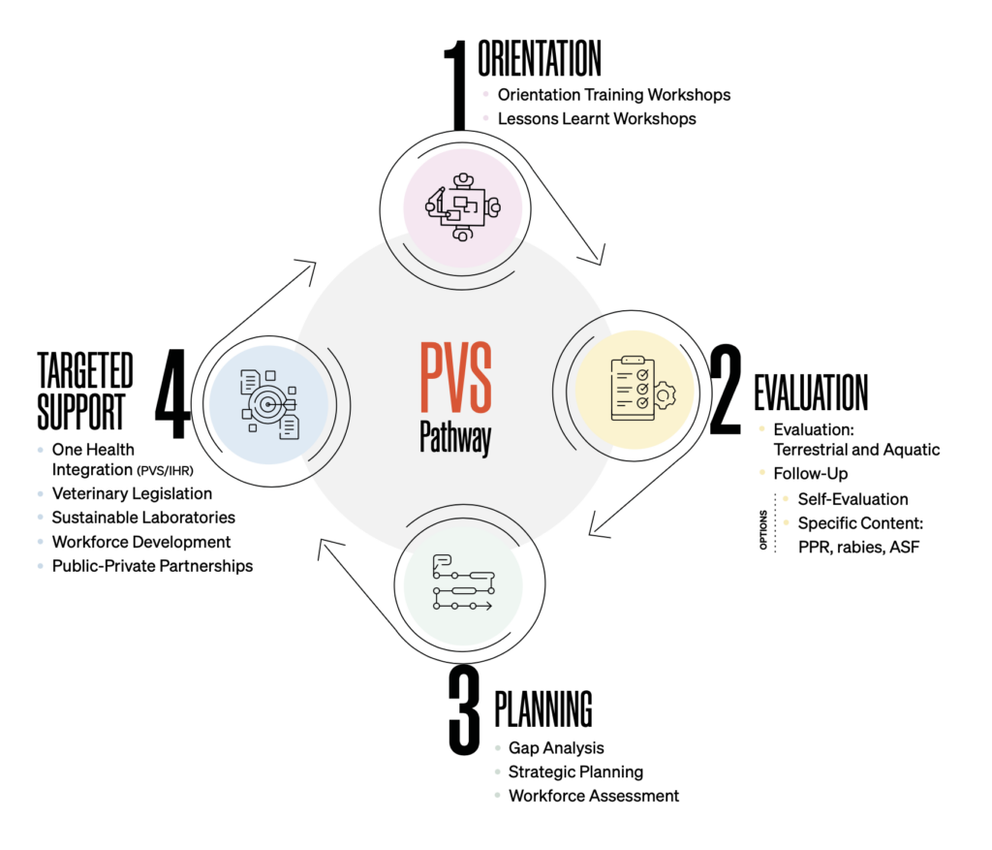
WOAH tools (examples)
Terrestrial Animal Health Code (TAHC)
Section 1:
Animal disease diagnosis, surveillance and notification
Terrestrial Animal Health Code (TAHC)
Section 3:
Quality of Veterinary Services
An evolving, cyclical and voluntary process, the PVS Pathway encourages continuous learning and improvement within national Veterinary Services throughout its four stages – orientation, evaluation, planning and targeted support. This assessment-based system also aims to support national Veterinary Services’ capacity to comply with WOAH international standards.
Notify listed diseases in Terrestrial and Aquatic Animal Health Code
Update system- mapping tools and dashboards
Extract data
Transparency of the animal disease situation worldwide
Alert message / Immediate notification
https://wahis.woah.org
https://www.woah.org/en/what-we-offer/improving-veterinary-services/pvs-pathway/

Slide 7
Global presence of WOAH
13
1
Regional and Sub-Regional
Representations
Headquarters
Moscow
Brussels
Astana
Paris
Tunis
Beirut
Tokyo
Abu Dhabi
Panama
Bamako
Bangkok
Gaborone
Buenos Aires

Slide 8

Distribution of WOAH Members per region
No country offices:
We work through and with Government
1
National Delegate
to WOAH per Member
7
53
National Focal Points on specific subject matter
Animal welfare,
Aquatic animals
Wildlife
Animal disease notification
Vet products-AMR
Communication
Veterinary Laboratories
12
31
32
54

Slide 9
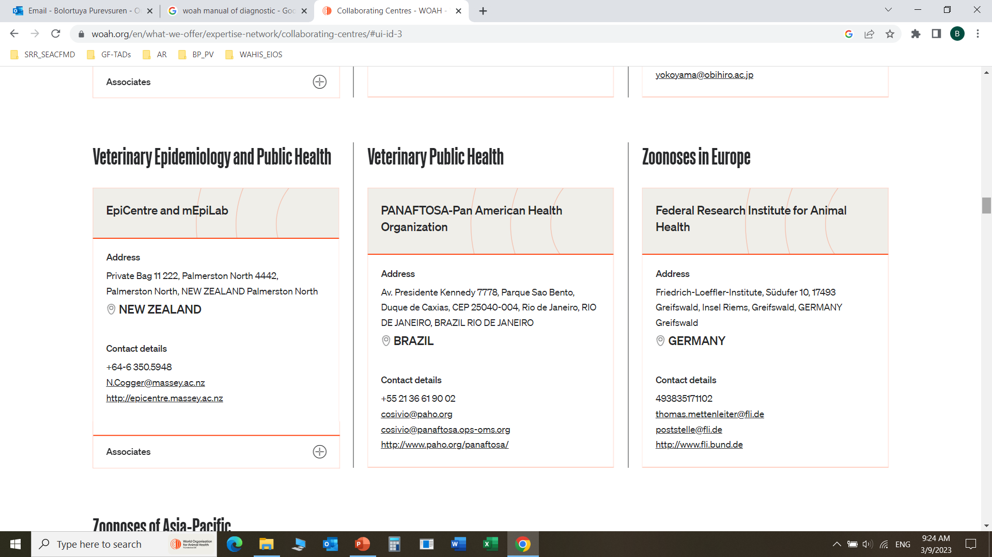
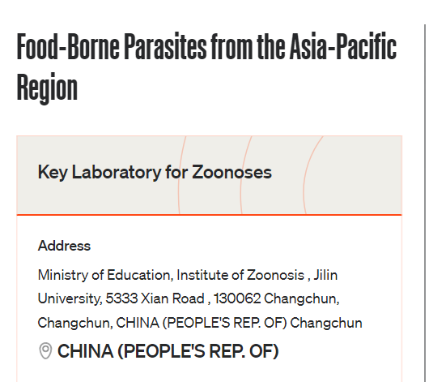
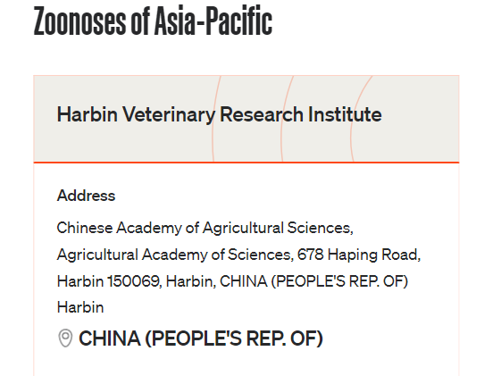
WOAH Collaborating Centre

Slide 10
Topic 2 : Introduction to Animal Health Standards
Overview of WOAH
Introduction to Animal Health Standards
Zoning and Compartmentlisation
Summary

Slide 11
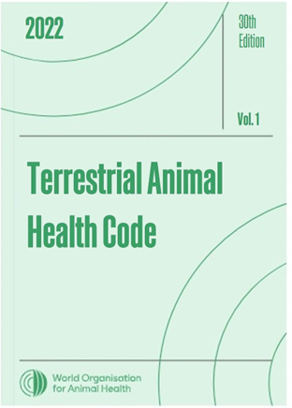
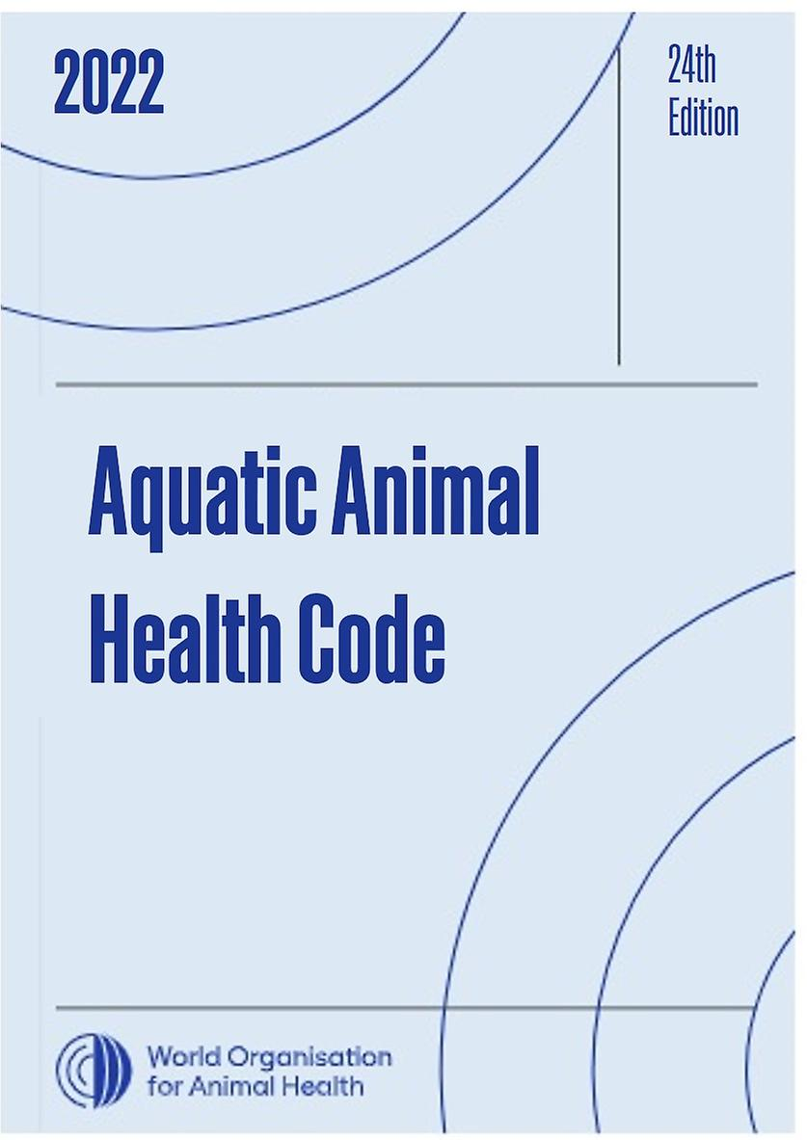
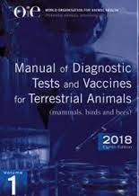
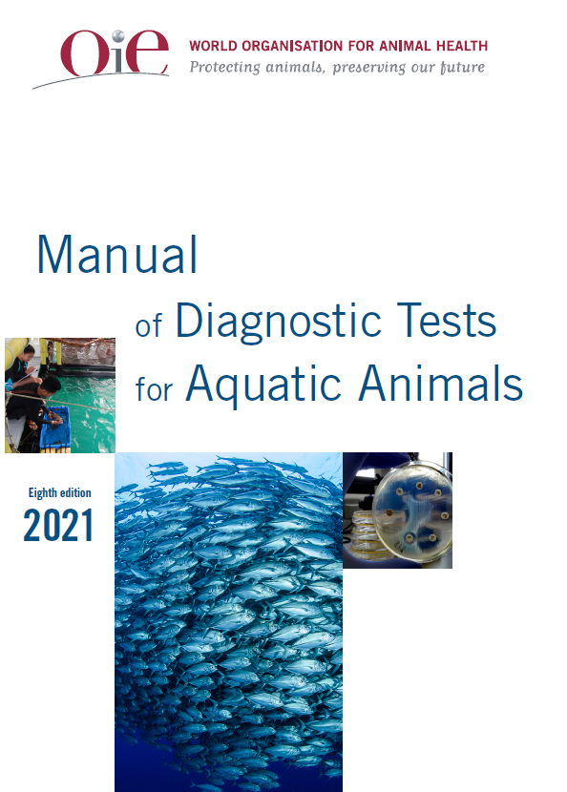
WOAH Standards and Manuals
Improvement of animal health, welfare, veterinary public health
Safe international trade in terrestrial and aquatic animal health
Standardised approach to the diagnosis of the diseases listed in the Terrestrial and Aquatic Codes.

Slide 12





WOAH International standards
WOAH International standards, the reference for:
Veterinary certification and export/import procedures
Assessment of potential trading partners and their animal health situation
Ensuring transparency and enhancing knowledge of the animal health situation worldwide.
Development of national policies and national animal health systems
Definitoin of import sanitary measures, according to the commodity and their origin
WOAH establishes standards for the improvement of animal health and welfare and veterinary public health worldwide, including the prevention of disease spread through international trade of animals and animal products.

Slide 13
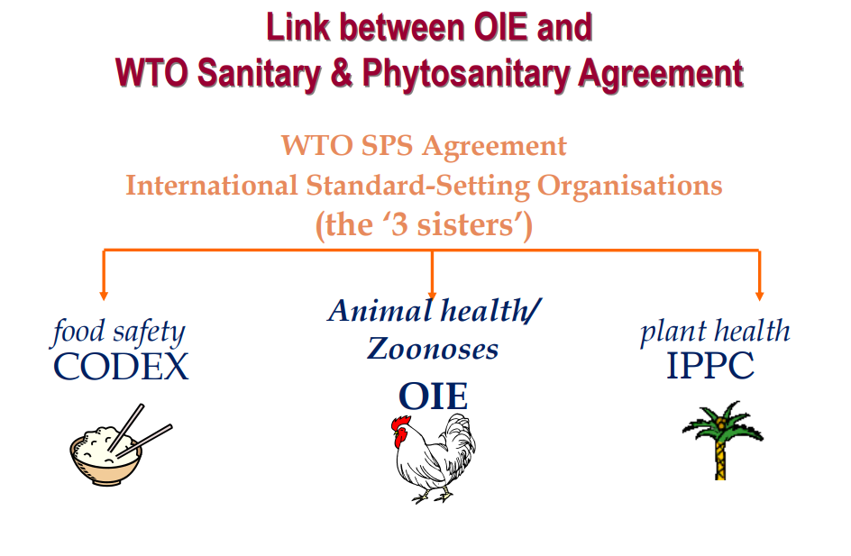
WOAH and WTO SPS agreement
WOAH
  Standards for trade live animals and animal products
WOAH

Slide 14


Link between WOAH and WTO SPS agreement
Improvement of animal health and veterinary public health worldwide, including the prevention of disease spread through international trade of animals and animal products
Rules of trade between nations
Open trade for the benefit of all
Sanitary
Measures
WOAH is recognised by the WTO SPS Agreement as the standard setting organisation for animal health and zoonoses.

Slide 15


Terrestrial Animal Health Code (TAHC)
New version every year
Latest version publicly available on the WOAH website
Previous editions are also available
Volume I
User’s guide and
Horizontal chapters
Volume II
Disease-specific
chapters
https://www.woah.org/en/what-we-do/standards/codes-and-manuals/terrestrial-code-online-access/

Slide 16
Terrestrial Code - Content
Volume I: Horizontal chapters
Volume II: Disease-specific chapters
User’s Guide
Glossary
Animal disease diagnosis, surveillance and notification
Risk analysis
Quality of Veterinary Services
Disease prevention and control
Trade measures, import-export procedures and veterinary certification
Veterinary public health
Animal welfare
  Definition of infection/ infestation and specific epidemiological considerations
  Safe commodities where appropriate
    Safe commodities = based on absence of the pathogenic agent in the traded commodity OR inactivation by processing or treatment that the commodity has undergone
    Importing countries should not apply trade restrictions to safe commodities with respect to the pathogenic agent concerned
  Determination of the animal health status of a country, zone or compartment
    Official status recognition
    Self declaration of animal health status
  Recommendations on safe trade for live animals, genetic material, other products of animal origin (meat, milk, eggs, skins, etc.)
  Specific management of commodities, e.g.
    Recommendations on inactivation
    Vector-protection during transport
  Recommendations on surveillance
    Surveillance strategies specific to infection/ infestation
    Link to Chapter 1.4 and 1.5 on animal health and vector surveillance

Slide 17
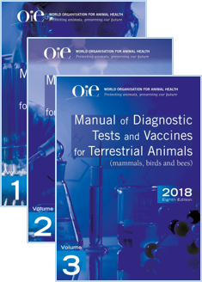
Terrestrial Manual
Volume I: General Standards
Volume II: Specific recommendations
Volume III: Disease specific Chapters
Selected chapters updated every year
Latest version publicly available on the WOAH Website
New printed version produced every 4 years
https://www.woah.org/en/what-we-do/standards/codes-and-manuals/terrestrial-manual-online-access/

Slide 18
Terrestrial Manual - Content
Part 1: introductory chapters that set general standards for the management of veterinary diagnostic laboratories and vaccine production facilities;
Part 2: specific recommendations and includes chapters of recommendations for validation of diagnostic tests and recommendations for the manufacture of vaccines;
Part 3 chapters on WOAH listed diseases and other diseases of importance to international trade;
Part 4 is the list of WOAH Reference Centres at the time of publication.

Slide 19
Impact of WOAH Standards Internationally
Facilitates understanding between countries, simplify processes, and reduces costs
Harmonization of national regulations and programs
across countries
Improved prevention and control of animal diseases and zoonosis at the source
Reduced
risk of international spread of diseases
Increases predictability
and fairness of trade
Science-based risk mitigation measures for international trade
Harmonization of sanitary measures for international trade
Safe, fair, predictable and sustainable international trade

Slide 20

Section 1. Animal Disease Diagnosis, Surveillance and Notification
TAHC Volume 1.
Chapter 1.1. Notification of diseases and provision of epidemiological information
Chapter 1.2. Criteria for the inclusion in the WOAH list
Chapter 1.3. Diseases, infections and infestations listed by WOAH
Chapter 1.4. Animal health surveillance
Chapter 1.5. Surveillance for arthropod vectors of animal diseases
Chapter 1.6. Procedures for official recognition of AH status, by WOAH
Chapter 1.7.-1.12. Application for official recognition by WOAH of free status for …
Disease Situation
Which diseases
Demonstrate
presence or absence
Official recognition by WOAH

Slide 21

Section 4. Disease Prevention and Control
TAHC Volume 1.
Chapter 4.2. Identification and traceability of live animals
Chapter 4.4. Zoning and compartmentalisation
Chapter 4.5. Application of compartmentalisation
Chapter 4.17. High health status horse subpopulation
Chapter 4.18. Official control programmes for listed and emerging diseases
Specific
regionalization
provisions
SECTION 8 & +: DISEASE-SPECIFIC CHAPTERS
Definition of infection/ infestation, its occurrence and specific epidemiological considerations
Determination of the animal health status of a country, zone or compartment
Recommendations on safe trade for live animals, genetic material, other products of animal origin (meat, milk, eggs, skins, etc.)
Recommendations on surveillance

Slide 22
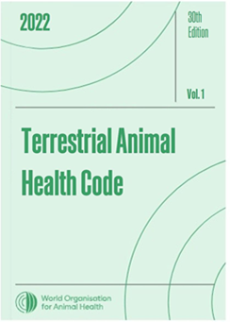
Section 5. Trade measures/import/export procedures and veterinary certification
TAHC Volume 1.
Certification procedures
Procedures to the Agreement on the application SPS measures of the WTO
Animal health measures before or at departure ,during transit (exporting and importing country)
Border post quarantine station
International transfer and laboratory containment and animal pathogenic agent
Model of International veterinary certificates

Slide 23
Section 6. Veterinary Public Health
TAHC Volume 1.
Role of Veterinary Services in Food Safety
Control of biological hazards through ante- and post-mortem meat inspection
Control of hazards in animal feed
Biosecurity in poultry production
Control of Salmonella in poultry
Controlling antimicrobial resistance

Slide 24
Section 7: Animal welfare
TAHC Volume 1.
Animal transport by different mode
Slaughter of animals
Killing animals for disease control purposes
Use animal in research and education
Animal welfare of different livestock production system
Killing of reptiles for their skins, meat and other products

Slide 25
Chapter 10.4 Infection with high pathogenicity Avian Influenza virus
Volume 2.
First ado[ted in 1998, most recent updated adopted in 2021
General provisions
Safe commodities
Country or a zone free from avian influenza
Recovery of free status
Recommendation from the importation of country, zone or compartment
Surveillance for early detection
Surveillance of wild population
Among others

Slide 26
Section 3 : Zoning and compartmentlisation
Overview of WOAH
Introduction to Animal Health Standards
Zoning and Compartmentlisation
Summary

Slide 27
Terrestrial Animal Health Code
Volume I.
Chapter 4.4 Zoning and compartmentalisation
Principles for defining and establishing a zone /compartment
Definition –free, infected, protected, containment zones
Bilateral recognition of country or zone status by trading countries

Slide 28
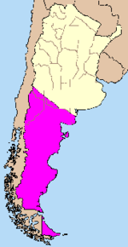

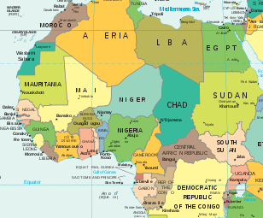
Key concept
Animal health status
means the status of a country, zone or compartment with respect to an animal disease in accordance with the criteria listed in the relevant disease-specific chapter or Chapter 1.4. of the Terrestrial Code.
Country
Zone
Compartment

Slide 29
Definition
BIOSECURITY
a set of management and physical measures designed to reduce the risk of introduction, establishment and spread of animal diseases, infections or infestations to, from and within an animal population.
BIOSECURITY PLAN
a plan that identifies potential pathways for the introduction and spread of disease in a zone or compartment, and describes the measures which are being or will be applied to mitigate the disease risks, if applicable, in accordance with the recommendations in the Terrestrial Code.
Zone
a part of a country defined by the Veterinary Authority, containing an animal population or subpopulation with a specific animal health status with respect to an infection or infestation for the purposes of international trade or disease prevention or control.
Compartment
an animal subpopulation contained in one or more establishments, separated from other susceptible populations by a common biosecurity management system, and with a specific animal health status ………
Sub-population
means a distinct part of a population identifiable in accordance with specific common animal health characteristics.

Slide 30
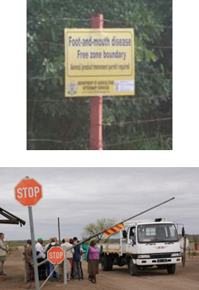
Zoning and Compartmentalisation application
Assist Member Countries wishing to establish and maintain different subpopulations within their territory
Applied in accordance with the measures in the relevant disease chapter(s)
To regain free status following a disease outbreak, follow the recommendations in the relevant disease chapter
Outlines a process through which trading partners may recognize such subpopulations, best implemented by gaining agreement prior to outbreaks

Slide 31
WTO SPS Agreement Regionalisation principle
Members shall recognise the concept of disease-free areas, whether all of a country, part of a country, or all or parts of several countries (Article 6)
Members shall ensure sanitary measures take into account (Article 6):
  Disease prevalence
  The existence of eradication or control programmes
  The criteria or guidelines developed by the relevant international organizations

Slide 32
Implementation of the Regionalisation principle in international trade
Exporting country
Importing country
Implement disease prevention and control
Surveillance and demonstration of freedom
Setting up regionalisation programmes
Assessing exporting country programmes
Defining import requirements
WOAH
International Standards
Specific WOAH Standards regionalization provisions
Zoning and Comparmentalisation

Slide 33
Zoning and compartmentalisation in practice
Zones are primarily defined based on geography (e.g. natural or legal boundaries)
INFECTED
INFECTED
Biosecurity management
Compartments are primarily defined by biosecurity management practices
FREE
Zoning
Compartmentalisation
Source : WOAHModified from USDA-APHIS

Slide 34
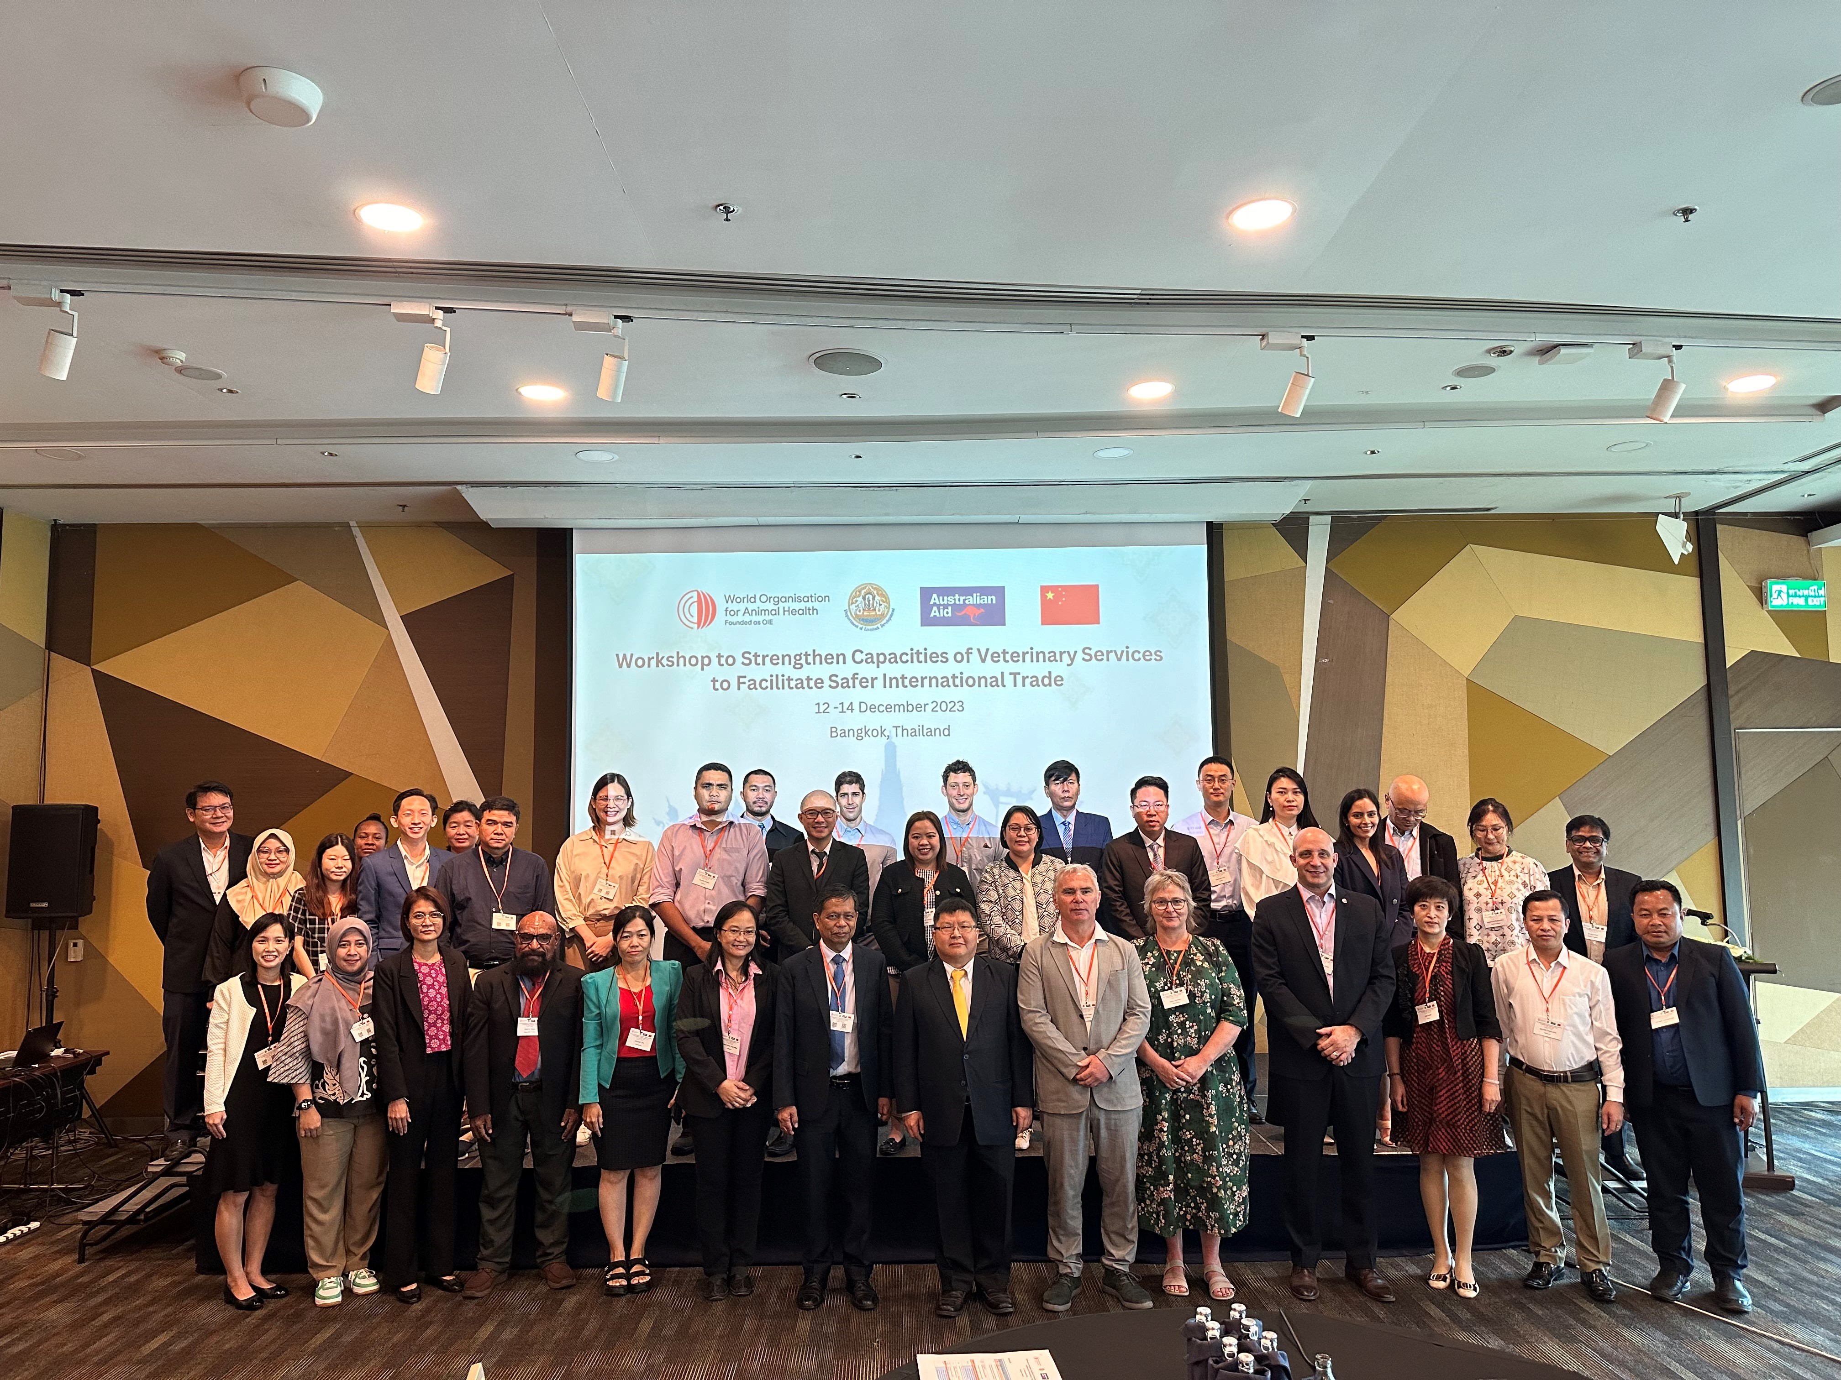
Capacity building on safe International trade
Strengthen capacities of Veterinary capacities to facilitate safer international trade workshop,Bangkok from 12-14 Dec,2023
Zoning and compartmentlisation approaches
Regionalisation
Please refer to the WOAH website for the resources here

Slide 35
Topic 4 : Summary
Overview of WOAH
Introduction to Animal Health Standards
Zoning and Compartmentlisation
Summary

Slide 36
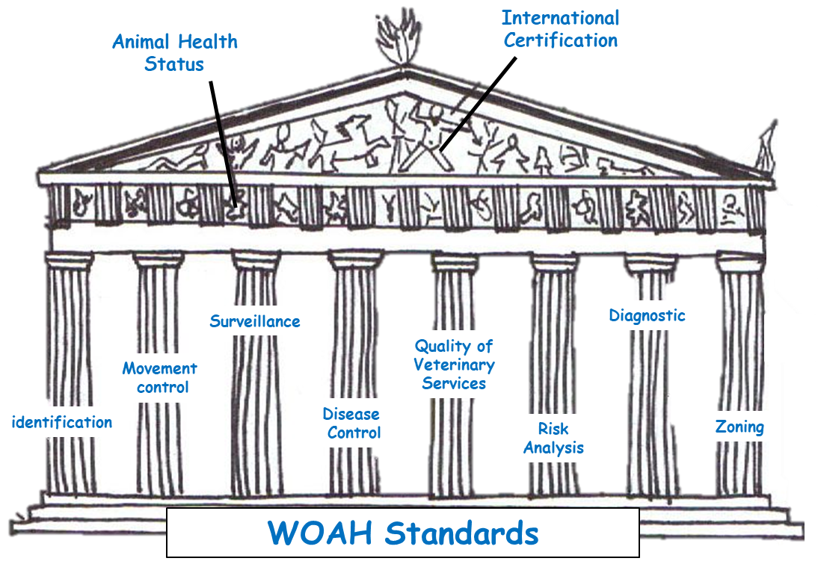
Summary
WOAH provides global leadership to improve animal health, welfare and sanitary governance.
WOAH Codes and Manuals provide for sound science-based risk management measures allowing safe trade.
International regulatory framework and WOAH standards contribute effectively to the global standard landscape to facilitate safe international trade.
Zoning and compartmentlisation are some of the tools used to control diseases and to facilitate safe trade.
Safe, fair, predictable and sustainable trade of animals and animal products

Slide 37
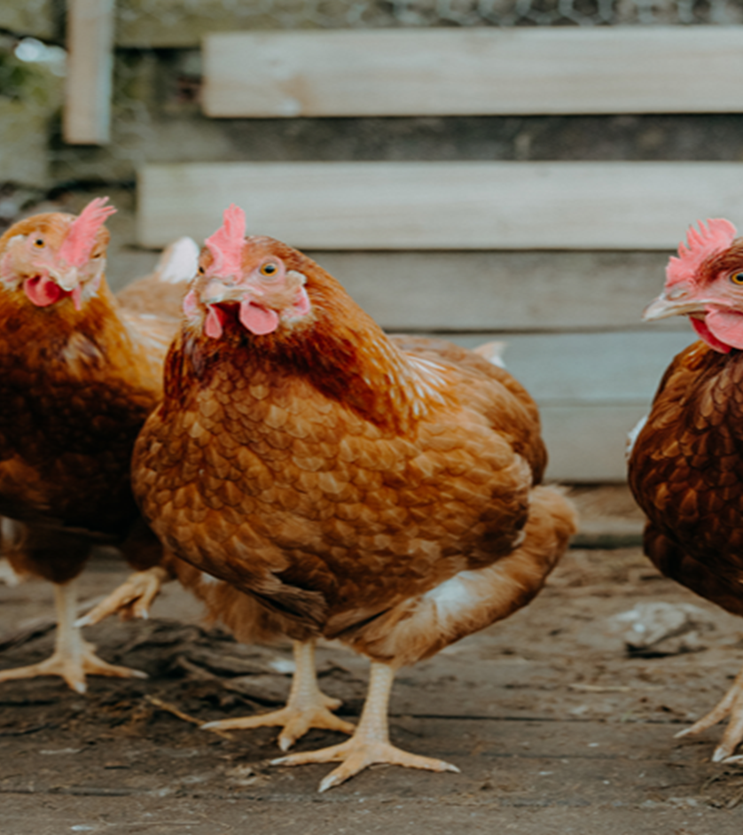
Thank you
Acknowledgement:
Francisco D’Alessio,
Deputy head, WOAH standards department,
WOAH Paris, France

