Slide 1
Prof. Andrea DIONISI European Commission DG Health & Food Safety
THE EUROPEAN COMMISSION IN THE SPS FIELDS: STRUCTURE AND DECISIONS
BTSF Bangkok 4-8 March 2024

Slide 2
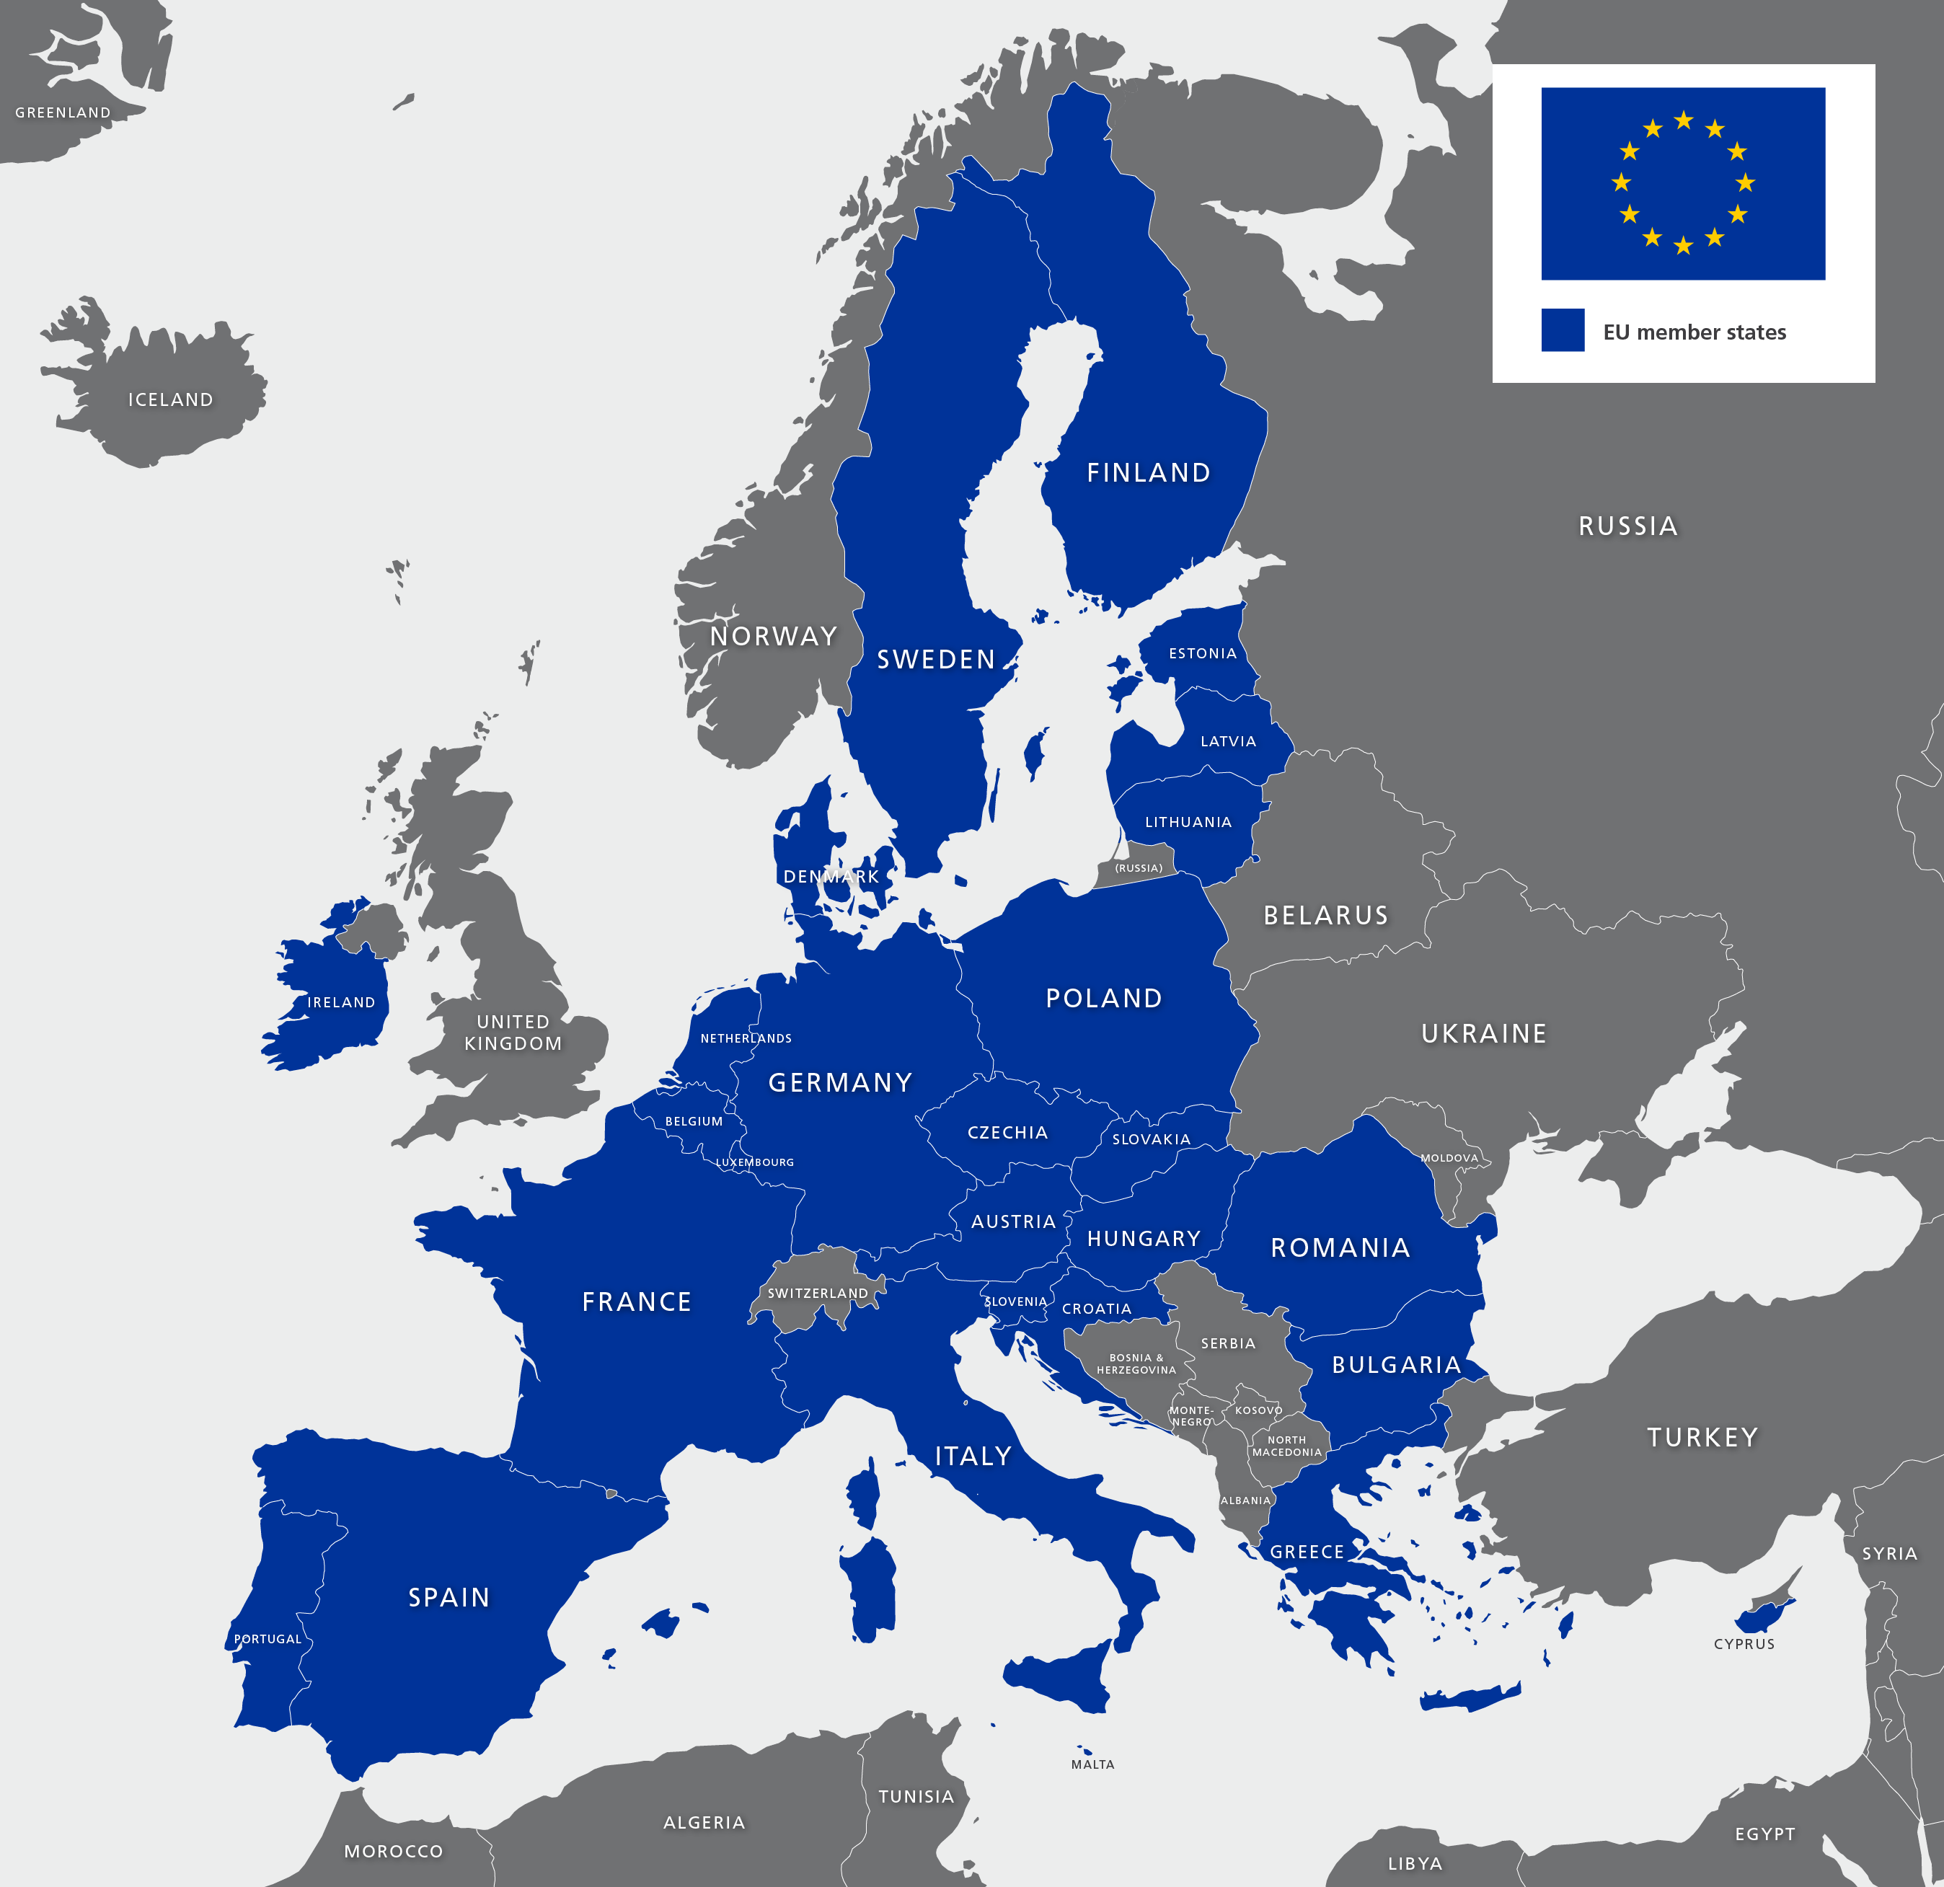
The European Union
27 Countries
Different structures and
and organization of controls
One policy
One set of animal health and
food safety rules

Slide 3
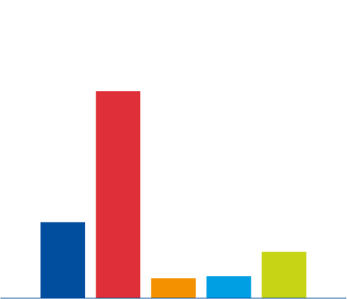
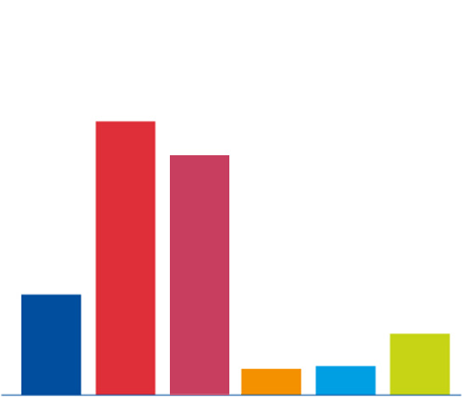
24 official languages - 500 million consumers
The European Union
1354
1215
508
318
127
143
EU
China
India
Japan
Russia
United States

Slide 4
EU Institutions and bodies
European Council
European Commission
European Parliament
Council of Ministers
Court of Justice and Court of Auditors
European External Action Services

Slide 5
European Commission
Proposes legislation
Enforces European Union Law
Sets objectives and priorities for action
Makes proposals
Manages and implements policies and budget
Trade agreements with non-EU countries

Slide 7
EU Commission - General Directorates
Economic and financial affairs
Environment
Agriculture and rural development
Communication
Energy
Education and culture
Justice and consumers
Competition
Trade
DG Health & Food safety
(SANTE)
8 Directorates: A, B, C, D, E , F, G and R
Notes:
7

Slide 8
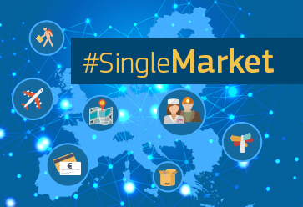
The European Union
It enables goods, services, money and people to move freely across “EU internal borders”.

Slide 9
The European Union
• An economic and political partnership.
• Based on the rule of law. Founded on Treaties voluntarily and democratically agreed by Member countries: binding agreements.
• Member States ceded part of their sovereignty which empowers the EU institutions to adopt laws.
• These laws take precedence over national laws and are binding on national Authorities.

Slide 10
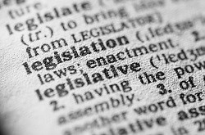
The EU legislation
The Treaties (Primary legislation): sets out EU objectives, rules for EU institutions, rules for decision-making, relationships between the EU and its member countries.

Slide 11
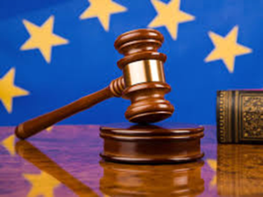
The EU legislation
• Regulations and Decisions are binding and directly applicable in all Member States. This means that once in force, the text becomes part of the national law in all Member States and supersede the national provisions.
• Directives are binding but need "National implementing measures" incorporating EU provisions (under EU scrutiny).
This traduces under the terms: "Member States shall ensure that … "

Slide 12
The EU legislation
• European Parliament and Council Regulations and Directives are primary legislation (directly based on the Treaty).
• Primary legislation may provide the Commission with implementing or delegated acts and quasi-legislative powers to be adopted in "Comitology". These procedures involve consultation with Member States and scrutiny by the European Parliament and the Council depending on the type of procedure.

Slide 13
Responsibilities and obligations
• Member States: implement and enforce EU legislation within their territory according to national administrative structures.
• Notify direct or indirect risks.
• Lay down the rules and sanctions applicable to infringement of EU law and implement them.

Slide 14
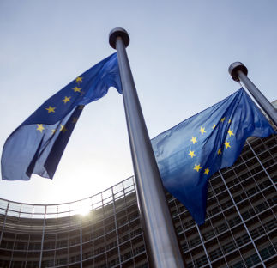
Responsibilities and obligations
The EU Commission promotes the common interest of the EU: four key roles.
• Right of initiative: proposes new legislation
• Executive organ: applies EU policies
• Guardian of the treaties: controls the application of the law
• Representation of the EU on the international stage

Slide 15
Responsibilities and obligations
• The EU Commission ensures that the EU law is properly applied.
• The EU Commission is responsible for overall coordination, inspection and audits of inspection systems and the necessary legislative action to ensure uniform application of standards and requirements within the Union's internal market.
• The EU Commission can bring a matter to the European Court of Justice (possibility of penalties) for MS incompliances

Slide 16
Responsibilities and obligations
• DG SANTE proposes policies on animal health, food safety,
plant health and public health.
DG SANTE carries out general and specific audits in Member States (and in non-EU countries): annual inspection programme / reports / recommendations / action plans / follow ups.
• The Commission takes emergency measures necessary to contain a risk (i.e. failure in a control system, possible risk for human, plant or animal health).

Slide 17
Responsibilities:
exports to non-EU countries
• EU legislation requires that products exported from the EU to a trade partenr shall comply with the relevant requirements of the EU legislation (unless otherwise requested by the importing Party).
• The Member States are responsible for the control of the production conditions and requirements, including statutory inspections and issuing health and animal welfare certifications attesting to compliance with trade partner's standards and requirements.

Slide 18
Responsibilities:
imports from non-EU countries
• EU import conditions are equivalent or identical to EU internal market requirements.
• The Member States are responsible for controlling compliance of imports with the Union’s import conditions.

Slide 19
Exporting to the EU: what does it mean?
27 EU Member States
Austria, Belgium, Bulgaria, Croatia, Cyprus, Czech Republic, Denmark, Estonia, Finland, France, Germany, Greece, Hungary, Ireland, Italy, Latvia, Lithuania, Luxembourg, Malta,
Netherlands, Poland, Portugal, Romania, Slovakia, Slovenia, Spain, Sweden
24 languages – almost 500 millions citizens
+ EFTA States
Iceland, Liechtenstein, Norway, Switzerland
+ Candidate countries to the EU
Albania, Montenegro, Serbia, North Macedonia, Turkey, etc.

Slide 20
DG Health and Food Safety (SANTE)
Where to place it?
Amongst different Institutions
Different competencies in comparison to MSs

Slide 21
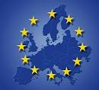
European Court of Justice
Commission
Parliament
DG TRADE
DG SANTE
Advisory group of the food chain
EU
Audits
Council
EFSA
National Government
Regulatory authorities
Control authorities
Evaluation bodies
Member States

Slide 22
DG Health and Food Safety
We aim to:
• protect and improve public health
• ensure Europe's food is safe and wholesome
• protect the health and welfare of farm animals
• protect the health of crops and forests

Slide 23
DG Health and Food Safety
Around 960 staff.
About 660 of us are in Brussels;
About 120 work in Luxembourg and
Another 180 in Grange, near Dublin.

Slide 24
DG Health and Food Safety
8 Directorates
Dir. A: One Health (International relations)
Dir D:Medical products and innovation
Dir. E Food safety sustainibilty, innovation
Dir. F Health and Food Audits and Analysis
Dir. G Crisis preparedness in food, animals and plants
Staff: +/-960

Slide 25
Directorate A –One Health
Unit A1 AMR, human nutrition
Unit A2 Inter-institutional relations
Unit A3 Communication
Unit A4 Multilateral international relations
Unit A5 Bilateral international relationship

Slide 26
Directorate F – Health and food audits and analysis
Unit F1 Food
Unit F2 Animals and BTSF
Unit F3 Plants and organics
Unit F4 trade related controls residues and feed safety
Unit F5 health protection
Unit F6 audit programming and planning, enforcement

Slide 27
Directorate G –Crisis preparedness in food, animals, and plants
Unit G1 Plant health
Unit G2 Animal health
Unit G3 Animal welfare
Unit G4 Official controls
Unit G5 Food hygiene, feed and frauds

Slide 28
DG Health and Food Safety
• General principles: risk analysis and scientific basis, precautionary principle, transparency
• Right of consumers to safe food and to accurate and honest information
• EU commitment to follow international obligations
•« Food and feed exported (or re-exported) from the EU for placing on the market of a non-EU country shall comply with the relevant requirements of food law, unless otherwise requested by the authorities of the importing country … »
Notes:
Article 12 Food and feed exported from the Community
Food and feed exported or re-exported from the Community for placing on the market of a third country shall comply with the relevant requirements of food law, unless otherwise requested by the authorities of the importing country or established by the laws, regulations, standards, codes of practice and other legal and administrative procedures as may be in force in the importing country. In other circumstances, except in the case where foods are injurious to health or feeds are unsafe, food and feed can only be exported or re-exported if the competent authorities of the country of destination have expressly agreed, after having been fully informed of the reasons for which and the circumstances in which the food or feed concerned could not be placed on the market in the Community.
Where the provisions of a bilateral agreement concluded between the Community or one of its Member States and a third country are applicable, food and feed exported from the Community or that Member State to that third country shall comply with the said provisions.
An integrated « Farm to fork approach »:
high level of protection of human life and health
covers: all foods (animal and plant origin) all feeds (for food producing animals), animal health and welfare, hygiene, contaminants and residues, novel food, additives, flavourings, packaging and irradiation

Slide 29
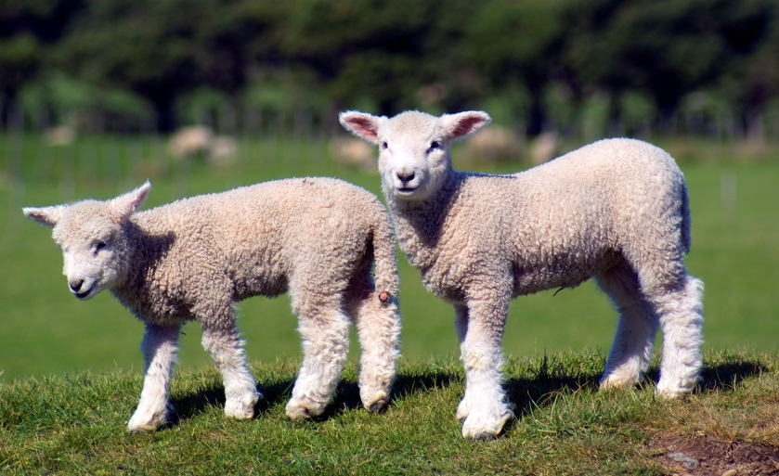
DG SANTE I
One Health
Zoonoses
Antimicrobial resistance
DG AGRI and DG TRADE
Sustainable food systems
Trade agreements
European Food Safety Authority (EFSA)
Independent, scientific and transparent

Slide 30
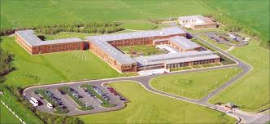
DG SANTE II
Directorate for Health and food audits and analysis
Standing Committee on Plants, Animals, Food and Feed (PAFF Committees)
Union measures practical and effective
opinions on draft measures that the Commission intends to adopt
TRACES NT
multilingual online sanitary and phytosanitary certification system
RASFF
reporting food safety issues

Slide 31
International agreements
Main objectives:
to follow international standards
proportionality, transparency, non-discrimination and scientific justification
single entity
regionalisation
systems audits
equivalencies - tbc
transparancy, transparency, transparency = TRUSTT!!

Slide 32
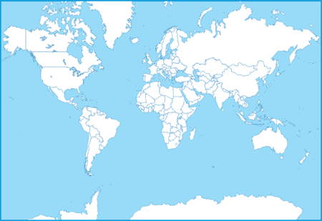
SPS Agreements
AM;UZ;TJ;
KZ;KG;AZ
Ukraine
Republic of Moldova
Switzerland and Liechtenstein
Canada
Georgia
Andorra and Faeroe Island
EU accession: SAA
European Economic Area
Philippines
USA
Japan
Mexico
India
South Korea
Central America
Cariforum
San Marino
Malaysia
Vietnam
Mercosur
Singapore
Tunisia
Thailand
Colombia, Peru
Indonesia
Morocco
& Ecuador
New Zealand
Chile
Australia
Agreements in force (SPS component)
Veterinary Agreements
Negotiations concluded
Ongoing FTAs negotiations
Negotiations halted

