Slide 1
REGIONAL WORKSHOP ON ANIMAL HEALTH:
DISEASE PREPAREDNESS, VACCINATION AND ONE HEALTH APPROACH
Disease awareness and preparedness: Animal Health
Dr Marius Masiulis
BANGKOK, THAILAND / 4-8 MARCH 2024

Slide 2
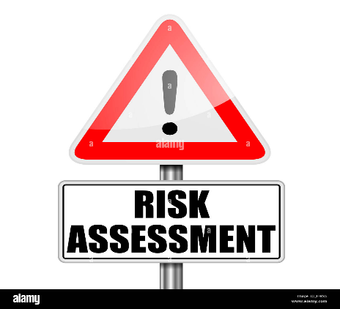
Animal Health
Outline
Animal disease control in the EU
Definitions and terms
How do we prepare for threats and hazards?
Risk assessment
Awareness
Notes:
2

Slide 3
With the signature of the General Agreement on Tariffs and Trade (GATT) and the implementation of the World Trade Organization (WTO) the trade of products of animal origin changed on the aim of the Agreement for the application of Sanitary and Phytosanitary measures (SPS).
Presently it is not possible to impose commercial barriers without having epidemiological data to justify it.
In this context it is necessary to have updated and quality information about the sanitary status of animal populations.

Slide 4
Some terms for the start…
What is preparedness?
“A state of readiness, preparation for an event“… Getting ready for something.
What is emergency preparedness?
In case of (animal disease) emergency it is:
the prior development of all necessary infrastructure needed for rapid response (and early detection) in case of an animal disease outbreak.

Slide 5
Some terms for the start…
What is an emergency preparedness plan?
It is high level document that includes all the activities required to prepare for the occurrence of the emergency (and prioritizes between them).
Basically, what needs to be done in order to get prepared.
What is a preparedness program?
It is the overarching program which makes the preparedness priorities into a set of actions.

Slide 6
Some terms for the start…
What is a contingency?
“An unusual and unpredictable event”. It may or may not occur
What is a contingency plan (~ crisis management plan~)?
It is a practical tool that can be used when an extraordinary incidence (outbreak of animal disease) occurs.
It is an essential element of the emergency preparedness.
There are multiple approaches to do it, but in all cases, it should detail what the government will do from the point of a suspect animal disease case is reported.

Slide 7
Emergency Preparedness Cycle
Emergency Preparedness Cycle
Plan
Equipment
Training
(Simulation) exercises
Applied in a targeted and structured manner to raise the level of preparedness

Slide 8
Early warning & preparedness
Early disease detection of an exotic disease is the key to maintain animal health and effective disease surveillance.
The challenge is to reduce as much as possible the time needed to detect the disease in the field or to suspect its occurrence.
Factors that delay the early detection can be, namelly:
Underestimation of the risk of introduction;
Low disease awareness -> under-reporting of disease suspicion;
Deficient epidemiological and diagnostic procedures;
Veterinary Official Services:
Insufficient availability of up-to-date epidemiological information from neighbouring countries;
Diagnostic Laboratory.
PASSIVE SURVEILLANCE

Slide 9
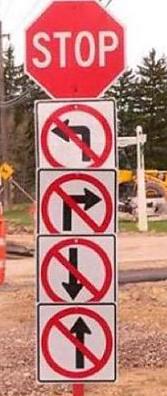
Disease prevention – be prepared!
Prevention of disease incursions from other countries by trade, traffic (private, commercial) or any other movements;
Prevention of spread within country, zone and region;
Prevention of spread to other countries.
Notes:
9

Slide 10
How do we prepare?
We need to understand:
landscape, livestock population, wildlife and human population, impact…;
endemic diseases.
Understand capacity for detecting threats:
Data capture, synthesis and analysis
Proxy indicators – trade, travel, climate, time and etc…
Understand concerns in terms of impact:
Where are the priorities - public health, animal welfare, economic (trade), biodiversity…

Slide 11
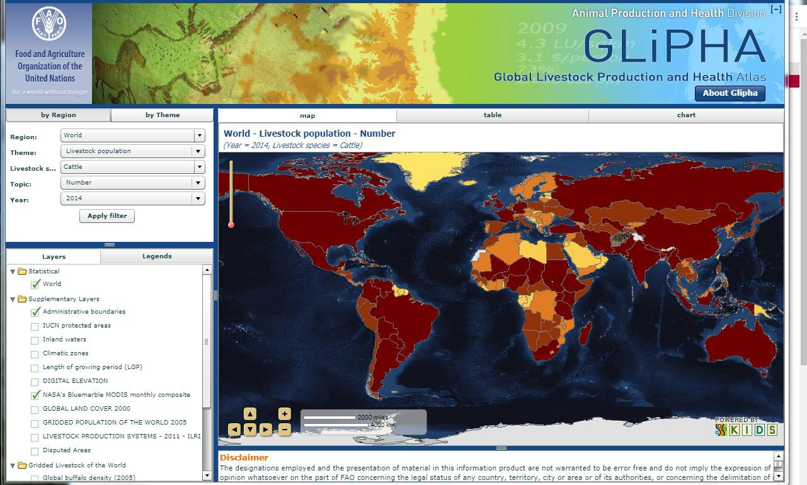
Understand population

Slide 12
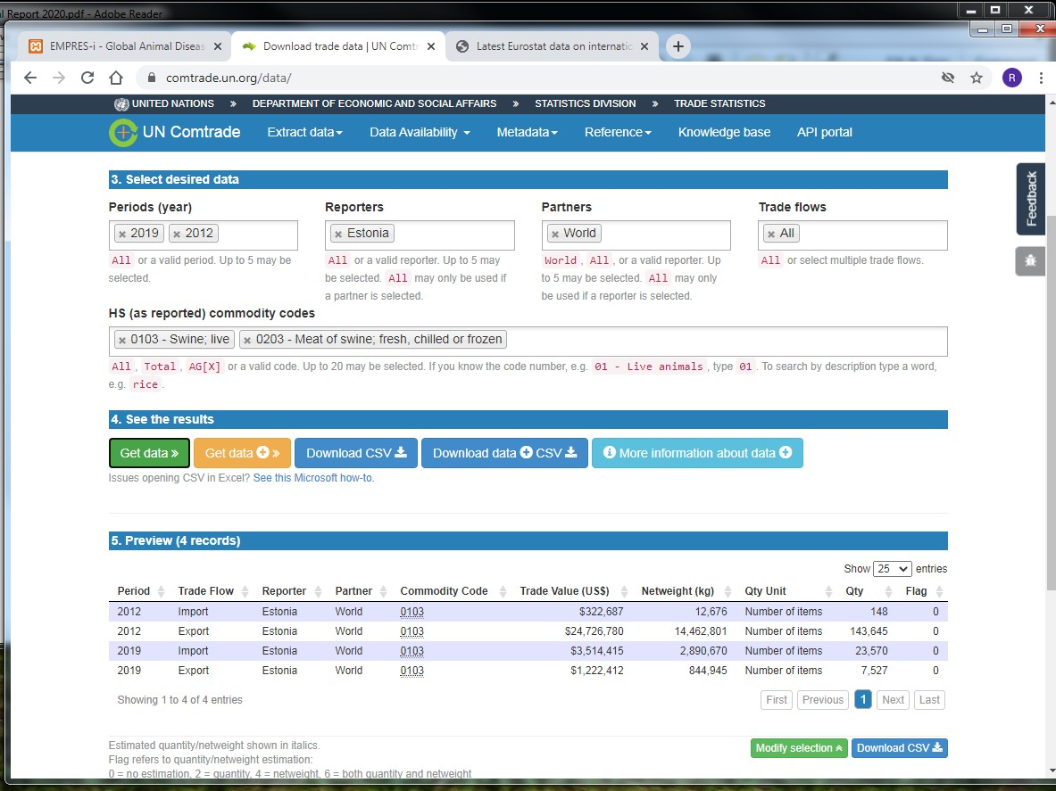
Understand impacts
https://comtradeplus.un.org/

Slide 13
Understand your data needs
World Animal Health Information System (WAHIS) - global animal health reference database of the World Organisation for Animal Health (WOAH) and data reflects the validated information since 2005 reported by the Veterinary Services from Member and non-Member Countries and Territories on terrestrial and aquatic Listed diseases in domestic animals and wildlife, as well as on emerging diseases and zoonoses.
The EU Animal Diseases Information System (ADIS) is designed to register and document the evolution of the situation of important infectious animal diseases as identified by the categorisation process performed in the framework of the Animal Health Law (AHL). The EU countries and the other countries connected to the application are responsible for supplying ADIS with the necessary information.
EMPRES Global Animal Disease Information System (EMPRES-i) is a web-based application that has been designed by FAO's Emergency Prevention System (EMPRES) to support veterinary services by facilitating the organization and access to national, regional and global level disease data and information.

Slide 14
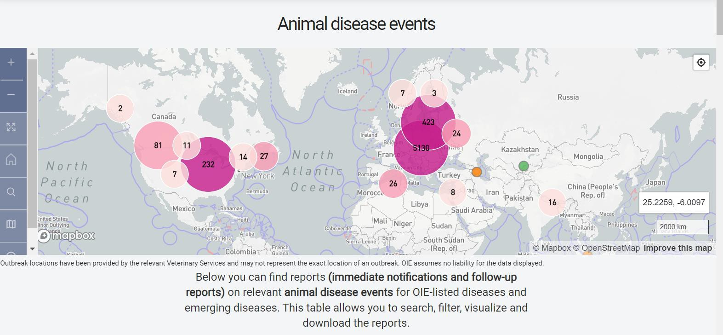
Understand your data needs
World Animal Health Information System (WAHIS)
https://wahis.woah.org/#/dashboards/country-or-disease-dashboard

Slide 15
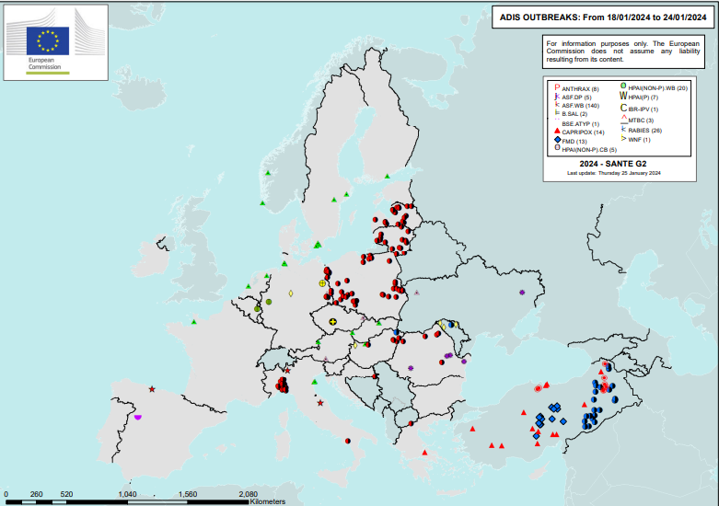
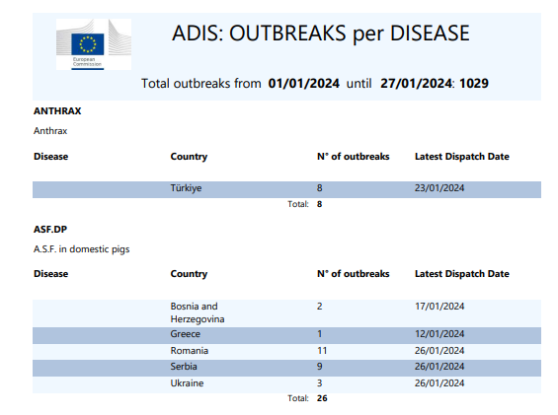
Understand your data needs
EU Animal Disease Information System (ADIS) (personal EU login)
Or public access: https://food.ec.europa.eu/system/files/2024-01/ad_adns_outbreaks-per-disease_weekly-map_1.pdf

Slide 16
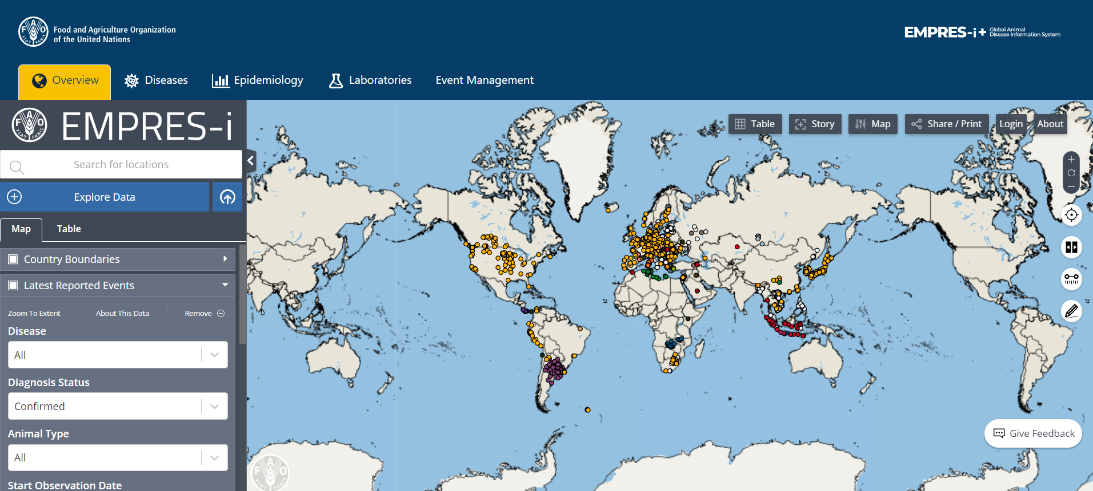
Understand your data needs
https://empres-i.apps.fao.org/

Slide 17
Be prepared!
Where will you detect the pathogen? Border, farm, slaughterhouse?
Can it spread easily?
Is it impact a trade?
Is it a zoonosis?
Does it impact on animal
welfare or biodiversity?
How many pathways for initial infection and for spread?
How easy is it to detect and
control?
How pathogenic is it in host species or others?

Slide 18
Respond! (Risk Management)
Official control at border or at destination;
Increased surveillance;
Animal disease investigation or control;
Communications to industry about border controls, biosecurity;
Must be proportionate and non-discriminatory;
Only short-term measures until safeguards are in place.

Slide 19
Assess your risk
In the importation of a product/species that was not previously considered;
On imports of products/animals of a new country;
When there is a change of the sanitary situation of the country;
When there are new data about a disease;
In the process of regionalisation;
On the promotion of export of products.
“ 15) The risk assessment should be based on the available scientific evidence and undertaken in an independent, objective and transparent manner. Due account should also be taken of the opinions of the European Food Safety Authority (EFSA) ”
EU Animal Health Law

Slide 20
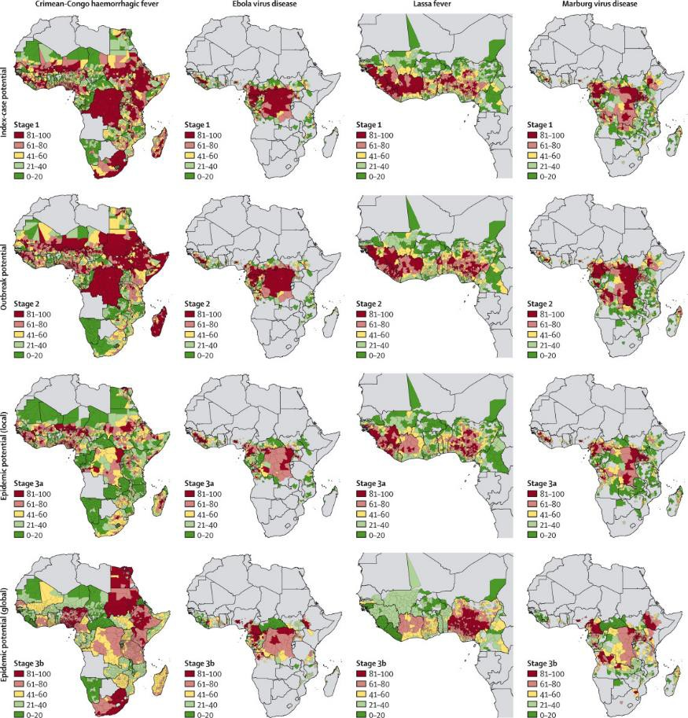
Typical risk factors: travel, trade or climate
Hot spots for emerging diseases or for changes in disease distribution can be identified from areas where several risk factors converge:
Livestock, humans, wildlife, climate, poor animal disease detection, travel and trade…
When you overlap them all you may be able to predict where threats come from.

Slide 21
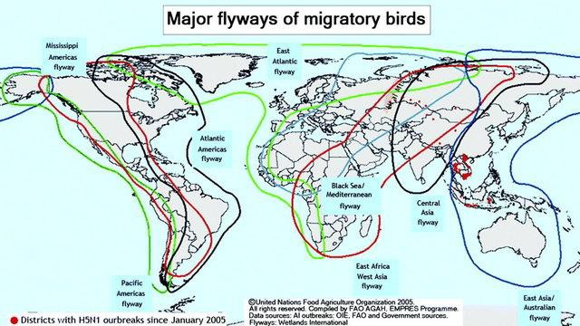
Predicting the wildlife threat
Highly pathogenic avian influenza in wild birds leads to unnecessary trade bans;
Endemic countries – where disease is not reported on a regular basis;
Wild bird risk is ever present;
Biosecurity is vital to prevent spread even if incursion cannot be prevented;
Network of laboratories is vital.

Slide 22
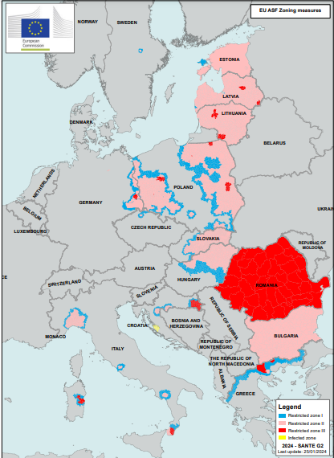
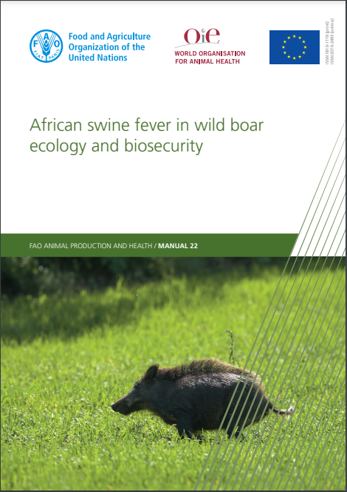
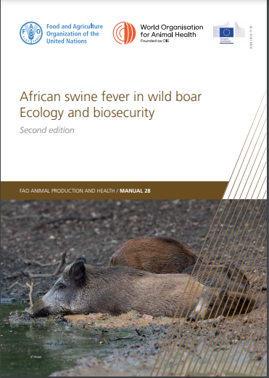
African swine fever: controlling wildlife risk
https://food.ec.europa.eu/animals/animal- diseases/diseases-and-control- measures/african-swine-fever_en
Restricted zones I, II and III listed in Annex I of Commission Implementing Regulation (EU) 2023/594 of 16 March 2023 laying down special disease control measures for African swine fever and repealing Implementing Regulation (EU) 2021/605
African swine fever in wild boar (fao.org): https://www.fao.org/documents/card/en/c/ cc0785en

Slide 23
Awareness
Animal diseases are transmitted through direct contact between animals or between animals and humans. Transmitted also through water and air systems, vectors etc.
Disease agents may also be contained in food and other products of animal origin
Various other objects such as transport vehicles, equipment, fodder, straw may diffuse disease agents
Therefore, awareness among «all players» about the risks - all paths of infection and material involved, and preventive measures are crucial!

Slide 24
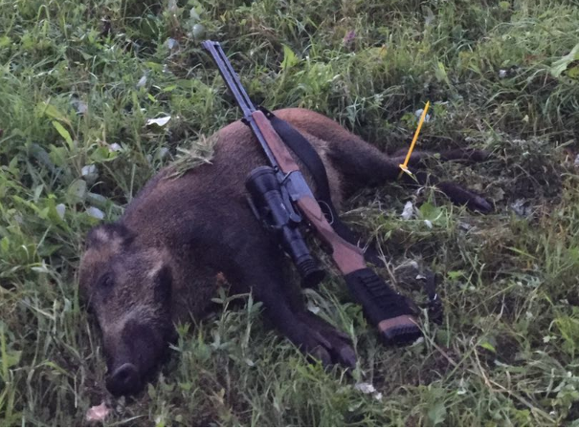
Example: awareness in legislation (ASF)
CHAPTER VI
SPECIAL INFORMATION AND TRAINING OBLIGATIONS IN THE MEMBER STATES:
Article 57 Special information obligations of the Member States concerned (…) Member States concerned shall organize and carry out regular public awareness campaigns to promote and spread information on the special disease control measures...
Article 58 Special trainings obligations of the Member States concerned: MS shall organize and carry out regularly or at appropriate intervals specific trainings concerning the risks of African swine fever and possible prevention, control and eradication measures for at least the following targeted groups:
(a) veterinarians;
(b) farmers keeping porcine animals and other relevant operators and transporters; (c) hunters.
Article 59 Special information obligations of all Member States
* Commission Implementing Regulation (EU) 2023/594 of 16 March 2023 laying down special disease control measures for African swine fever and repealing Implementing Regulation (EU) 2021/605

Slide 25
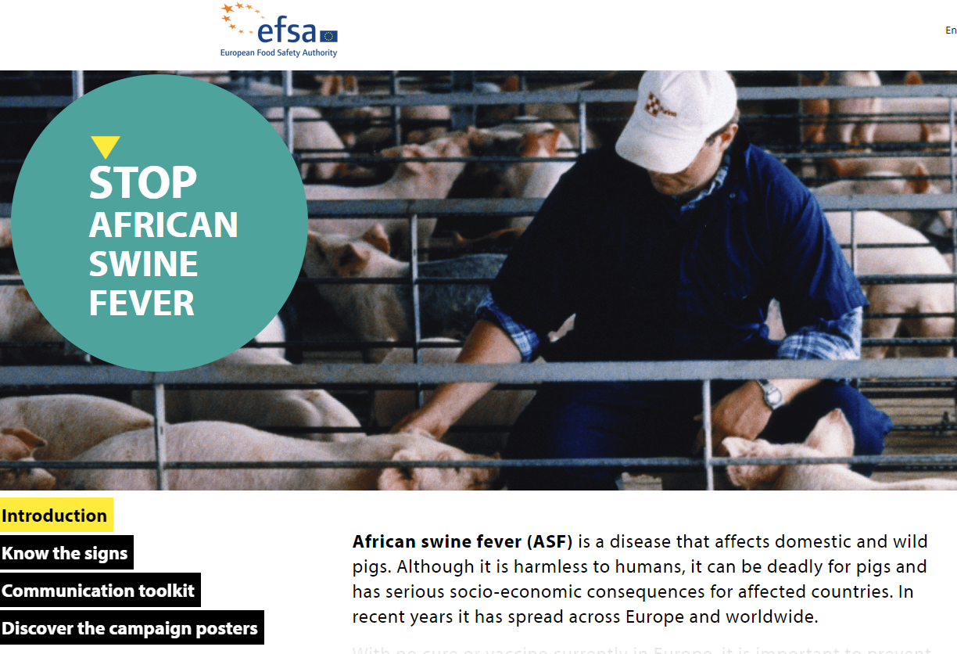
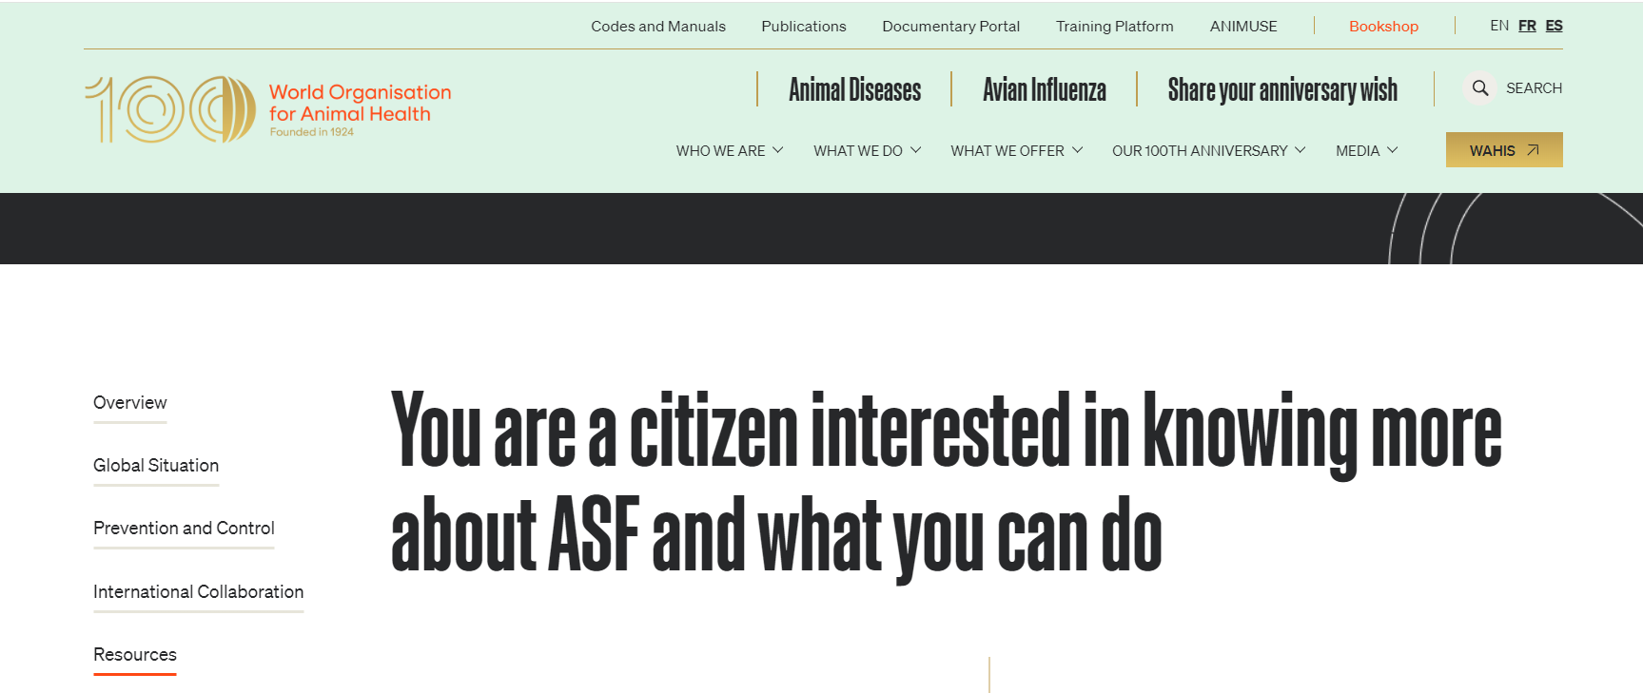
Example: awareness
- Awareness Materials
https://www.woah.org/en/disease/african-swine-fever/#ui-id-5
https://multimedia.efsa.europa.eu/asf/#/

Slide 26
Early warning
At Farm level (holdings)
Handling of early warnings at national level
Handling of early warnings at international level
Notes:
26

Slide 27
Early warning – information flow from national to international level
Early detection and a clear chain of disease notification and reporting are crucial for effective disease control.
To achieve an efficient response, any suspicion or confirmation of an outbreak should be immediately notified to the competent authority – awareness!!
In the EU, Member State has an obligation to immediately notify the European Commission and the other countries about an outbreak.

Slide 28
Early warning – information flow at national level
Veterinarians are key actors in the investigation of diseases and a key link between operators and the competent authority.
Veterinarians should be notified by the operator in cases of abnormal mortalities, other serious disease problems, significantly decreased production rates, etc.

Slide 29
Main actors for information flow
Persons (Operators) working with animals are the cornerstone of any surveillance.
They observe animals on a regular basis and are best positioned to detect serious disease symptoms - they have first–hand knowledge of the animals under their care.
They bear primary responsibility for carrying out measures for the prevention and control of the spread of diseases among animals and the monitoring of products under their responsibility.
They should maintain up–to–date records of information which is relevant for assessing the animal health status, for traceability and for an epidemiological enquiry.

Slide 30
Main actors
Veterinarians ensure the early detection of diseases. They play an important role in arising awareness about disease prevention and provide rapid response if disease is detected.
Competent authorities for animal health – take actions and apply measures, conduct surveillance.
! To provide all these measures qualified personnel, facilities, equipment, financial resources are crucial.
National diagnostic laboratories – provide disease diagnostic and differential diagnostic procedures to confirm or rule out the disease.

Slide 31
Conclusion
Knowledge on animal health, including on disease symptoms, consequences of diseases and on preventive tools and control, is a prerequisite for efficient animal health management.
Competent authorities for animal health, are amongst the key actors in the prevention and control of transmissible animal diseases - plays an important role in relation to preparedness, surveillance, eradication, control, contingency planning and raising awareness.
Optimal animal health management can only be achieved in cooperation with animal keepers (operators), veterinarians, other stakeholders and trading partners.

Slide 32
Keep in touch
ec.europa.eu/
europeancommission
europa.eu/
@EuropeanCommission
@EU_Commission
EUTube
@EuropeanCommission
EU Spotify
European Commission
Notes:
Delete/update as appropriate

Slide 33
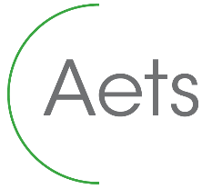
17 Avenue André Marie Ampère, Induspal Lons
64140 Lons – France
Phone : +33 5 59 72 43 23
https://thetrainingplace.eu
Avenue de Tervuren 36
1040 Brussels – Belgium
Phone: +32 2 736 22 77
https://aesagroup.eu/
Notes:
Update/add/delete parts of the copy right notice where appropriate.
More information: https://myintracomm.ec.europa.eu/corp/intellectual-property/Documents/2019_Reuse-guidelines%28CC-BY%29.pdf

