Slide 1
REGIONAL TRAINING WORKSHOP ON “ANIMAL HEALTH: DISEASE PREPAREDNESS, VACCINATION AND ONE HEALTH APPROACH’’
Bangkok, Thailand / 04-08 February 2024

Slide 2
Contingency planning
Stefano Marangon
Bangkok, Thailand / 04-08 February 2024

Slide 3
Epidemic disease emergencies
Emergency: a serious, unexpected and harmful event that requires immediate action and availability of extra resources
Disease emergency: introduction of a highly contagious disease in a free country or zone (exotic diseases such as FMD, HPAI, ASF, CSF)
The aim of contingency planning is to arrange in advance for an epidemic that may or may not happen, if it happens:
disease control and eradication actions shall be immediately enforced
necessary resources must be available
a legal and administrative framework shall be in place

Slide 4
Control of epidemic diseases
Efficacy of disease control measures → capacity to limit the initial spread of infection during the high risk period of an epidemic:
application of good biosecurity and hygienic standards (difficult to sustain in the long term)
rapid identification of disease introduction (early detection)
prompt enforcement of appropriate disease control policies

Slide 5
Contingency planning
Regulation (EU) 2016/429 (“Animal Health Law”)
The rapid implementation of adequate disease eradication measures is associated to the level of preparedness of the veterinary services:
a contingency plan should be developed in times of peace
In case of infection the prompt execution of the measures reported in the contingency plan is critical in limiting the magnitude of the epidemic
EU Member States must set up and continuously update contingency plans and instruction manuals for transboundary animal diseases

Slide 6
Contingency planning
Regulation (EU) 2016/429 (“Animal Health Law”)
A contingency plan
Describes the organization of the system to be implemented for an effective disease control
Identifies the resources which must be available to make the system operational (resource manual)
Provides up-to-date information on the procedures to be applied and the actions to be taken with suspected and confirmed outbreaks of a certain disease (operational manual)

Slide 7
Contingency planning
Regulation (EU) 2016/429 (“Animal Health Law”)
Legal powers
Financial provisions
Chain of command
National and local disease control centres
Operational expert groups
Resources required for disease emergencies
Instructions for managing notifiable exotic diseases
Diagnostic laboratories
Plans for emergency vaccination
Training - Publicity - Disease awareness

Slide 8
Legal powers
Veterinary services must have legal powers to guarantee that the control and eradication of a notifiable disease are promptly successful
Reference to the legislation containing the legal powers relevant for disease eradication shall be made in the contingency plan
The legal powers shall encompass:
The notification of suspected exotic disease
The access to establishments keeping animals

Slide 9
Legal powers
The access to documents and records for epidemiological investigation
The killing of infected and contact animals
The destruction of carcasses and contaminated materials
The payment of compensation
Sanitation and other procedures at infected premises
The control of movements and other restrictions
Vaccination

Slide 10
Financial provisions
The costs of an epidemic can be huge
FMD type O epidemic in UK 2001
> 2,000 outbreaks
≈ 6 million animals culled
£ 8b total impact for UK economy
H5N2 HPAI epidemic in USA 2014-2015
279 outbreaks
≈ 50.5 million birds stamped out
$ 1.6b direct costs
$ 3.3b total impact for the USA economy

Slide 11
Financial provisions
A Country must have the budgetary powers resources to cover the costs of an epidemic:
Personnel (well above normal operating costs)
Capital equipment and consumable items
Laboratory testing
Culling, destruction of carcasses/contaminated material, and sanitation
Compensation payments to livestock owners
Emergency vaccination, if needed
The cooperation of farmers is fundamental and it can be relied on only if compensation for depopulated animals is paid promptly

Slide 12
Chain of command
A clear-cut chain of command shall be established. It should be:
Understood by all who are involved with disease eradication
Clearly described in the contingency plan
The chain of command can be different in various countries according to the organization of the veterinary services
The CVO should be ultimately in charge of eradication operations and should establish and coordinate the National disease control centre

Slide 13
National disease control centre (NDCC)
The NDCC must direct and verify the operations of the Local disease control centres (LDCCs)
Responsibilities of NDCC include:
Definition and overall direction of control strategies
Ensuring that the LDCCs implement them promptly and effectively
Deployment of staff and other resources
Provision of information to National and International authorities and organizations (transparency)
Liaison with diagnostic laboratories, and liaison with the media

Slide 14
Local disease control centre(s)
LDCC(s) shall be established in the affected area(s) and shall be responsible for the enforcement of eradication and surveillance measures within their territory
A veterinarian shall be directly in charge of the centre with the powers to:
Designate an establishment as an “infected premises” and deploy the necessary staff, materials and equipment to infected sites

Slide 15
Local disease control centre(s)
Arrange valuation and culling of infected and contact animals, disposal of carcasses and contaminated material and sanitation procedures
Advise on delineation of protection and surveillance zones and impose movement restrictions
Close markets for live animals and abattoirs
Liaise with police, environmental and other authorities (e.g., movement control)

Slide 16
Disease control centre(s)
NDCC and LDCCs must be adequately staffed and equipped:
Suitable means of communication
Maps and other sources of information (access to livestock database, etc.)
Updated lists of organizations, staff and other persons who must be contacted
LDCCs must have direct availability to the resources required for disease emergencies (personnel, equipment, materials, facilities, ……..)

Slide 17
Disease control centre(s)
Disease control centres must have rapid access to up-to-date sets of data
Livestock data (e.g. list-database of livestock establishments)
Data on related plants (e.g. abattoirs, feed mills, hatcheries)
Inventory of services and emergency contact details of:
Veterinary authorities and other veterinary services
Enterprises/staff for eradication actions ( e.g. rendering plants, CO₂ suppliers, killing crews)
Other authorities involved

Slide 18
Disease control centre(s)
The prompt and effective implementation of eradication measures is also based on a close cooperation with other authorities:
Municipal authorities
Local/regional government
Police, civil defence, army, fire brigade, environment authorities (e.g. for disposal of carcasses), etc.
Financial services for compensation of farmers
………………………………………

Slide 19
Resources for disease emergencies
Personnel
One of the most critical resource factors is the immediate availability of trained and experienced personnel
lists of the staff trained and available for a disease emergency shall be established and maintained
International support teams like the EU Emergency Veterinary team

Slide 20
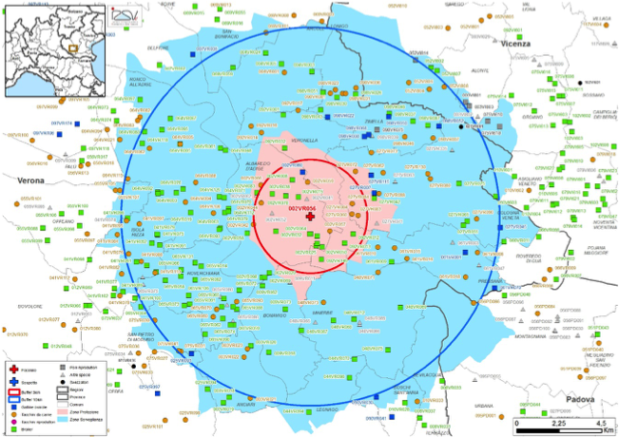
DPPA – Restriction areas

Slide 21
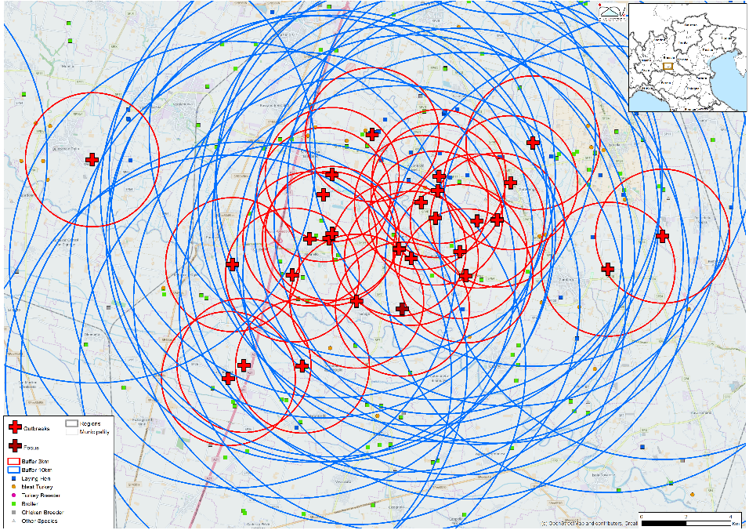
DPPA – Restriction areas

Slide 22
Resources for disease emergencies
Stamping out
Standing arrangements/contracts for culling and disposal of carcasses, and cleansing and disinfection of infected premises:
Culling crews and all equipment and materials to rapidly enforce stamping out measures (destruction method)
Rendering plants (capacity)
Equipment and staff for cleansing and disinfection
………………………….

Slide 23
Instructions for dealing with exotic diseases
The operational manual contains a set of instructions and detailed procedures for dealing with disease outbreaks
It describes the actions to be taken:
In the event of a suspected outbreak
Where disease is confirmed

Slide 24
Instructions for dealing with exotic diseases
Procedures at an ‘infected premises’
Isolation of the outbreak site
Valuation and compensation
Culling of animals
Carcasses and contaminated material disposal
Sanitation
Restocking

Slide 25
Instructions for dealing with exotic diseases
Epidemiological inquiry and movement tracing
A standardised form and system should be used
Establishment of restriction zones around the outbreak site
Inventory of all livestock establishments
Regular surveillance of all livestock establishments
Movement controls
Prohibition of markets, shows, etc.
…………………………………

Slide 26
Diagnostic laboratories
Regulation (EU) 2017/625
Disease control centres must have immediate and continuous access to a diagnostic facility
The contingency plan shall contain information on the available resources and the diagnostic capacity (Laboratory contingency plan)
In the European Union a network of National Reference Laboratories coordinated by the EU-Reference Laboratory is in place for each exotic disease

Slide 27
Emergency vaccination
The implementation of an effective emergency vaccination programme is related to the level of preparedness
The emergency vaccination programme must:
be part of the national contingency plan
include decision making patterns in different scenarios in order to allow a rapid decision on whether to vaccinate or not in the face of an epidemic

Slide 28
Training
Staff shall be regularly trained in procedures for detecting and eradicating exotic diseases
Publicity and awareness
Awareness of the disease shall be maintained within veterinary profession, agricultural community, etc., to guarantee a prompt notification of suspected outbreaks

Slide 29
Conclusions
Contingency planning is not the production of a “fancy” manual but the organization of a coordinated system that must become fully and promptly operational in case of a disease outbreak
In order to fulfil this objective the plan shall be:
widely distributed to stakeholders
regularly updated
regularly tested by means of external audits and simulation exercises
More modern IT based formats may be explored

Slide 30
Keep in touch
ec.europa.eu/
europeancommission
europa.eu/
@EuropeanCommission
@EU_Commission
EUTube
@EuropeanCommission
EU Spotify
European Commission
Notes:
Delete/update as appropriate

Slide 31
17 Avenue André Marie Ampère, Induspal Lons
64140 Lons – France
Phone : +33 5 59 72 43 23
https://thetrainingplace.eu
Avenue de Tervuren 36
1040 Brussels – Belgium
Phone: +32 2 736 22 77
https://aesagroup.eu/
Notes:
Update/add/delete parts of the copy right notice where appropriate.
More information: https://myintracomm.ec.europa.eu/corp/intellectual-property/Documents/2019_Reuse-guidelines%28CC-BY%29.pdf

