Slide 1
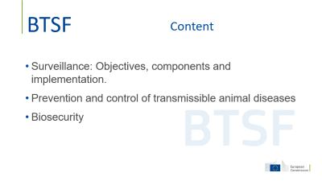
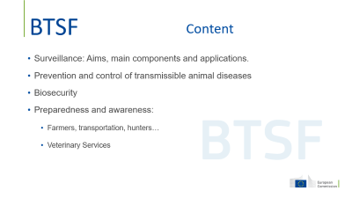
SURVEILLANCE, PREVENTIVE MEASURES AND BIOSECURITY
LUIS JOSÉ ROMERO GONZÁLEZ
Bangkok, Thailand / 4-8 March 2024

Slide 2
Content
Surveillance: Objectives, components and implementation.
Prevention and control of transmissible animal diseases
Biosecurity

Slide 3
Key elements for the management of epidemic diseases
PREVENTION (preparedness, bio-security)
EARLY DETECTION (surveillance)
CONTROL AND ERADICATION

Slide 4
Surveillance
Objectives of surveillance:
  Demonstrate the absence / presence of a disease or infection to support freedom status and provide guarantees to trading partners.
  Early detection of incursion, in order to adopt early control measures
  Monitor prevalence of diseases over time in a population, performance of control and eradication programs, provide data for risk analysis and management.

Slide 5
..in the WOAH Code surveillance is specifically required for:
Disease freedom (Country- Zone):
  Initial declaration
  Maintenance
Zoning & Compartment:
    Internal and
    external surveillance
Outbreak management
Surveillance must be adapted to evolving situations
5

Slide 6
High Risk Period
1 st High Risk Period
2 nd High Risk Period
The period between the introduction of an agent into a country and the first detection.
The period between the first detection and the setting up of effective control measures to prevent further virus spreading.
Outbreak Management
The length of the 1st HRP will affect the size of the epidemic
Contribute to reduce number of Secondary Outbreaks

Slide 7
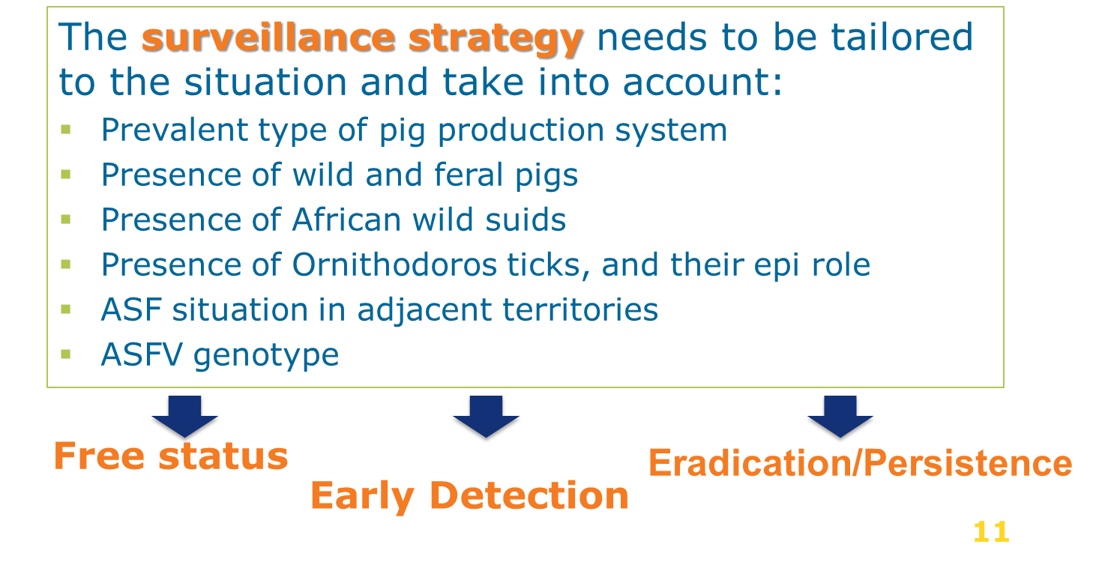
Surveillance Strategy (ASF)

Slide 8
Basic surveillance components
PASSIVE SURVEILLANCE: notification based on the immediate communication of suspicions of notifiable disease by any person in contact with the animals to the competent authority.
Cheap/continuous/covers the entire target population.
ACTIVE SURVEILLANCE: actively search for disease detection in animal population.
  Random sampling strategy → estimate prevalence / demonstrate presence or absence.
  Identification of risk factors: production systems, epi links, vector populations, density of animals → risk-based active surveillance

Slide 9
Requirements for passive surveillance
Clinical signs and lesions of the disease known by all stakeholders (farmers, vets, hunters, etc.).
Awareness of stakeholders regarding the impact and the need for immediate communication of compatible clinical signs and lesions.
Immediate communication to OVS of any suspicion case.
Immediate investigation by the OVS of suspicions including official sampling if necessary.
Reliable and rapid laboratory diagnosis to confirm or rule out suspicion.
Critical step: Immediate communication to OVS of suspicions

Slide 10
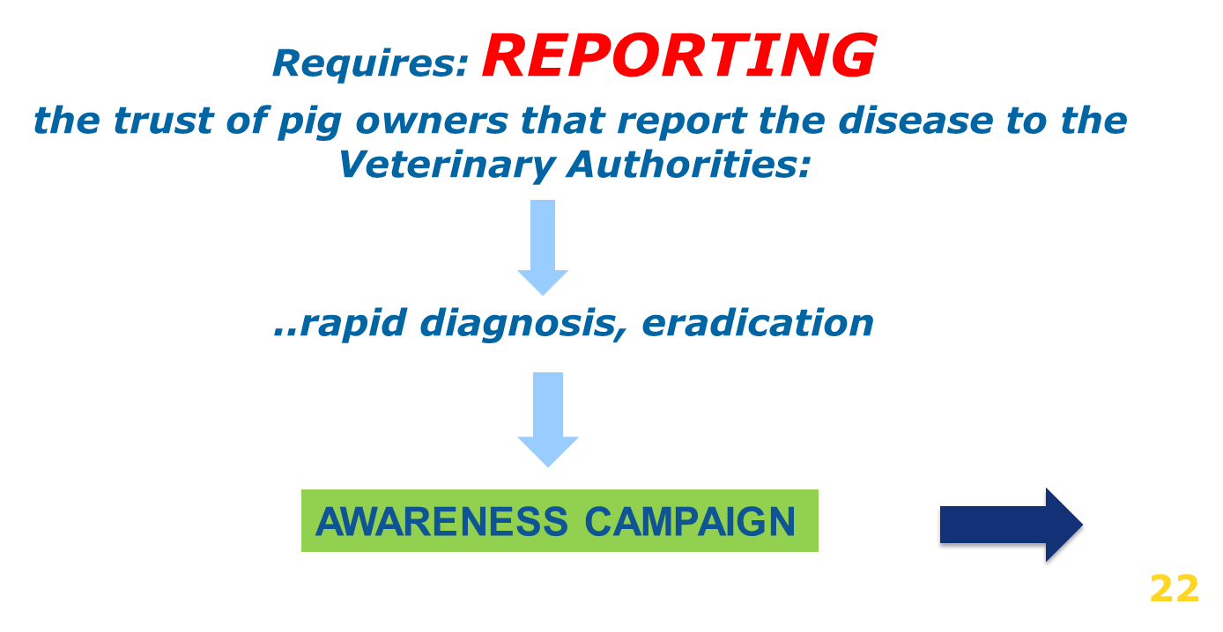
Passive surveillance: only effective surveillance for early detection
nobody will report what is unknown

Slide 11
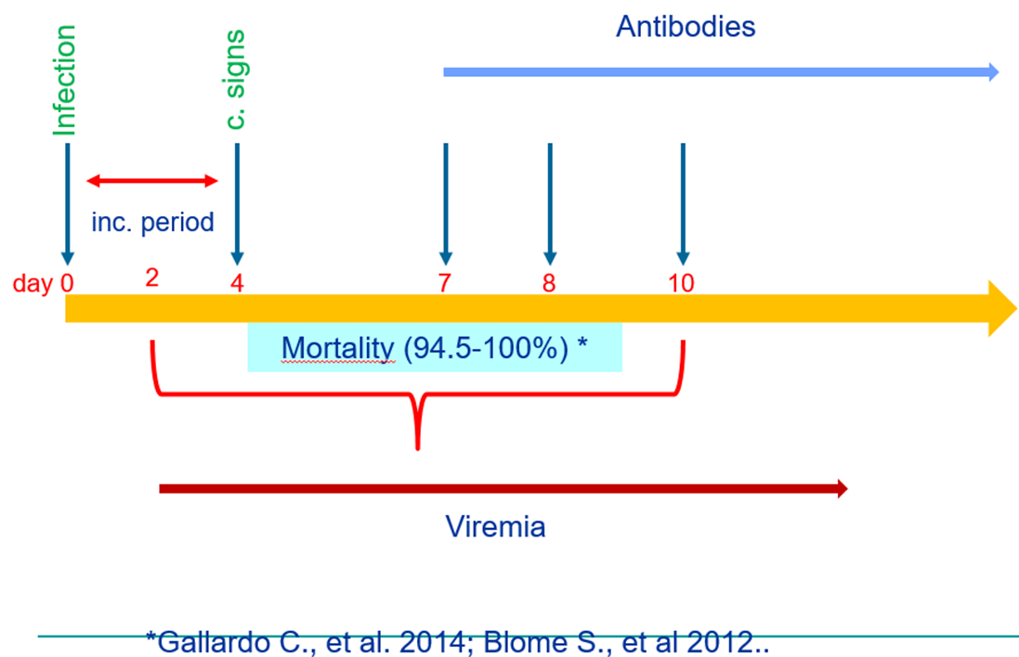
ASF Surveillance (acute form)

Slide 12
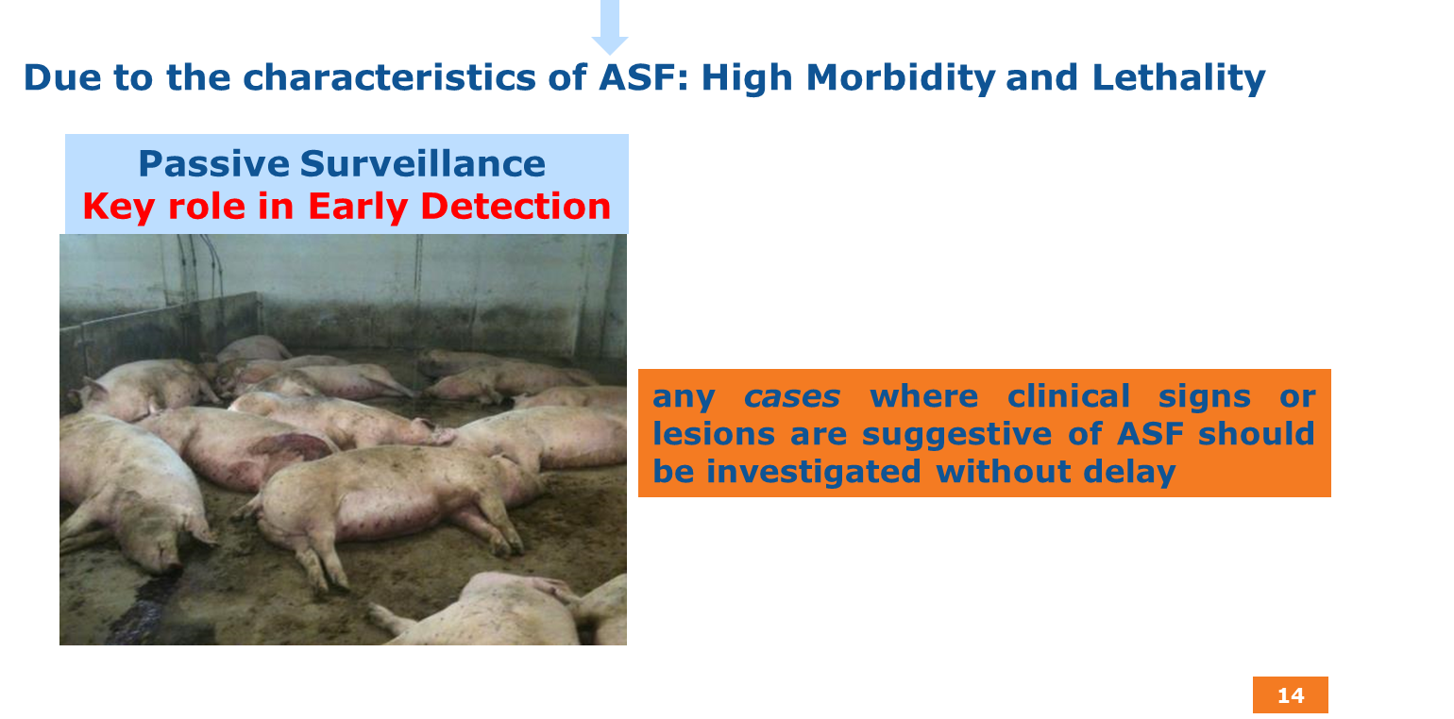
Clinical Surveillance

Slide 13
Virological surveillance
It is important for early detection, differential diagnosis and for systematic sampling of target populations. It should be conducted:
to investigate clinically suspected cases
to monitor at risk populations (epidemiological links)
to follow up positive serological results
13

Slide 14
Serological surveillance
Serological surveillance aims at detecting antibodies against the pathogen.
Positive antibody test results indicate contact with the agent (recent or past infection).
Precaution in case of vaccinated animals (¿DIVA?)
Serology is not suitable for Early Detection
14

Slide 15
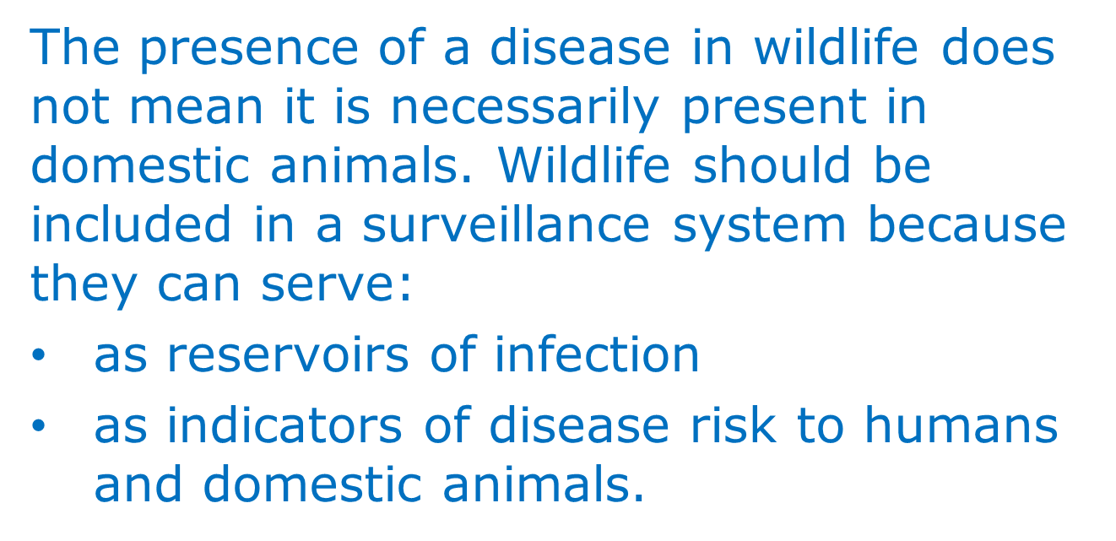
Surveillance: Wildlife
Role played by wildlife in the epidemiology of infection: reservoir
Epidemiological unit: the wildlife metapopulation that lives in a continuous geographic area delimited by natural or artificial barriers
Sample collection: how to collect sample? Hunters ? Timing: seasonal hunting, captures

Slide 16
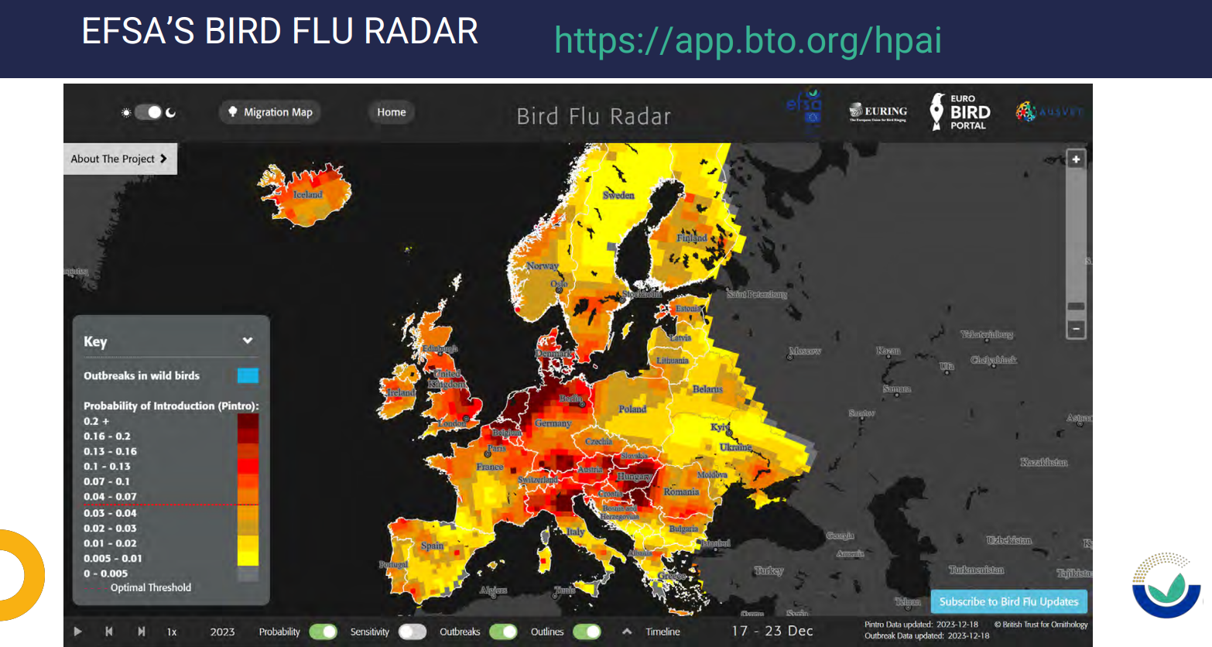
HPAI risk models: Bird Flu RADAR

Slide 17
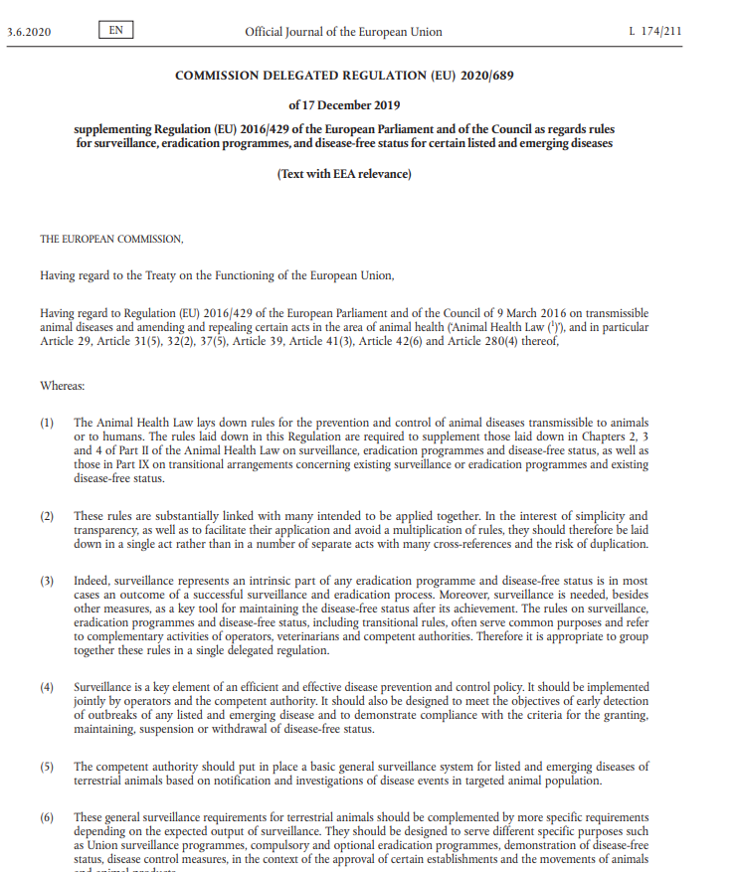
HPAI UE Legal framework
Commission Delegated Regulation (EU) 2020/687 as regards rules for the prevention and control of certain listed diseases
Commission Implementing Regulation (EU) 2020/690 as regards the listed diseases subject to Union surveillance programmes
Commission Delegated Regulation 2020/689 (Art. 10-11, and Annex II)→ Union Surveillance Program.
Commission Implementing Regulation (EU) 2020/2002 with regard to Union notification and Union reporting of listed diseases, to formats and procedures for submission and reporting of Union surveillance programmes.

Slide 18
Union surveillance programme for HPAI and Infection with LPAI viruses (Annex II CDR 2020/689)
Early detection of HPAI in poultry
change in production and health parameters (mortality rate, feed and water intake, egg production)
any clinical sign or post-mortem lesion suggesting HPAI; carcasses in risky areas
Early detection of HPAI in wild birds
targeted populations ⇨ EURL website
found dead, injured or sick, hunted with clinical signs
risk-based (relevant information on ornithology, virology, epidemiology and environmental matters): list of wild birds
may include active surveillance at priority locations linked to wild bird migratory movements (trapped / hunted healthy / sentinel birds)

Slide 19
Union surveillance programme for HPAI and Infection with LPAI viruses
(Annex II CDR 2020/689)
Detection of HPAI in poultry species not showing significant clinical signs
Ducks, geese, Anseriformes for supplies of game or quails
Risk factors
Detection of LPAI that may spread between flocks
Risk-based surveillance in areas with a high density
Establishments where clusters occurred in the past or are more likely to occur
Risk factors (cycle, age, species, BS practices)
Laying hens including free-range; turkeys; Galliformes for supplies of game
Sampling and laboratory methods: nº establishments/ frequency/ tests

Slide 20
SPECIFIC CONDITIONS FOR PREVENTIVE VACCINATION OF HPAI
(Annex XIII CDR 2023/361)
Reinforced surveillance in HPAI vaccinated establishments:
Enhanced passive surveillance shall be implemented by weekly virological testing of a representative sample of dead birds collected within one week;
Active surveillance has to be carried out by an official veterinarian every 30 days:
  a clinical examination (check of the production records and health records);
  a collection of representative samples for laboratory surveillance by serological or virological testing to enable detection of a prevalence of HPAI virus infection in the epidemiological unit of 5 % with a confidence level of 95 %, using appropriate methods and protocols that allow early detection of the virus and taking into account the specific characteristics of the vaccine used.

Slide 21
ASF Risk-based active surveillance → efficiency
Wild boar density + Highways resting areas
Wild boar density + pig holding density + bio-security (outdoor /indoor)

Slide 22


Campaign “Prevent feeding wild animals – It’s not natural” targeted at Society in general
Massive diffusion through social media and YouTube three campaigns in 2021, 2022 and 2023

Slide 23
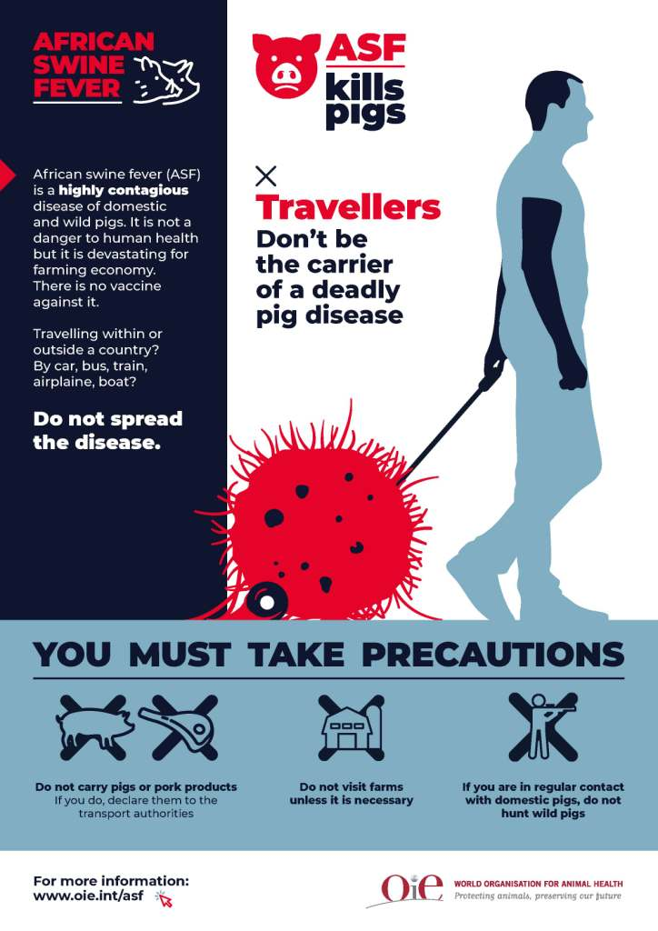
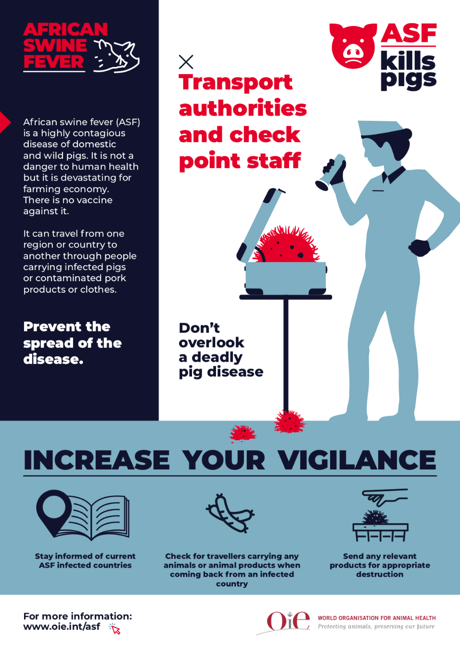
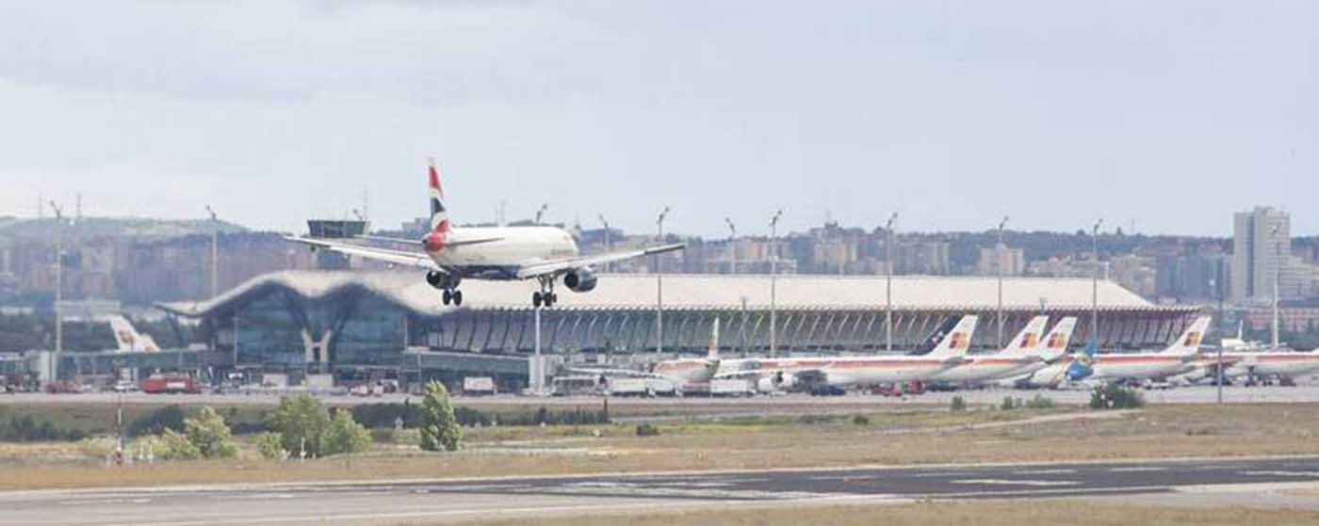
Awareness campaigns targeted at international travellers (ports and airports)

Slide 24
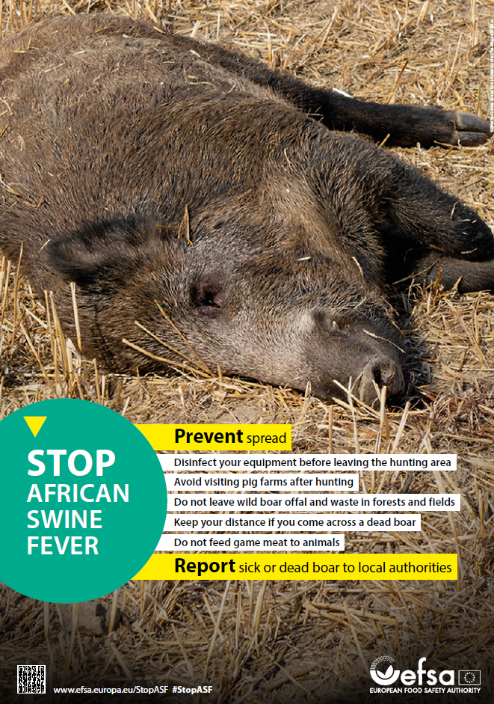
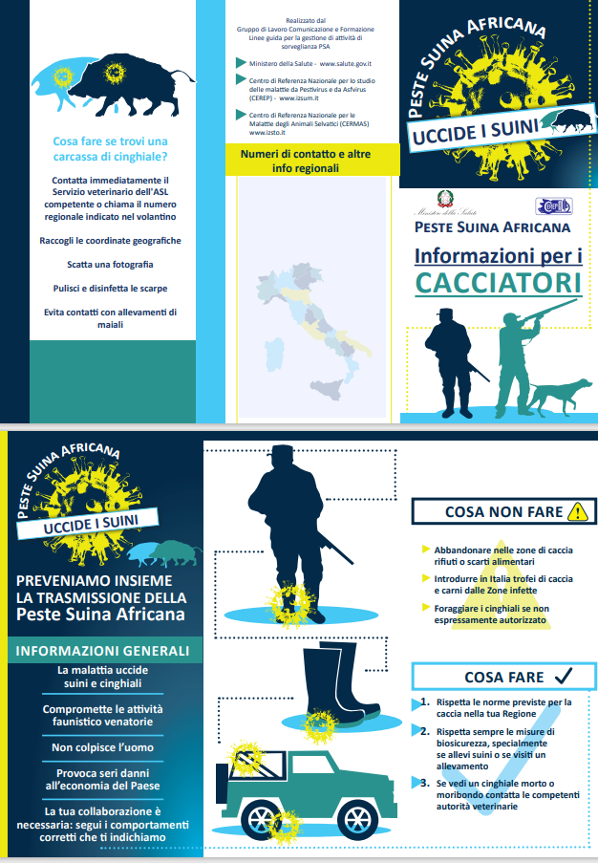
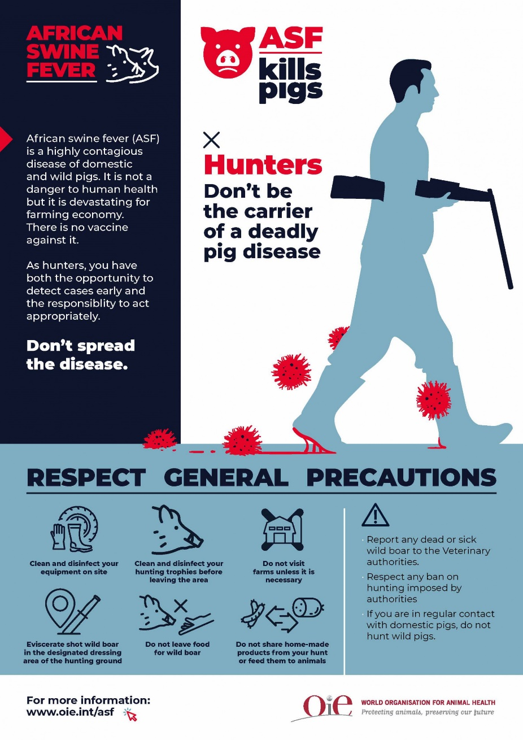
Awareness campaigns targeted at hunting sector

Slide 25
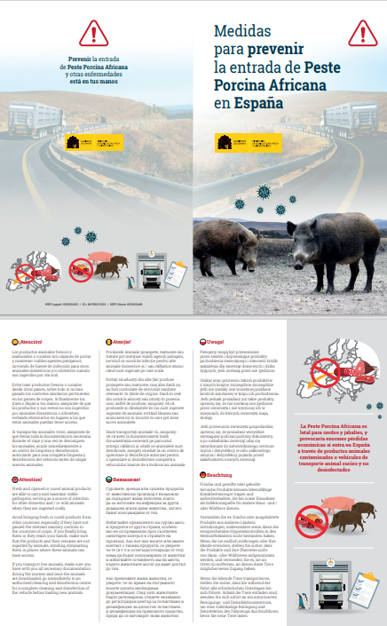

Awareness campaigns targeted at transporters and drivers

Slide 26
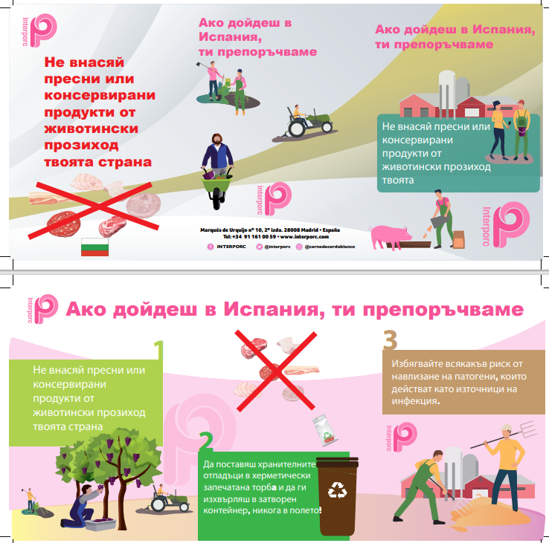
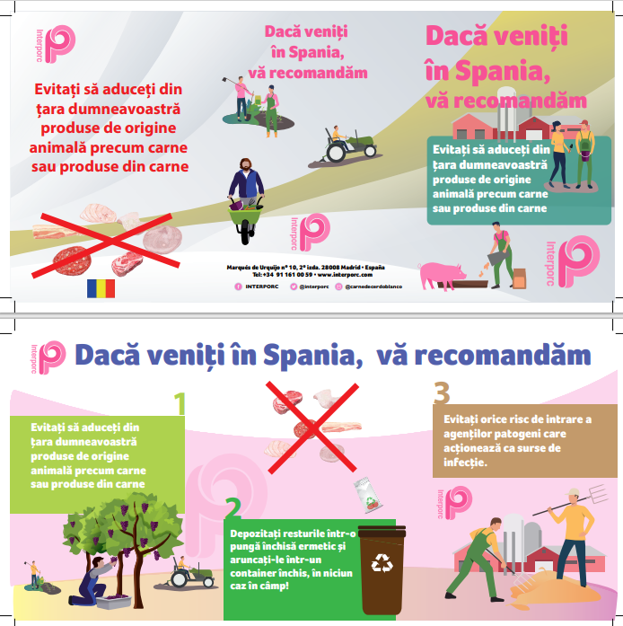
Awareness campaigns targeted at workers coming from ASF affected countries

Slide 27
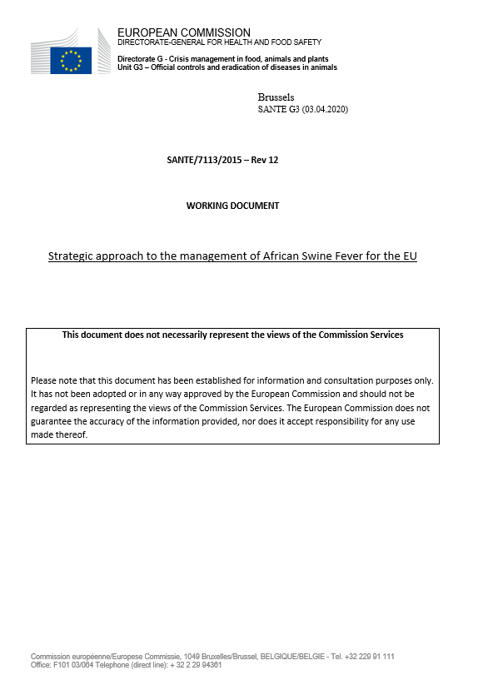
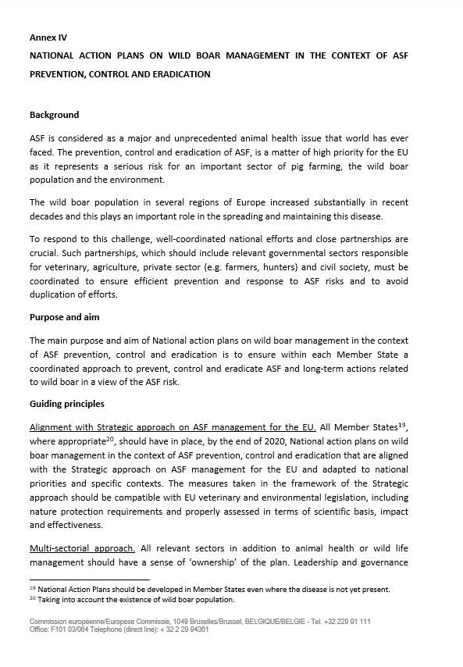
Context: Strategy for the control of ASF in the EU
National Action Plan for management of wild boar populations in the EU
Annex IV
Necessity of implementing national action plans in all MMSS for the long-term management of wild boar populations due to their negative effects on different sectors, but mainly due to the risk of introduction/spread of ASF within the EU

Slide 28
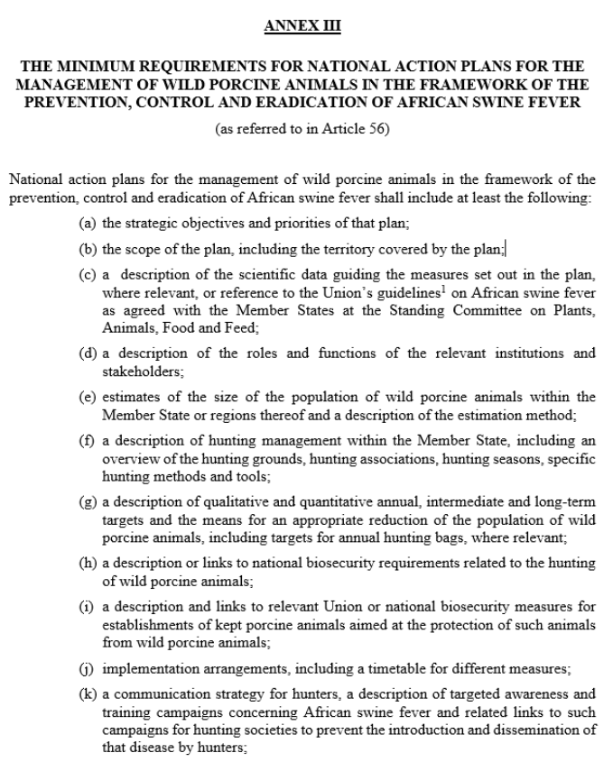
Context: Implementing Regulation (EU) 2023/594, special measures on ASF
Annex IV: minimum requirements for the National Action Plans of MMSS.
It establishes the necessity of adopting these Action Plans within a lapse of 6 months in all MMSS since the approval of the Regulation.

Slide 29
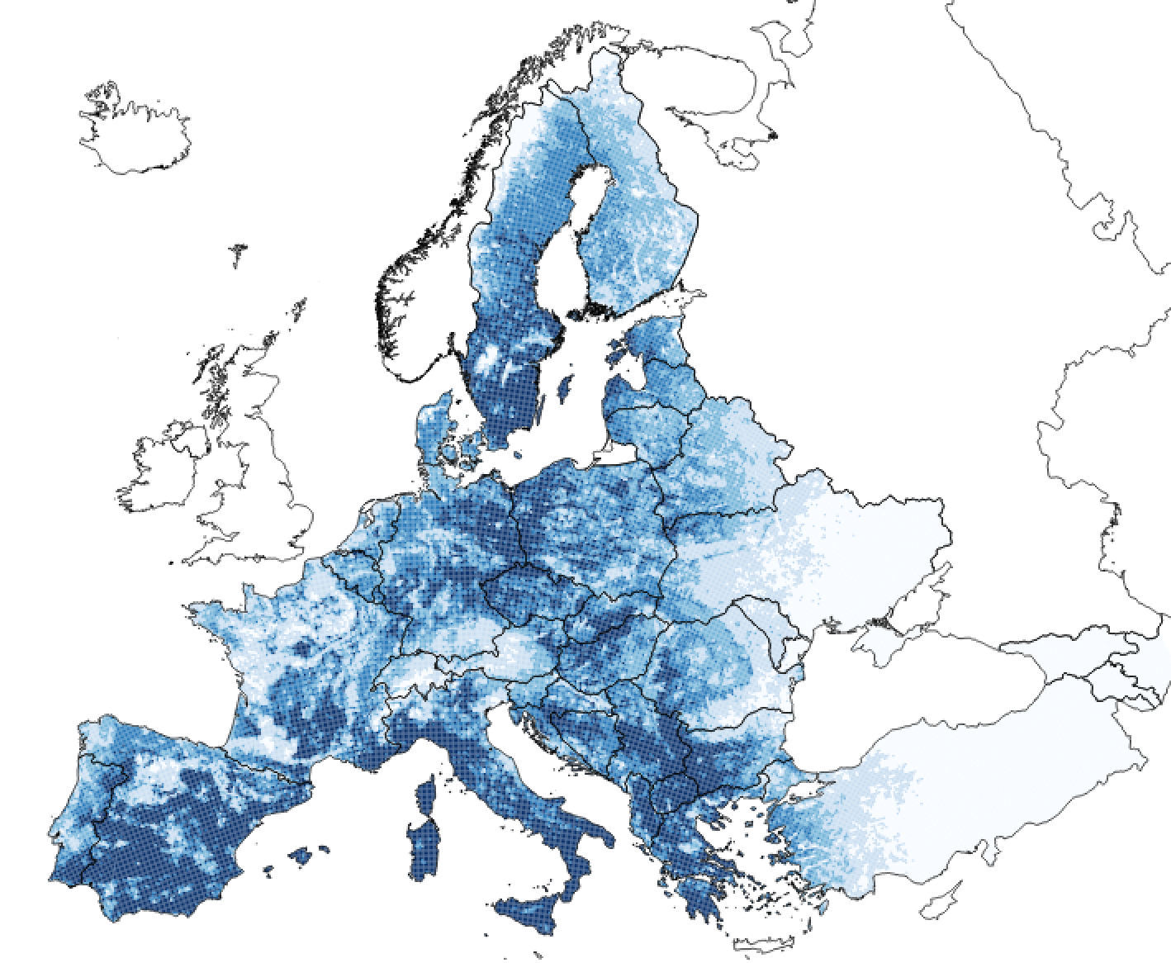
National Action Plans for mid/long-term management of wild boar populations in EU
Coordinated strategy between Animal Health, Hunting sector and Environment authorities, both at central, regional and local level.
Long-term sustainable strategy and adapted to specificities of each region.
Strategic approach for prevention/control ASF in EU.
Foundations
There is a problem of overpopulation of wild boars in certain areas of EU.
It is necessary to manage, with a tendency to decrease, the population of wild boars in these areas.
Identify and eliminate obstacles to address effective management, especially through hunting.
Eliminate/control factors that are driver of the overpopulation situation.

Slide 30
Biosecurity concept
Definition of WOAH: Set of physical and management measures to reduce the risk of introduction, establishment and dissemination of animal diseases, infections or infestations, to, and within animal populations
UNDISPUTED IMPORTANCE OF BIOSECURITY
“Axis that interlinks all animal health”

Slide 31

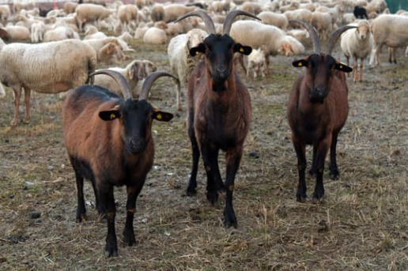

Types of biosecurity
External Biosecurity
Internal Biosecurity
Control entry to prevent the spread of diseases between farms
Key in the case of exotic diseases
Biocontainment/Personnel
Prevent the spread of diseases within the farm itself

Slide 32
Bio-Security Levels
Large scale commercial farms
Small scale commercial farms
Backyards
Level of
Risk (??)

Slide 33
To define farm biosecurity it is necessary to know
The Holding
The Area
The Situation
Size (?)
Type of production
Management
Infrastructure/limits
Health Status
Location
Animal density
Health Status
peace time
emergency
To Identify the Risks
To Apply Proper Control Measures
..and the proper SURVEILLACE

Slide 34
Main Elements of Biosecurity
Segregation:
  Controlling the entrance of animals: from outside farms, markets or villages;
  implementing quarantine for newly purchased animals;
  limiting the number of sources of replacement stocks;
  fencing the farm area and controlling access for people, as well as wildlife, birds, bats, rodents, cats and dogs;
  maintaining adequate distances between farms;
  providing footwear and clothing to be worn only on the farm;
  using an all-in-all-out management system.
Cleaning and Disinfection
  buildings on the premises, but also vehicles, equipment, clothing and footwear
  Disinfectants
(FAO/WOAH/World Bank, 2008 – Good Practices for Biosecurity in the Pig Sector)

Slide 35
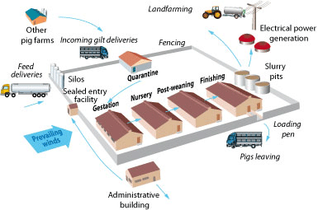
Biosecurity at farm level
Introduction of infected animals
Entrance of non-farm personnel
Entrance of transport vehicles in non-proper C&D conditions
Bed material, dirty clothes or boots, tractors, other machinery…
Other close sources: slaughterhouses, ABP plants, other holdings, roads and pathways…
Infected reproductive material
Other animals in the farm (dogs, cats, birds…)
Aerosols (coming from other close holdings)
Wild boar and other wild animals in the area

Slide 36
Example of a National Strategic Plan for Biosecurity in pig holdings
Strategic plan first implemented in 2016 with the frame objective to evaluate and improve biosecurity in the pig sector to reduce risk of ASF.
Components
  Biosecurity survey specifically developed to assess Biosecurity in extensive, intensive and small farms (voluntary in small holdings / self-consumption excluded)
  Central national database (BIOSEGPOR) and specific website about biosecurity in the MAPA website.
  Awareness campaign in cooperation with pig-sector associations.

Slide 37
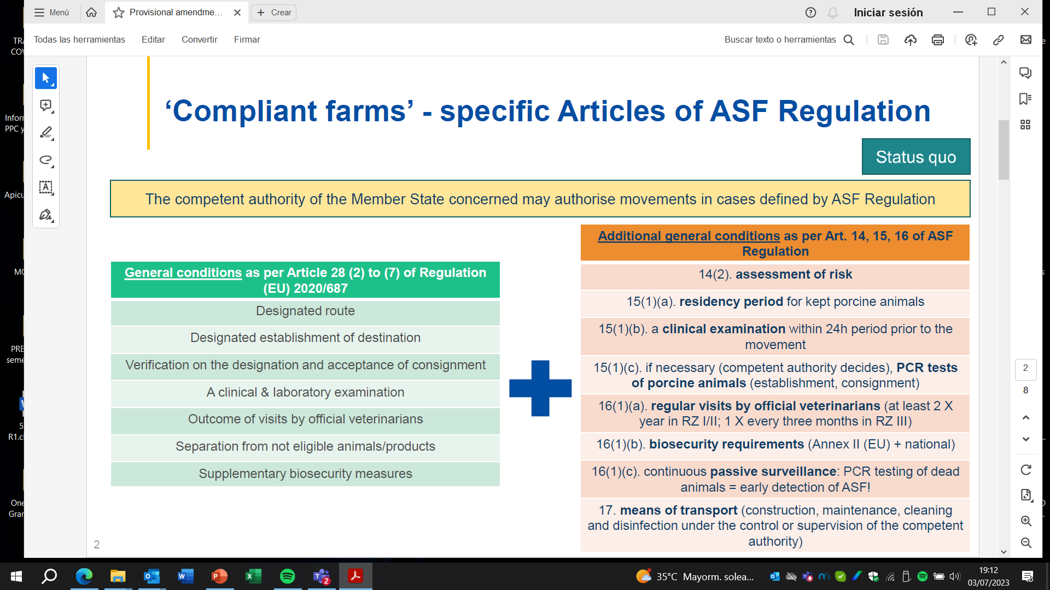
Regulation (EU) 2023/594
Biosecurity requisites made compulsory in ASF affected area to keep business ongoing

Slide 38
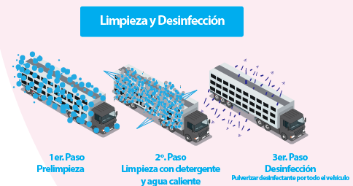
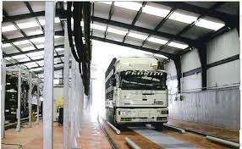
Cleaning and Disinfection – Means of transport
Compulsory after animals unloading.
Controls to be performed:
Documentary control. Activity, training, records, certificates issued.
On-site control: Facilities and equipment / Cleaning and disinfection operations.
Surveillance and follow-up in the event of non-compliance.

Slide 39

Contingency
National contingency plan for animal diseases.
Operational Manual for prevention and control of each disease.
Simulation exercises to test capacity of response against outbreaks.

Slide 40
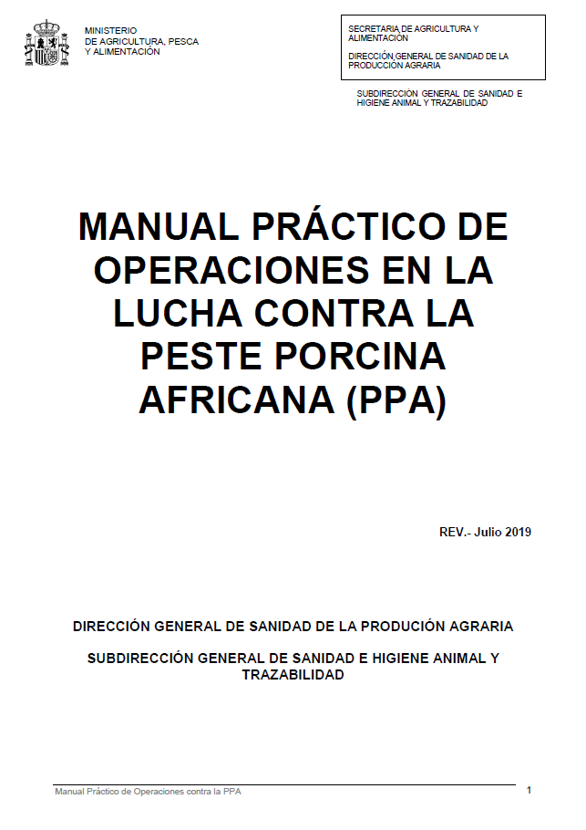
Contingency Plan for ASF

Slide 41
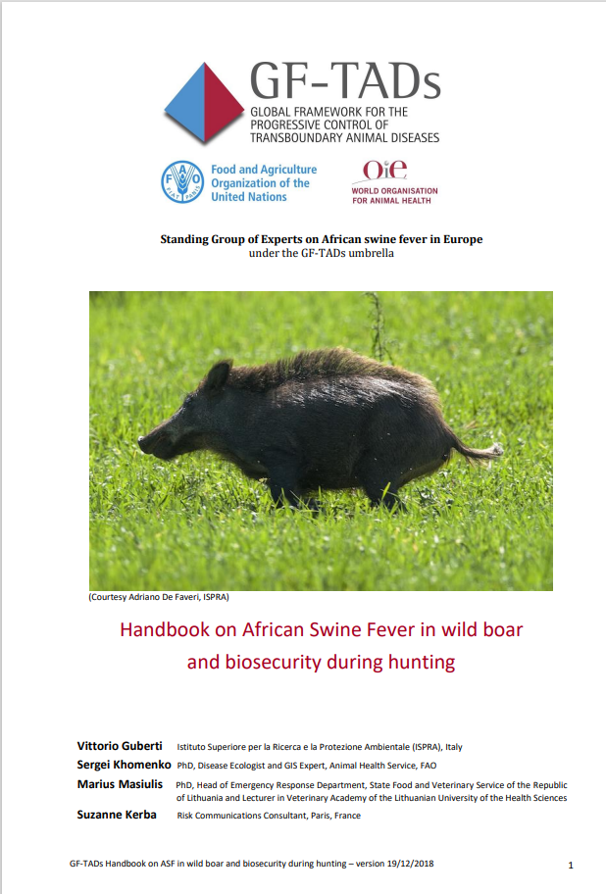
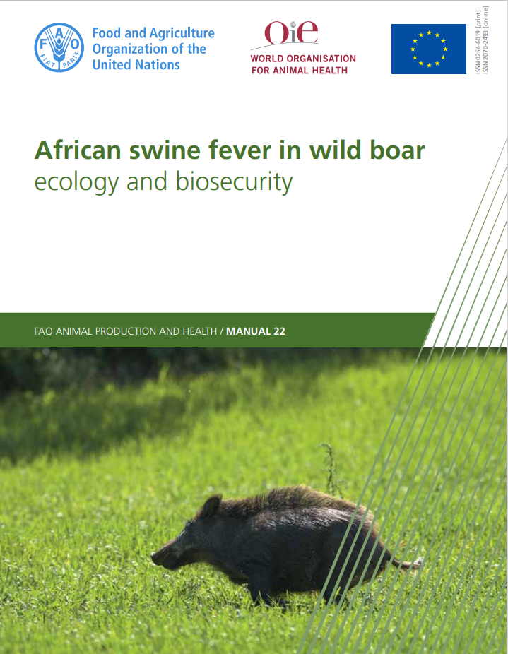
Other complementary protocols for contingency
EN_Manual_ASFinwildboar_2019_Web.pdf (woah.org)
GF-TADs_Handbook_ASF_WILDBOAR_version_2018-12-19.pdf (woah.org)

Slide 42

Diagnostic laboratory capacity
- National Reference Laboratory (NRL) equipped with necessary technology for the diagnosis of the disease:
  - Virological diagnosis
  - Serological diagnosis
- Enough capacity (personal, technical and financial resources) guaranteed in the event of an outbreak.
- Participation in proficiency testing and ring trials.
- Highest quality standards
- Biosecurity
- WOAH reference laboratories support: scientific and technical training.

Slide 43
Main conclusions
Passive surveillance: Irreplaceable for early detection of almost all infectious diseases
Risk-based active surveillance enhance its efficiency
Awareness and training of different stakeholders on prevention, control and eradication measures
Necessity of enough human, material and financial resources
Biosecurity remains an essential tool to prevent and control animal diseases

Slide 44
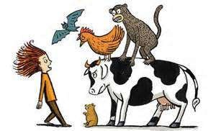
There's nothing to be afraid of...
…as long as we’re well prepared!!

Slide 45








Keep in touch
ec.europa.eu/
europeancommission
europa.eu/
@EuropeanCommission
@EU_Commission
EUTube
@EuropeanCommission
EU Spotify
European Commission
Notes:
Delete/update as appropriate

Slide 46


17 Avenue André Marie Ampère, Induspal Lons
64140 Lons – France
Phone : +33 5 59 72 43 23
https://thetrainingplace.eu
Avenue de Tervuren 36
1040 Brussels – Belgium
Phone: +32 2 736 22 77
https://aesagroup.eu/
Notes:
Update/add/delete parts of the copy right notice where appropriate.
More information: https://myintracomm.ec.europa.eu/corp/intellectual-property/Documents/2019_Reuse-guidelines%28CC-BY%29.pdf

