Slide 1
REGIONAL WORKSHOP ON ANIMAL HEALTH:
DISEASE PREPAREDNESS, VACCINATION AND ONE HEALTH APPROACH
Disease control measures to be taken in case of outbreaks
Dr Edvīns Oļševskis
BANGKOK, THAILAND / 4-8 MARCH 2024

Slide 2
Content
Introduction: legal framework, terms
Control measure in the event of suspicion
Control measures in case of confirmed outbreak

Slide 3
Legal Framework
Word Organisation for Animal Health (WOAH): Terrestrial Code
European Union:
Regulation (EU) 2016/429 – Animal Health Law
Delegated Regulation (EU) 2020/687- prevention and control
Delegated Regulation (EU) 2020/689 – surveillance, eradication programmes, disease-free status
Intra-Union movement, Entry into EU, Official Controls,
Animal by-products etc:
National Legislation of each Member State: In accordance with EU–Law e.g.: contingency plans, chain of command, implementation.

Slide 4
Legal obligations, competencies
Structured approach – obligations – responsibilities - competencies
Operator - means any natural or legal person having animals or products under his responsibility (excluding pet keepers and veterinarians);
Veterinarian, Transporter, Trader,
Animal professional, natural or legal person having an occupational relationship with animals or products – other than operator or veterinarian,
Competent authority - official veterinarian

Slide 5
Suspicion
Suspicion when: Delegated Regulation (EU )2020/689 (Art. 9)
clinical signs, post-mortem lesions or histological findings are indicative; or
results from a diagnostic method are indicating the likely presence of the disease; or
an epidemiological link with a confirmed case has been established

Slide 6
Officially confirmed outbreak
Outbreak when:
Delegated Regulation (EU) 2020/689 (Art. 9)
the disease agent, excluding vaccine strains, has been isolated
an specific antigen or nucleic acid identified and animals showing clinical signs or an epidemiological link with a confirmed case;
a positive result from an indirect diagnostic method and animals showing clinical signs or an epidemiological link with a confirmed case.

Slide 7
Procedure
Suspicion
Control measures
suspected establishment
Epidemiologically linked establishments
Outbreak confirmation
Control measures
Infected establishment
Epidemiologically linked establishments
Zoning
Lifting of measures
Eradication
Disease free status
Restricted zones
Infected establishment

Slide 8
Notification
of suspicion
Procedure
Official investigation
competent authority
clinical examination
epidemiological investigation
post-mortem lesions
sampling and laboratory examination
Official confirmation of the outbreak
Ruling out Suspicion
International notification:
WOAH via ‚WAHIS‘
EU via ‚ADIS‘
Control measures - establishment
- zoning (restricted zones)
Tracing (on and back)
Notification: epidemiologically linked establishments

Slide 9
Obligations of operators:
on disease surveillance (AHL, Art. 24) :
observe the health and behavior of animals;
observe any changes in the normal production parameters that may rise a suspicion;
look for abnormal mortalities and other signs disease.
on the notification of suspicions (AHL, Art. 18) :
immediately notify the competent authority where there are any reasons to suspect the presence in animals of a listed disease or where the presence of such a disease is detected in animals;
notify a veterinarian of abnormal mortalities and other signs of serious disease or significant decreased production rates with an undetermined cause.

Slide 10
Suspicion Phase:

Slide 11
Suspicion: obligations on operators
In order to avoid any risk of spread of the disease:
isolate all animals suspected of being infected
keep the manure, litter and used bedding, any product, material or substance likely to be contaminated isolated,
implement appropriate additional biosecurity measures,
cease all movements of kept animals of listed species from or to the establishment
ensure that production, health and traceability records are updated
collaboration with the competent authority (CA): - provide the CA with any relevant information - follow any instructions given by the CA regarding the control of the disease.

Slide 12
Suspicion: Measures by CA
Investigation – confirm or rule out the suspicion (clinical examination/ sampling)
Transport of samples to the laboratory- immediately, identification, biosafety
Preliminary restriction and biosecurity measures
Prohibition movements animals, of listed and of non-listed species, products
Isolation of animals of listed species, protection from wild animals
Animal by-products from dead animals: e.g. bodies, parts, manure: disposed of
Certain derogations: possible based on risk assessment,

Slide 13
Suspicion: Measures by CA (2)
Inventory:
of the animals kept in the establishment, relevant products,
epidemiological units available
Records analysis:
Inventory, Movements of animals, products (tracing back),
Production records, visits records (contacts through persons)
Optional:
preventive killing (if necessary – epidemiological situation)
temporary restricted zones: movement restrictions, preventive killing or slaughtering,

Slide 14
Suspicion: Measures by CA (3)
Similar measures in the event of suspicions in:
food and feed businesses,
border control posts,
animal by-products establishments or
any other location of relevance,
including means of transport

Slide 15
Epidemiologically linked establishments
Investigation: epidemiological contacts through animals, products, materials, means of transport, feed, animal by-products, persons etc.
Notification of the relevant competent authorities / establishments having a relevant epidemiological contact to the affected establishment
Epidemiological relevant monitoring period before the date of suspicion defined for significant diseases (FMD, HPAI 21 days, ASF, CSF 15 days.

Slide 16
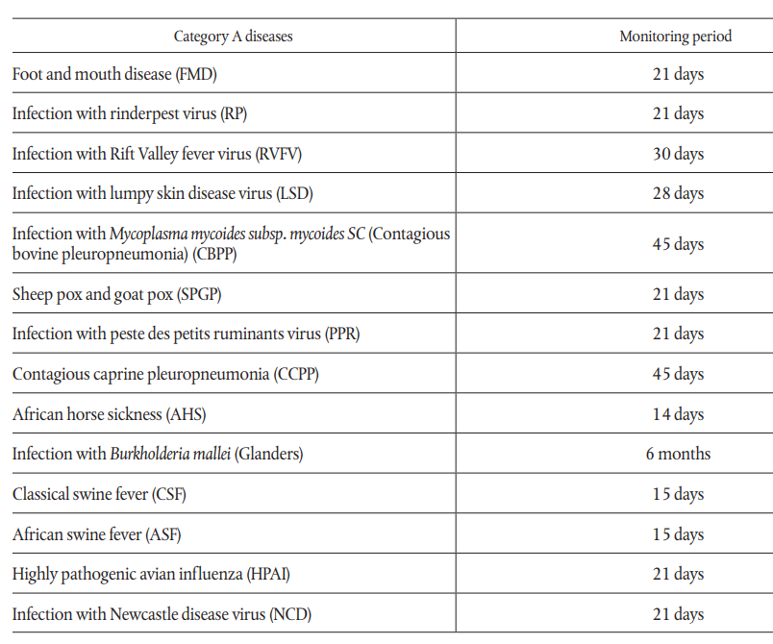
Monitoring period
Important time frame for e.g.:
the epidemiological investigation
repopulation of the affected establishment

Slide 17
Officially confirmed outbreak

Slide 18
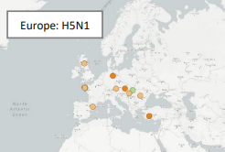
Notification
World Organisation for animal health (WOAH) via WAHIS:
European Union ADIS
(Animal Disease Information System)

Slide 19
Link between ADIS and WAHIS

Slide 20
Control measures - levels
In the infected establishment
In epidemiologically linked establishments keeping animals of listed species
In epidemiologically linked food, feed businesses, slaughterhouses etc.
Other locations of relevance including means of transport
In the established restricted zones
In a larger area: region, country.

Slide 21
Outbreak: control measures in the infected establishment
In addition to the measures already ordered/carried out during suspicion CA: measures ordered and immediately applied, under supervision of official vet.:
Enhanced biosecurity measures,
Isolation products food and feed, animal by-products, other materials
Assessment of the value of animals for financial compensation,
Killing animals of listed species as soon as possible on the spot
Logistical challenges: adequate staff, animal welfare, adequate procedure, equipment, sampling, biosecurity, means of transport, disposal capacity
Disposal: rendering, incineration, burial

Slide 22
Derogations – from certain measures
Certain derogations based on risk assessment
Accompanied by additional risk mitigation measures
E.g.: other epidemiological units, zoological gardens, animals kept for scientific purposes, endangered breeds or species etc.
Animals of non-listed species: optional sampling or killing when necessary, to avoid any risk of spreading of the disease.

Slide 23
Cleaning and disinfection (C&D)
General requirements:
adequate biocidal products for the particular disease agent, concentration, temperature, surface, biological safety for the staff etc
procedure: effective C&D, avoid re-contamination
disposal/disinfection of the water used for cleaning
protection of the environment
C&D: - preliminary and - final

Slide 24
Preliminary C&D
Bodies or parts of dead animals
must be sprayed with disinfectant and removed for disposal
transport in closed and leak-proof vehicles or containers
contaminated tissue or blood must be carefully collected and disposed of;
parts of the establishment in which the animals were kept
buildings and surfaces or equipment contaminated during killing
manure, including litter and used bedding soaked with disinfectant;
Disinfectant has to remain on the treated surface at least 24 hours
After official completion: beginning of the validity of the restricted zone.

Slide 25
Final C&D
Manure, including litter and used bedding: to be removed
Solid phase:
heat treatment > 70°C, destroyed by burning, buried deep enough,
be stacked to heat, sprayed with disinfectant and left for 42 days
Liquid phase: stored at least 42 days (HPAI- 60 days)
Buildings, surfaces, equipment: cleaned and sprayed with disinfectant After 7 days cleaned and disinfected again
Completion: starting date for the repopulation and for lifting of measures in the affected establishment.

Slide 26
Restricted zones - type
Criteria to be considered
the disease profile;
the results of the epidemiological enquiry provided for and other epidemiological data;
distribution and type of establishments keeping animals of listed species
distribution of listed wildlife species
structure of the regional trade and movements
the geographical situation of the restricted zone;
the results of surveillance;
the disease control measures applied;
other relevant epidemiological factors.
Protection zone
Surveillance zone
Further restricted zone if necessary:
Wild animals Infected zone (if necessary)

Slide 27
Minimum radius
protection
and
surveillance zones

Slide 28
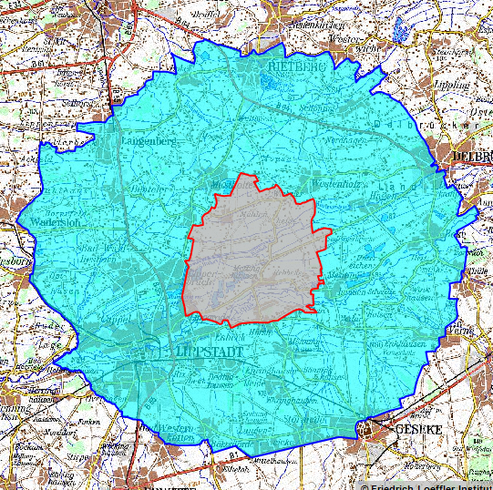
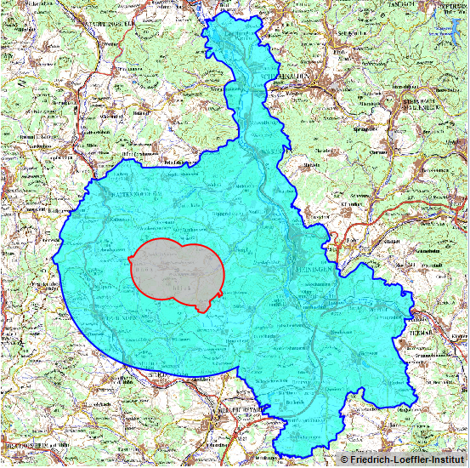
Examples of the restricted zone

Slide 29
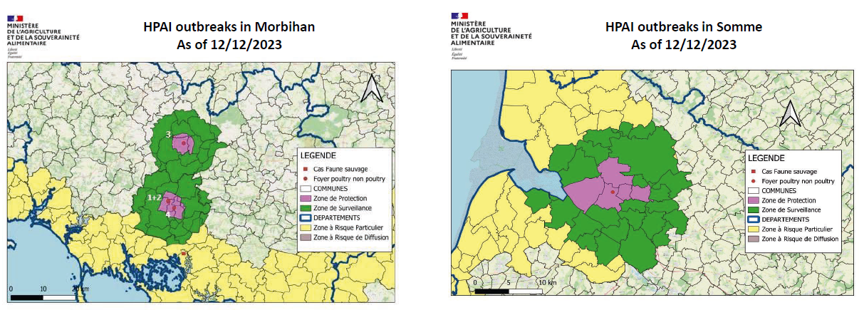
Examples of restricted zone
France

Slide 30
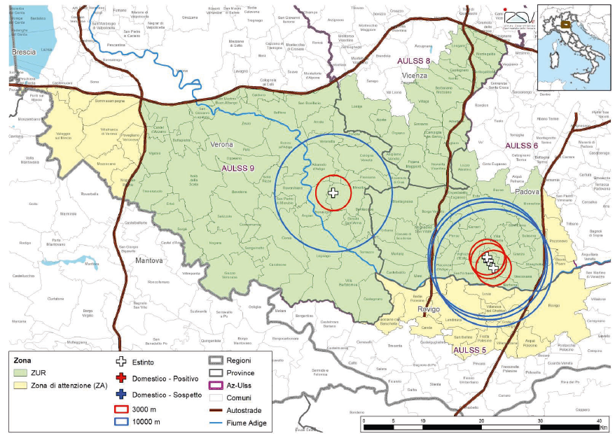
Example of further restricted zone
Italy

Slide 31
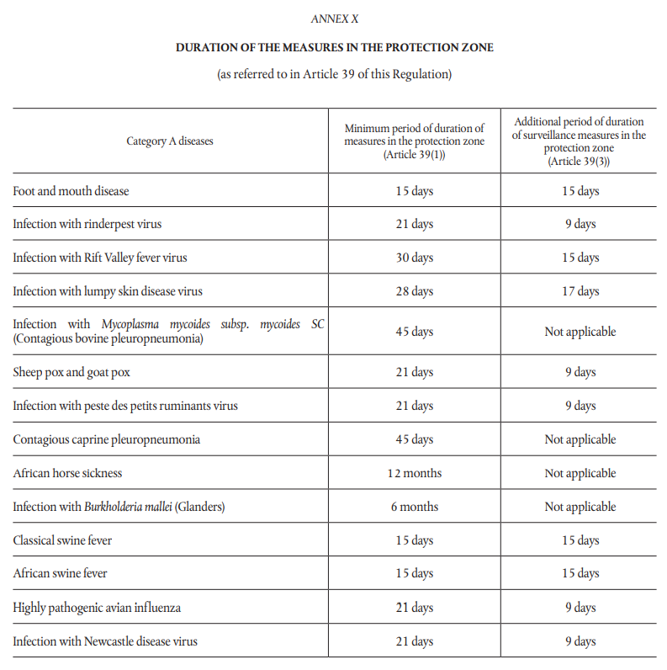
Minimum duration of measures in the protection zone
SZ
PZ
SZ
PZ ≥ 21 days
9 days as SZ
SZ ≥ 30 days

Slide 32
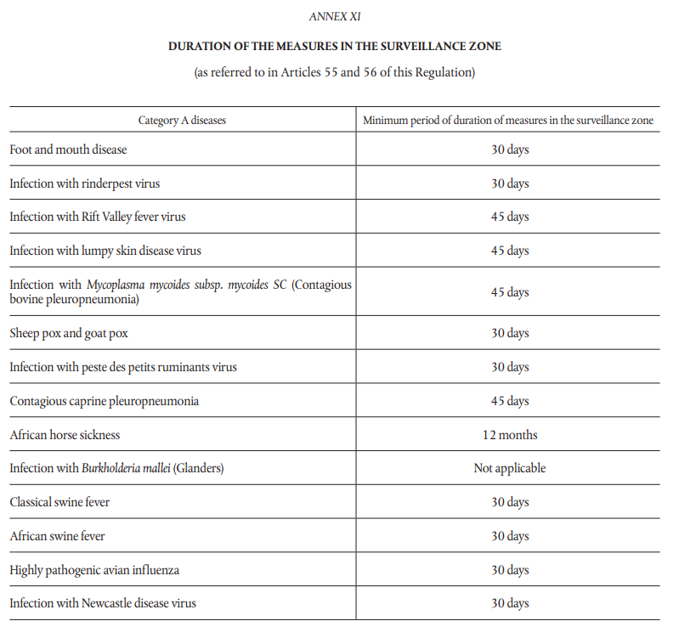
Minimum duration of measures in the surveillance zone
ASF, HPAI 30 days
Rift Valley fever 45 days

Slide 33
Measures in the restricted zones
Comprehensive list of control measures
Significant tools for the competent authorities to effectively mitigate the risk of spread and to control and eradicate the disease
Mainly: movement restrictions
Surveillance in kept and wild animals, establishments
Well adjusted control measures for the different:
types of restricted zones, animal species affected,
categories of animals (for slaughter, day-old chicks, hatching eggs, eggs for human consumption, meat, milk, manure, feed, straw, products etc.)

Slide 34
Measures in the restricted zones: derogations
Derogations based on risk assessment done by CA,
General conditions for granting derogations (visits, clinical and laboratory examinations, collaboration between the related competent authorities etc)
Specific particular conditions for authorising movements
distance for the transport as short as possible
residency period
risk mitigating treatments of products (heat treatment, natural fermentation and maturation)

Slide 35
Lifting of measures in the restricted zone
Lifting protection zone (≥ 3km):
Completion of preliminary C&D in the infected establishment,
Visits in all establishments keeping animals of listed species with favourable results: clinical and when necessary laboratory examination
Minimum period of validity left (e.g. 21 days)
Lifting surveillance zone (≥ 10km)
Protection zone lifted – requirements met and for a certain period (e.g. 9 days) transformed in surveillance zone.
Visits in a representative number of establishments keeping animals of listed species with favourable results.

Slide 36
Repopulation and lifting measures Affected establishment
Final cleaning and disinfection and, when relevant, control of insects and rodents has been carried out (official supervision)
Monitoring period after completion of the final cleaning and disinfection has elapsed
Repopulation with animals not originated from restricted zones
Laboratory examination with favorable results of a representative number of animals
Visits carried out by official veterinarian on the last day of the monitoring period with favourable results by the clinical and laboratory examination
Record keeping proved
Lifting of measures when repopulation completed and favourable results.

Slide 37
Keep in touch
ec.europa.eu/
europeancommission
europa.eu/
@EuropeanCommission
@EU_Commission
EUTube
@EuropeanCommission
EU Spotify
European Commission
Notes:
Delete/update as appropriate

Slide 38
17 Avenue André Marie Ampère, Induspal Lons
64140 Lons – France
Phone : +33 5 59 72 43 23
https://thetrainingplace.eu
Avenue de Tervuren 36
1040 Brussels – Belgium
Phone: +32 2 736 22 77
https://aesagroup.eu/
Notes:
Update/add/delete parts of the copy right notice where appropriate.
More information: https://myintracomm.ec.europa.eu/corp/intellectual-property/Documents/2019_Reuse-guidelines%28CC-BY%29.pdf

