Slide 1
REGIONAL WORKSHOP ON ANIMAL HEALTH:
DISEASE PREPAREDNESS, VACCINATION AND ONE HEALTH APPROACH
Investigation of a suspect case
Dr Edvīns Oļševskis
Dr Marius Masiulis
BANGKOK, THAILAND / 4-8 MARCH 2024

Slide 2
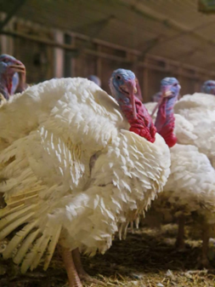
Scenario
Commercial holding – 6 300 turkeys.
Poultry shed No. 1 was empty, all turkeys were sent for slaughter last week, and the shed was cleaned and disinfected before the arrival of new poultry.
Turkeys were kept in three poultry sheds: No. 2, 3 and 4 – approx. 2000 turkeys in each shed.

Slide 3
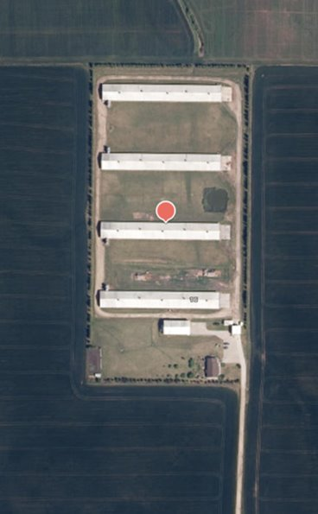
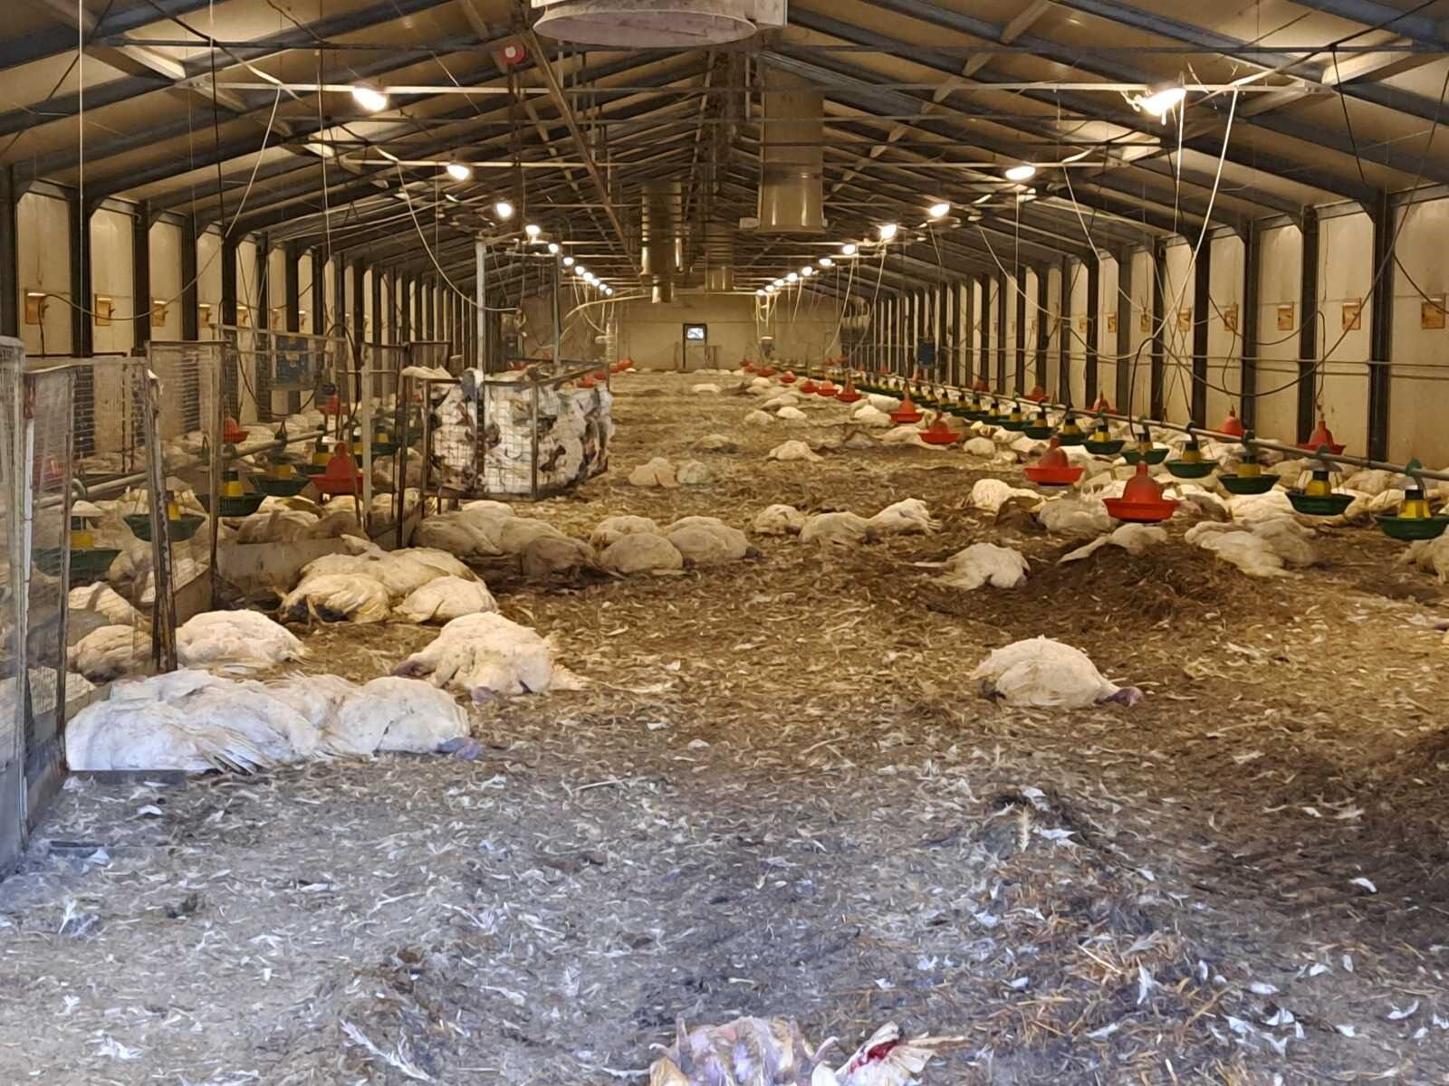
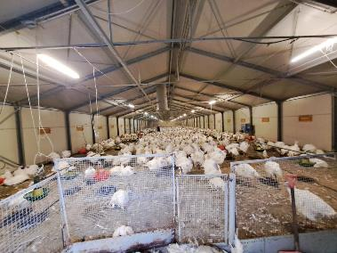
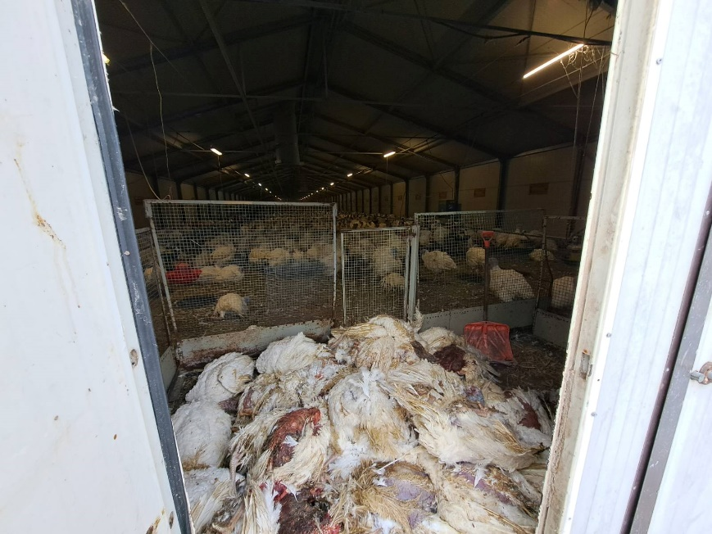
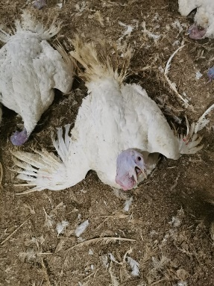
Scenario
The owner observing poultry in the morning, has found the following:
In poultry shed No. 2 – 1900 turkeys dead;
In poultry shed No. 3 – 200 turkeys dead;
In poultry shed No. 4 – 80 turkeys dead.
Other visible symptoms: serious respiratory symptoms, diarrhea.
He immediately informed the local veterinary authority.

Slide 4
Participants work in 4 groups
National Disease Crises Center
Group 1:
...............................
Group 2:
………………………
Local Disease Crises Center
Group 3:
...............................
Group 4:
………………………

Slide 5
Questions for groups 1 and 2 – NDCC
According to the clinical symptoms, morbidity, and lethality of the infection, would you consider HPAI?
Will you notify at this stage to any national or international institution about the suspected case? If yes, to which?
What measures will you recommend/order to LDCC to implement in the suspected poultry holding?
Will you order to implement any measures in the surrounding commercial poultry holdings or backyards? If yes, please list them.
In case the suspicion turns to the confirmed outbreak, what would be your steps for outbreak eradication?

Slide 6
Questions for groups 3 and 4 – LDCC
You have received the information from the owner of poultry holding about the sudden death of turkeys.
According to the clinical symptoms, morbidity, and lethality of the infection, would you consider HPAI? Will you inform any local or national authorities about the suspicion? If yes, which?
Will you restrict the suspected farm before visiting it? If yes, which measures will you apply?
How will you prepare for the investigation of the suspected holding (how many people will go to the holding? what equipment will you take with you?);
Which diagnostic procedures will you follow (how many samples? What type of samples? What lab tests?);
How many days/weeks/months your epidemiological investigation will go back to trace the possible introduction of virus?

Slide 7
Keep in touch
ec.europa.eu/
europeancommission
europa.eu/
@EuropeanCommission
@EU_Commission
EUTube
@EuropeanCommission
EU Spotify
European Commission
Notes:
Delete/update as appropriate

Slide 8
17 Avenue André Marie Ampère, Induspal Lons
64140 Lons – France
Phone : +33 5 59 72 43 23
https://thetrainingplace.eu
Avenue de Tervuren 36
1040 Brussels – Belgium
Phone: +32 2 736 22 77
https://aesagroup.eu/
Notes:
Update/add/delete parts of the copy right notice where appropriate.
More information: https://myintracomm.ec.europa.eu/corp/intellectual-property/Documents/2019_Reuse-guidelines%28CC-BY%29.pdf

