Slide 1
HIGHLY PATHOGENIC AVIAN INFLUENZA
VACINATION in the EU
BTSF Regional workshop on Animal Health:
disease preparedness, vaccination and One Health approach
Bangkok, Thailand
4-8 March 2024
Žilvinas Ilevičius,
EUROPEAN COMMISSION
DIRECTORATE-GENERAL FOR HEALTH AND FOOD SAFETY
Head of Unit G2 - Animal Health

Slide 2
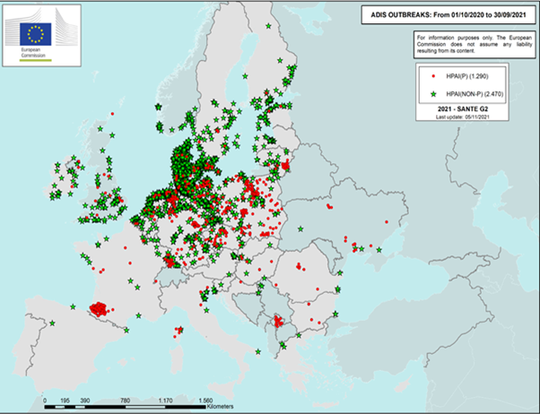
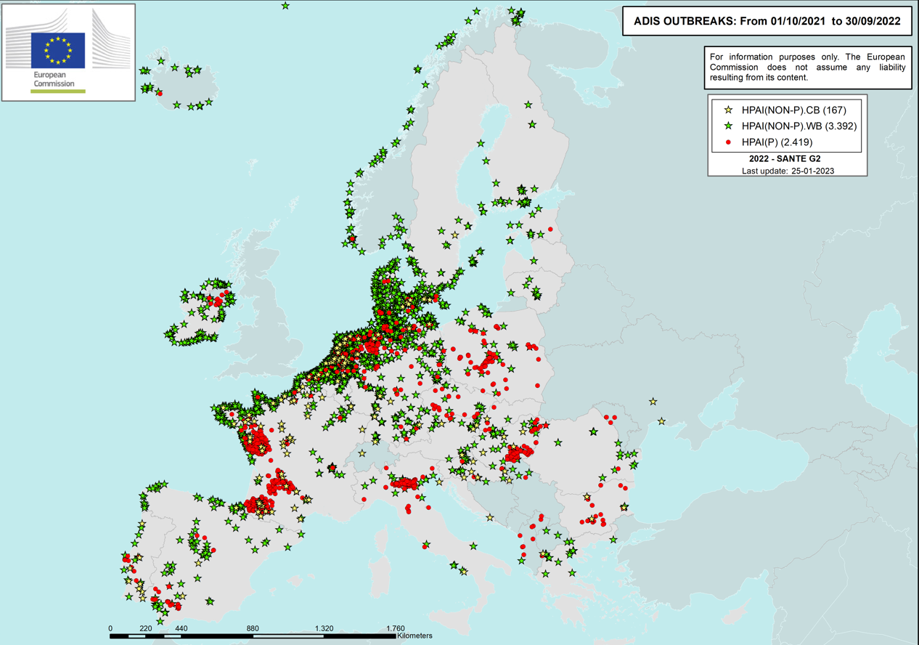
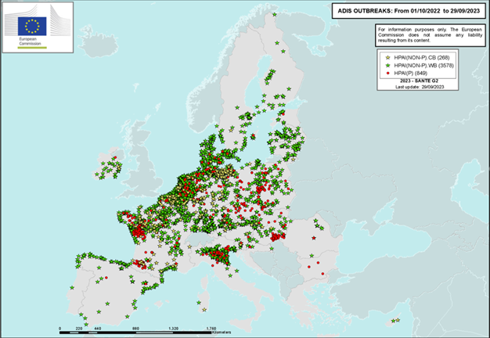
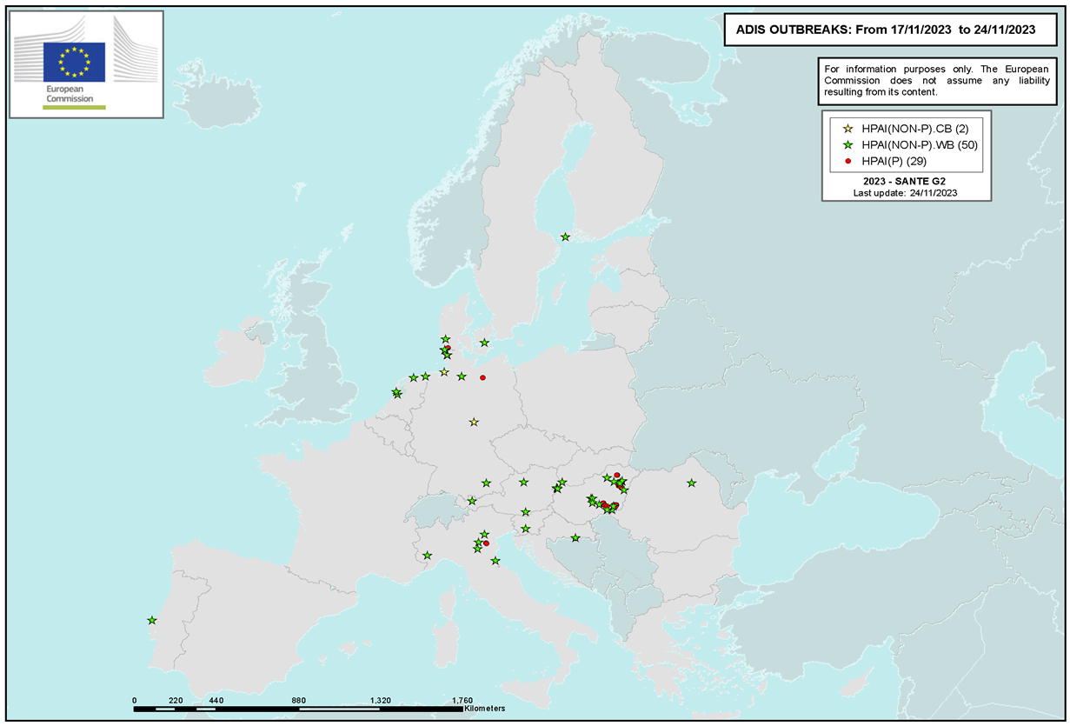
Outcome of surveillance: HPAI in Europe in birds in 2020 – 2023
Oct 2020 – Sept 2021
Oct 2021 – Sept 2022
Oct 2022 – Sept 2023
Oct 2023 – nov 2023
Virus spread with wild birds in all parts of Europe
Recurrent clusters in poultry in certain areas with high density of certain poultry production

Slide 3
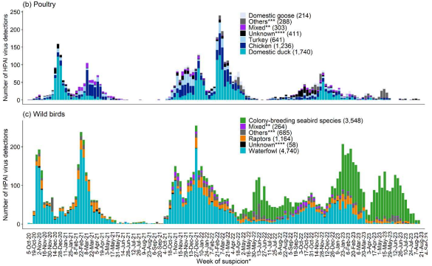
Number of HPAI detections 2020-2023
2020-2021 epidemic season
2021-2022 epidemic season
2022-2023 epidemic season
Distribution of total number of HPAI virus detections reported in Europe by week of suspicion and
affected poultry categories (above)
affected wild bird categories (below)
Poultry:
High peaks of outbreaks in the past
Currently reduced number of outbreaks
Main affected specie: ducks
Wild birds:
Seasonality in the past, related with autumn and spring migration
Main affected species: waterfowl
Worrying trend since spring 2022:
Persistence of HPAI virus in wild birds during summer
new bird species highly affected playing a role in spreading, i.e. seabirds breeding in colonies
Source EFSA (Sept 2023)

Slide 4
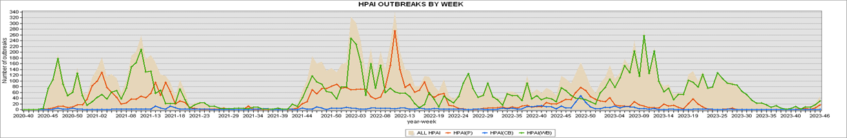
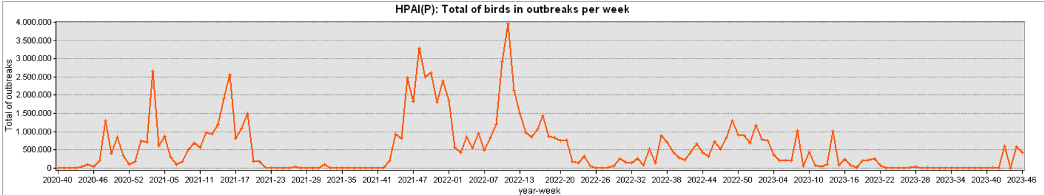
The trends

Slide 5
VACCINATION AGAINST HPAI
IN THE EU
Delegated Regulation (EU) 2023/361
on the use of veterinary medicinal products for disease prevention and control

Slide 6
Animal Health Law legal framework

Slide 7
General approach
Rules on the use of certain VMPs for prevention and control of certain listed diseases - Terrestrial and Aquatic animals
Circumstances under which vaccines for category A
diseases can be used
Rules on the use of vaccines for prevention and control of category A diseases – Terrestrial animals (partially Aquatic)
Preconditions
Strategies
Disease-specific conditions
Implementation
+
post vaccination surveillance
Measures (movement prohibitions for animals and products ) in the vaccination zone
Which VMPs cannot be used for category A and B diseases (including some vaccines, i.e. Rinderpest and Mycobacterium tuberculosis complex)
Recovery of the previous animal health status
General rules
Risk-mitigation measures (movement restrictions)

Slide 8
Allowed vaccination strategies for HPAI
Vaccination
Emergency
Protective
Preventive
Suppressive
Link to disease control measures
Biosecurity remains the cornerstone as preventive measure to protect poultry from HPAI-infection
Stamping out is still always a compulsory measure in all establishments where HPAI is detected

Slide 9




Specific rules for vaccination against HPAI
Vaccines
that do not contain live AI virus (attenuated or not)
Risk mitigation measures
General prohibition for movements of vaccinated poultry and their products
Derogations to move, under conditions
Reinforced surveillance
clinical and laboratory (official activity)
to assess effectiveness (emergency protective vaccination)
to early detect infection with HPAI virus
Traceability/Certificates
Emergency vaccination: certificates for movements from vaccination zone within MS and to other MS
Preventive vaccination: certificates for poultry and hatching eggs when moved to other MS

Slide 10
Risk mitigation measures
General prohibition for movements of vaccinated poultry and their products
Derogations to move, under conditions
 | Emergency protective vaccination | Preventive vaccination
Poultry for slaughter | Within restricted zone or as near as possible | National + EU (pre-movement inspection by official vet, and virological test (for Anseriformes) within 72 hours + certification )
Poultry | National (Ready to lay poultry) | National
Captive birds | Based on risk assessment by CA | National + EU (pre-approval of CA from destination and virological test within 72 hours prior movement + certification)
Day-old chicks | National | National + EU (certification)
Hatching eggs | National | National + EU (certification)
Meat | National | National + EU
Eggs for human consumption | National | National + EU

Slide 11
Reinforced surveillance when vaccination is applied
Delegated Regulation (EU) 2023/361
Objective/ Method | Emergency protective vaccination | Preventive vaccination
Assess effectivenes of vaccination in vaccination zone | YES | NO
Early detection of outbreaks in vaccination zone/vaccinated establishment | YES | YES
Visits by official veterinarians in all establishments in the restricted/vaccination zone | at least once during the duration of the restricted zone | at least every 30 days
Passive surveillance | - virological testing - when necessary, based on suspicion | virological testing every week representative sampling of dead birds
Active surveillance | - virological testing - every 2 weeks - in all vaccinated establishlents - with 95 % confidence for a prevalence of 5% | serological or virological at least every 30 days with 95 % confidence for a prevalence of 5% in each epidemiological unit
Pre-movement virological test within 72 hours before movement to other MS | - | captive birds poultry for immediate slaughter

Slide 12
Decision Making - Implementation process for the use of vaccines against HPAI
Member State
Assessment of the situation based on specific criteria (Annex II of DR (EU) 2023/361)
Member State
Preliminary information sent to the other MS and the COM (at least 2 days before start of vaccination)
COM
Disease-specific surveillance – Risk mitigation measures (Annex XIII of DR (EU) 2023/361)
INITIATION OF VACCINATION
Official vaccination plan sent to the other MS and the COM (at the latest 2 weeks after start of vaccination)
Member State
Review of the national measures in the official vaccination plan. May act with additional measures in accordance with Article 71 of Regulation (EU) 2016/429
Preparation of official vaccination plan (in accordance with information required in Annex III of DR (EU) 2023/361)
Decision to vaccinate (strategy selection etc.)
Regular reports sent to the other MS and the COM (content / intervals according to the vaccination strategy – Annexes V and VI of DR (EU) 2023/361 )

Slide 13

Thank you
© European Union 2020
Unless otherwise noted the reuse of this presentation is authorised under the CC BY 4.0 license. For any use or reproduction of elements that are not owned by the EU, permission may need to be sought directly from the respective right holders.
Slide xx: element concerned, source: e.g. Fotolia.com; Slide xx: element concerned, source: e.g. iStock.com
Notes:
Update/add/delete parts of the copy right notice where appropriate.
More information: https://myintracomm.ec.europa.eu/corp/intellectual-property/Documents/2019_Reuse-guidelines%28CC-BY%29.pdf

