Slide 1
Vaccination of poultry against HPAI Available vaccines and vaccination strategies
07 March 2024
BTSF
Inma Aznar
Team Leader Animal Health
Biological Hazard & Animal Health and Welfare Unit (BIOHAW)

Slide 2
Term of References
Update on the available vaccines against HPAI for poultry
Vaccination strategies
Surveillance in the vaccinated zone and/or vaccinated establishments
Restrictions and risk mitigation measures to be applied in a vaccinated establishment or a vaccination zone
available at:
https://www.efsa.europa.eu/en/efsajournal/pub/8271
by March 2024
https://open.efsa.europa.eu/study-inventory/EFSA-Q-2022-00550

Slide 3
TOR 1 – AVAILABLE VACCINES

Slide 4
ToR 1 – AVAILABLE VACCINES
Inactivated vaccines or vaccines based on technologies other than live attenuated AIV
Prototypes of vaccines still in an early stage of development have been only mentioned when relevant
Data sources: information retrieved by the literature review pharmaceutical company websites responses to the survey and network consultation

Slide 5
Tor 1 –VACCINE type and technologies
Large array of vaccine types and technologies available with only a small proportion produced commercially and used in the field outside of scientific studies:
classical oil-adjuvanted inactivated whole virus vaccines remain the most widely used (not bound to poultry species-specific limitations, allows for easy manufacturing and offers potential versatility in strain adjustment) but not for DIVA strategies differently from the recombinant ones that can rely on already commercially available and consolidated serological assays
Although there is no specific experience with AI vectored vaccines in the EU, the same vector backbone technology (e.g. recombinant HVT) is widely used for prevention of other diseases (e.g, IBD, NDV, ILT)
Nucleic acid-based vaccines hold promise for the poultry sector particularly for their characteristic to allow for a smooth adaptation to the circulating strains compared with whole virus vaccines

Slide 6
Tor 1 - available VACCINEs and CHARACTERISTICS
There is a significant lack of usable and harmonised data regarding the characteristics of available vaccines
Most available poultry vaccines are designed for and evaluated in chickens
Most of the available vaccines administered through injection
Minimum age for the first administration varies, ranging from 1 day to 6 weeks of age, with some live vectored vaccines administered in-ovo/in the hatchery
Certain live vectored vaccines (HVT) are less affected by maternal immunity and can be given early even in the presence of maternally derived antibodies
Humoral immunity has been measured from 10 to 14 days following primary vaccination, however more time or even successive vaccine doses may be required to obtain full protective immunity; for HVT there is slower onset of immunity (4 weeks)

Slide 7
ToR 1 – vaccine characteristics
Technology | Poultry species (experimental data) | Administration route | Vaccine name | Estimated antigenic distance (AU) | Lineage, clade | Predicted efficacy of a vaccine to stop sustained HPAIV transmission in a vaccinated population (VE_{T})
Inactivated full virus | Chickens (Pekin ducks, turkeys) | Subcutaneous or intramuscular | Nobilis Influenza H5N2^{(NL)} | 4.37 | Eurasian H5 | < 0.5 in chickens after 1 dose
Inactivated full virus | Poultry (Muscovy ducks) | Subcutaneous | Vaxigen Flu H5N8^{(IT)} | 2.32 | 2.3.4.4b | in chickens >0.9; in Muscovy ducks <0.5 after 1 dose, >0.9 after 2 doses
Subunit | Chickens (Muscovy, Pekin, mule ducks, turkeys) | Subcutaneous | Volvac B.E.S.T. AI + ND^{(FR, IT)} | 4.18 | 2.3.2 | In mule duck > 0.9 (after 2 doses); in Muscovy ducks 0.8-0.9 after 1 dose, >0.9 after 2 doses; in Pekin ducks >0.9
Live vector | Chickens (ducks, turkeys) | In ovo or subcutaneous | Vectormune AI^{(IT, NL)} | 4.18 | 2.2 | in chickens > 0.9; in turkeys 0.5-0.8
Replicon | (ducks, geese, chickens, zoo birds) | Intramuscular | Duck H5-SRV vaccine®^{(FR, HU)} | 2.32 | 2.3.4.4b | > 0.9 in mule ducks
Nucleic acids (DNA) | (chickens, turkeys) | Intramuscular | ExactVac – Vaxliant ENABLE adjuvant^{(IT, NL)} | 2.51 | 2.3.4.4a | <0.5 in chickens after 1 dose
The only authorised in the EU
DIVA strategies

Slide 8
Tor 1 - Recommendations
Generate suitable and harmonised data on:
the onset and duration of immunity particularly for long living poultry types
the impact of maternal immunity
the indications of vaccines for poultry species other than chickens and considering different poultry production types
VE to reduce R₀<1 under experimental condition and to assess effectiveness in field trials taking into account regional differences
The development of mass applicable AI vaccines
The rapidly update if required based on the antigenic match; for this purpose, continuous surveillance efforts to monitor virus evolution are needed

Slide 9
TOR 2 – VACCINATION STRATEGIES

Slide 10
ToR 2 – VACCINATION STRATEGy scenarios
A number of specific vaccination scenarios focussing on the main domestic poultry species - ducks, turkeys, chickens - were defined using data from France, Italy and the Netherlands as case studies
The virus was assumed to be introduced via wild birds into densely populated poultry areas, where the risk of between-farm transmission is the highest
The between-farm transmission and the impact of the vaccination scenarios were then investigated using a SEIR model framework incorporating a spatial kernel for between-farm transmission dynamics
likelihood of virus transmission between farms is dependent on the distance between the source farm $i$ and the destination farm $j$ and the corresponding poultry type

Slide 11
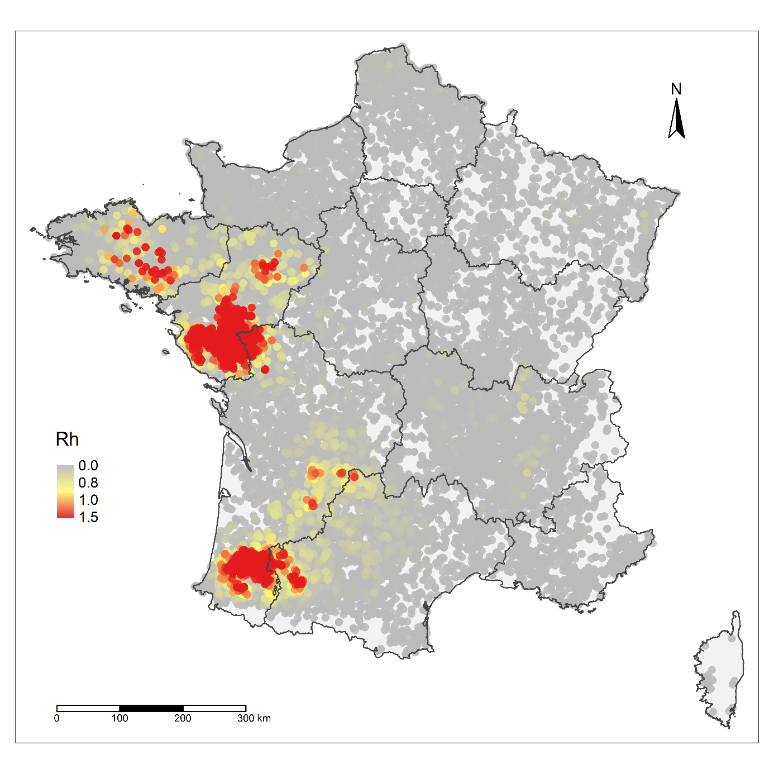
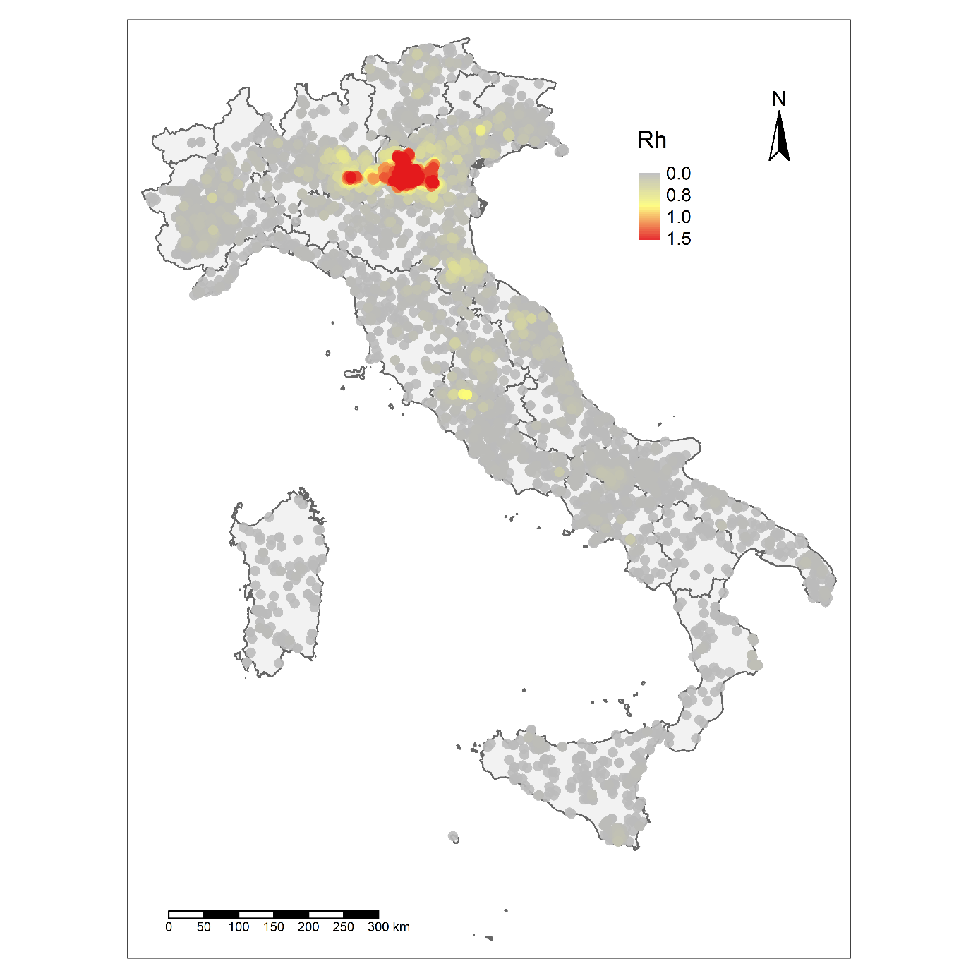
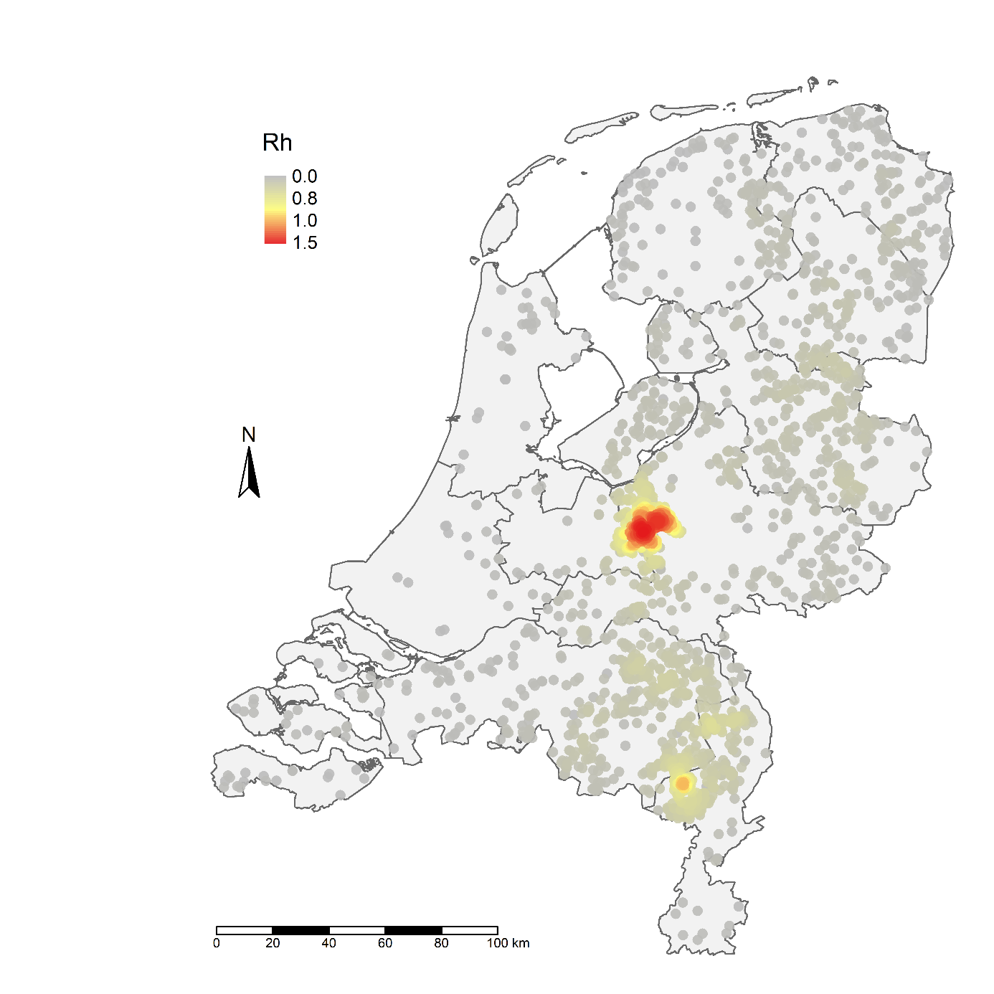
Tor 2 – transmission maps
Rh are the between-farm reproduction numbers quantified using the kernel. Areas where Rh > 0.8 are considered high-risk areas for transmission
Rh=1.58
Rh=1.52
Rh=1.05
(farm density > 0.54 farm/km2)
(farm density > 0.52 farm/km2)
(farm density > 0.84 farm/km2)

Slide 12
TOR 2 – vaccination scenarios
Scenario 0 (S0) | No vaccination Culling in all infected poultry farms
Scenario 1 (S1) | No vaccination Culling in all infected poultry farms Preventive ring culling in all poultry farms within 1-km radius of infected poultry farms
Scenario 2 (S2) | Emergency protective vaccination of all poultry farms (except broiler farms) within a 1-km radius of infected poultry farms Culling in all infected poultry farms
Scenario 3 (S3) | Emergency protective vaccination of all poultry farms (except broiler farms) within a 3-km radius of infected poultry farms Culling in all infected poultry farms
Scenario 4 (S4) | Emergency protective vaccination of all poultry farms (except broiler farms) within a 10-km radius of infected poultry farms Culling in all infected poultry farms
Scenario 5 (S5) | Preventive vaccination of only duck farms (France), turkey farms (Italy) or layer chicken farms (The Netherlands) located in the high-risk transmission area (R_{h} ≥ 0.8) Culling in all infected poultry farms

Slide 13
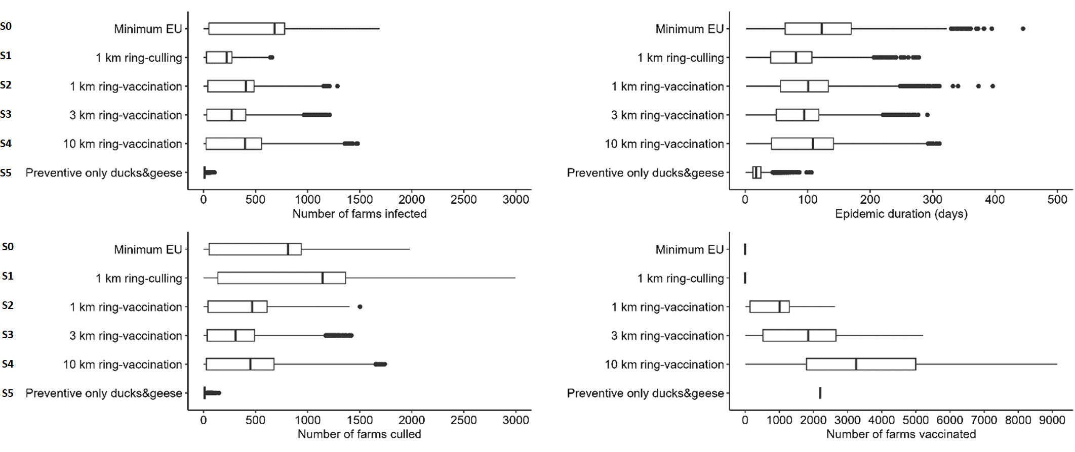
Tor 2 – vaccination scenarios
Results from the model simulation for each scenario in France

Slide 14
Tor 2 – vaccination scenarios
Results from the model simulation for each scenario in France

Slide 15
Tor 2 – vaccination scenarios
Results from the model simulation for each scenario in France

Slide 16
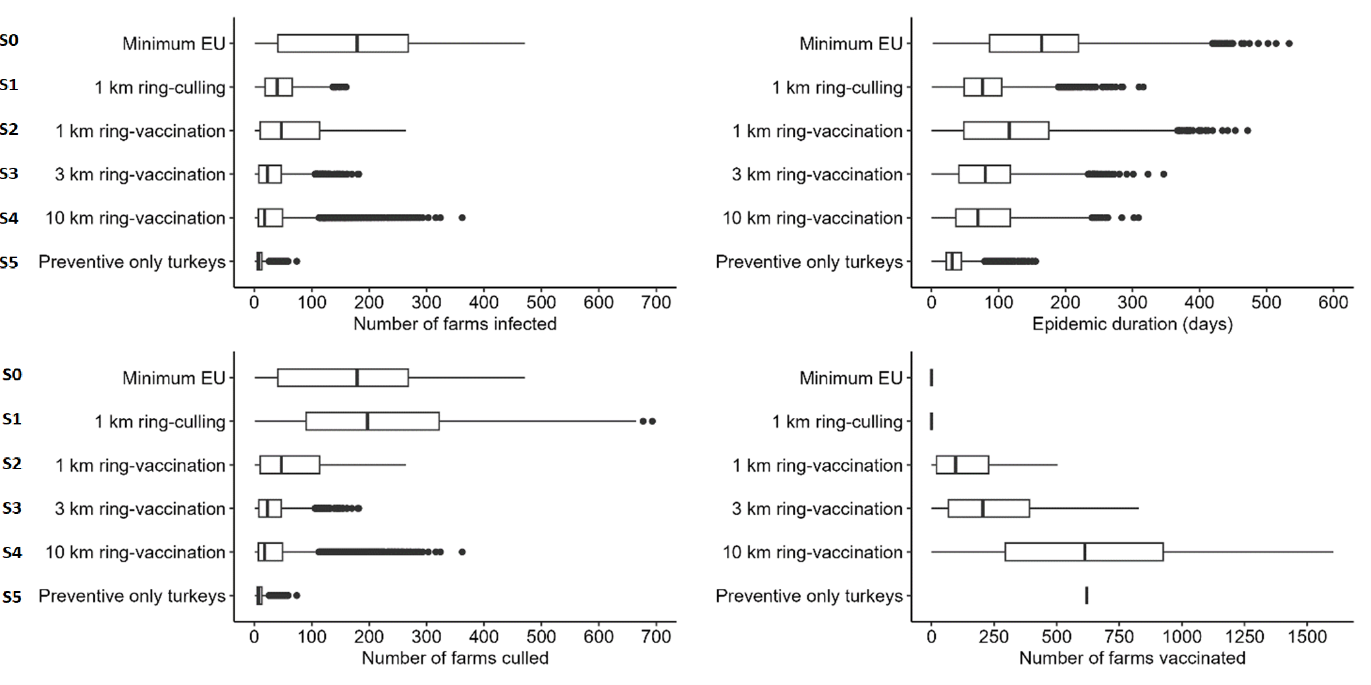
Tor 2 – vaccination scenarios
Results from the model simulation for each scenario in Italy

Slide 17
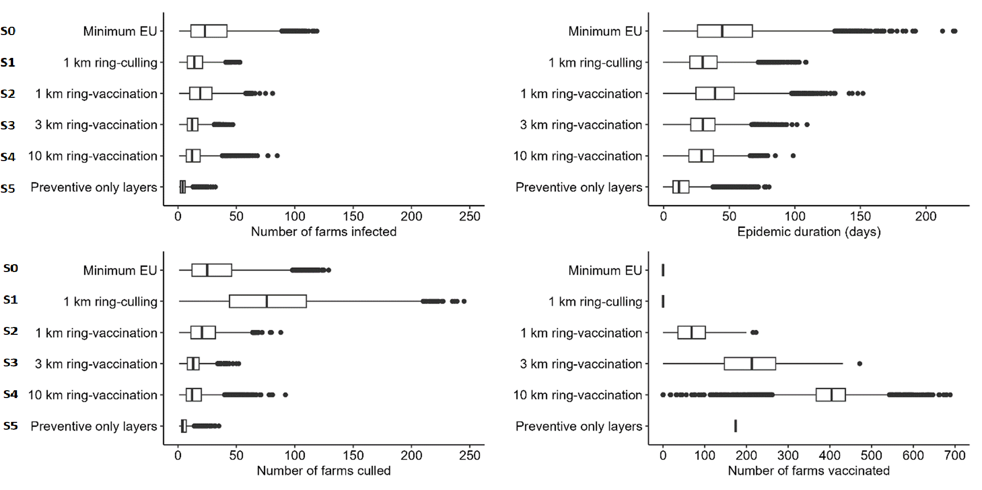
Tor 2 – vaccination scenarios
Results from the model simulation for each scenario in the Netherlands

Slide 18
Tor 2 – Recommendations
To minimise the number of infected and culled farms and epidemic duration, preventive vaccination of the most susceptible and/or infectious poultry species is recommended in high-risk transmission areas. Depending on the region, these species are ducks, geese, turkeys and layers chickens
In case of an outbreak in a high-risk transmission area, emergency protective vaccination in a 3-km radius is recommended, as it showed to be the most effective strategy among the three emergency vaccination scenarios tested
Monitoring of vaccine efficacy over time should be planned under the implementation of every vaccination strategy, due to possible changes in the antigenicity of circulating HPAI viruses, changes that can also be accelerated by the selection pressure exerted by vaccine-induced immunity

Slide 19
Tor 2 – Recommendations
For areas with high risk of introduction from wild birds and low farm density, preventive vaccination could be considered to reduce the number of outbreaks resulting from primary introductions
It is a crucial prerequisite that vaccination should not replace other preventive and control measures such as infection monitoring in wild birds, early detection and biosecurity, but complement them to reinforce their impact, so to adopt an integrated disease prevention and control approach

Slide 20
Thanks to all the Experts involved
Working group experts
BASTINO Eleonora (EMA)
BORTOLAMI Alessio (EURL)
FEDIAEVSKY Alexandre (WOAH)
GONZALES Josè (WUR)
GRASLAND Beatrice (ANSES)
GUINAT Claire (ENVT)
HARDER Timm (FLI)
MIRAS Christine (CVMP, EMA)
SCOLAMACCHIA Francesca (EURL)
STEGEMAN Arjan (WUR)
TERREGINO Calogero (EURL)
VILTROP Arvo (EMU)
Member State
Hungary
Italy
France
The Netherlands
EFSA
AZNAR Inmaculada
BALDINELLI Francesca
BROGLIA Alessandro
LINDGREN KERO Linnea
LANFRANCHI Barbara
MUR Lina

Slide 21
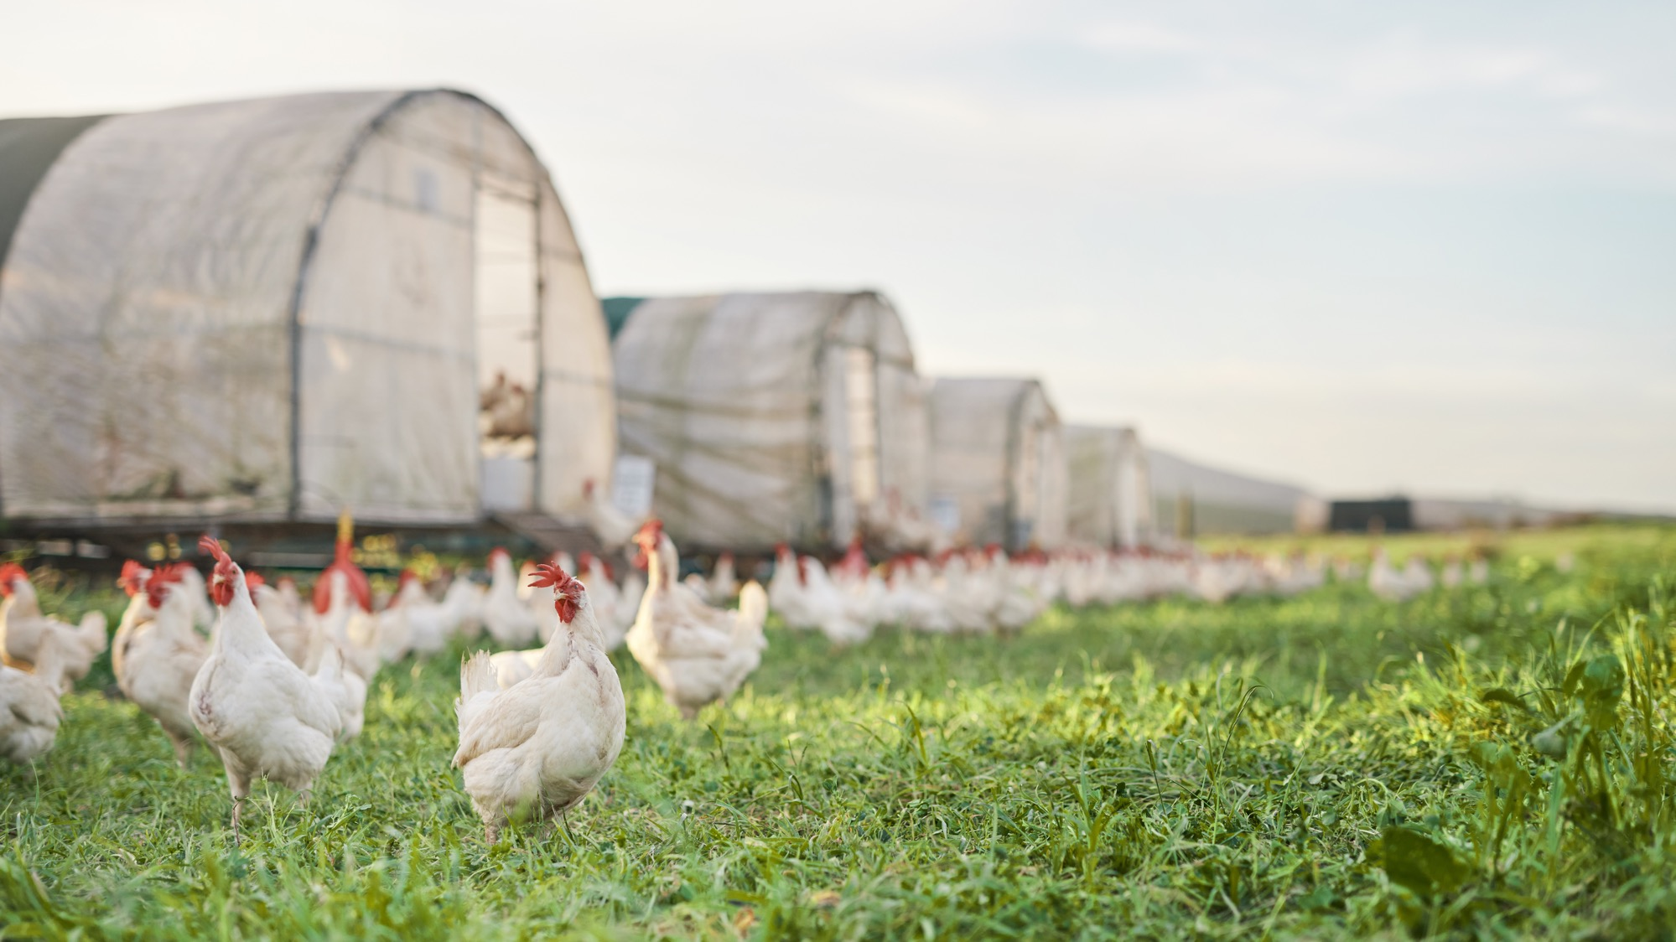
Thank you for your attention!
#OpenEFSA

Slide 22
Stay connected
SUBSCRIBE TO
efsa.europa.eu/en/news/newsletters
efsa.europa.eu/en/rss
Careers.efsa.europa.eu – job alerts
LISTEN TO OUR PODCAST
Science on the Menu –Spotify, Apple Podcast and YouTube
FOLLOW US ON TWITTER
@efsa_eu @methods_efsa
@plants_efsa @animals_efsa
FOLLOW US ON LINKEDIN
Linkedin.com/company/efsa
FOLLOW US ON INSTAGRAM
@one_healthenv_eu
CONTACT US
efsa.europe.eu/en/contact/askefsa

