Slide 1
EU regionalisation (zoning) for animal diseases
BTSF Regional workshop on Animal Health:
disease preparedness, vaccination and One Health approach
Bangkok, Thailand
4- 8 March 2024
Žilvinas Ilevičius,
DG SANTE
Unit G2 – Animal Health

Slide 2
Outline
General issues:
  EU Veterinary – animal health control system
  Tools for disease control in the EU
  Animal health legislation
Regionalisation/zoning:
  EU legal framework for regionalisation
  Key principles of regionalization (zoning) in the EU
  Examples
Conclusions

Slide 3

General
EU Veterinary/animal health control system
Tools for disease control in the EU
EU animal health legislation

Slide 4
EU veterinary / animal health control system
Member States
European Commission
Competent veterinary authorities in EU Member states
  Veterinary services
  Resources, capacities, equipment
  Network of animal health laboratories
  Legal powers
  Chain of command
DG SANTE
Standing Committee for Plants, Animals, Food and Feed (section Animal Health and Welfare)

Slide 5
Main tools for the control of animal diseases in the EU
EU Animal health legislation and official controls: Animal Health Law, Official Controls Regulation
Regionalization (zoning) policy
Contingency plans
The EU Reference Laboratory network (EURLs): 16 EURLs for animal health
The EU co-financed eradication programs and financial support in case of outbreaks
Enforcement – audits
Trainings: Better training for safer food – BTSF, Sustained training missions – STMs, etc.
The European Food Safety Authority – EFSA: scientific advice = risk management decisions based on science!
International cooperation – WOAH/FAO, e.g. through the GF-TADSs, and bilateral cooperation with trading partners
EU research projects – e.g. Horizon Europe
EU Specific rules: Delegated and Implementing acts, specific rules: ASF,CSF, LSD Regulation etc.
Fully harmonised EU legislation across 27 MSs!

Slide 6
Additional tools for disease control
TRACES NT (New technology): EU online certification
Animal Disease Information System (ADIS)
EU Vaccine Banks: FMD, CSF, LSD, PPR, SGP
EU Veterinary Emergency Team – EUVET

Slide 7
Animal Health Law legal framework
EU-fully harmonized animal health legislation
Regulation (EU) 2016/429

Slide 8
Regionalisation/zoning
In the EU
Considerations
Key elements for successful regionalisation
Legislation
How regionalisation is applied in the EU?

Slide 9
The problem of animal diseases and trade
All countries are confronted occasionally or regularly with outbreaks of animal diseases.
The economic damage caused by the disease itself and the eradication measures is unavoidable.
The damage caused by trade restrictions can be minimised.

Slide 10
Regionalisation (zoning) in the EU context
Regionalization is applied in the EU in line with WOAH standards and as an integral element of the EU comprehensive disease control strategy aimed at:
  ensuring the best possible disease control
  minimize the negative impact of disease outbreaks on the EU single market (intra-EU trade) and on exports, without lowering the level of safety of the commodities that are traded/exported (WTO SPS agreement principles)

Slide 11
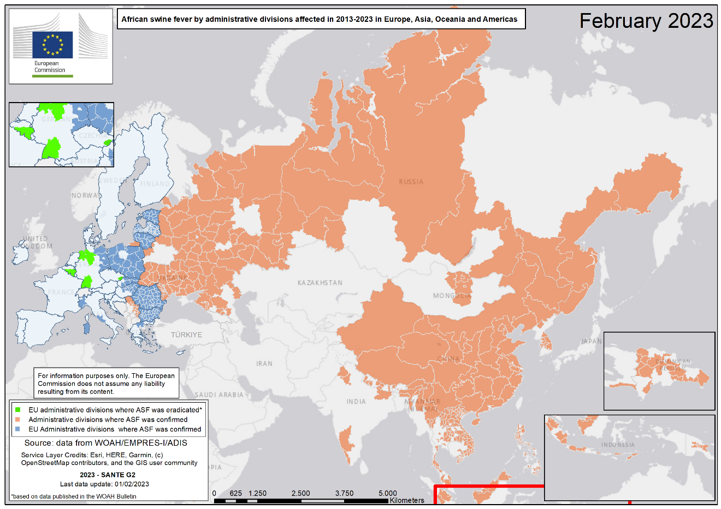
Key elements for successful regionalisation
Swift response
Risk based / Proportionality
Consistency / Predictability
Transparency / Trust
Overall disease control system (identification, registration, control of movements, traceability etc.)
Capacity of the competent authorities
Appropriate surveillance within and outside restricted zones
Flexibility, suitability with different peculiarities depending on the diseases and other factors

Slide 12
Main EU legal framework for regionalisation
Regulation (EU) 2016/429 of the European Parliament and of the Council of 9 March 2016 on transmissible animal diseases and amending and repealing certain acts in the area of animal health (Animal Health Law)
Commission Delegated Regulation (EU) 2020/687 of 17 December 2019 supplementing Regulation (EU) 2016/429 of the European Parliament and the Council, as regards rules for the prevention and control of certain listed diseases
Examples of special disease control rules:
  Commission Implementing Regulation (EU) 2023/594 laying down special control measures for African swine fever
  Commission Implementing Regulation (EU) 2021/934 of 9 June 2021 laying down special control measures for classical swine fever
  Commission Implementing Regulation (EU) 2021/1070 of 28 June 2021 laying down special control measures for a limited period of time related to infection with lumpy skin disease virus

Slide 13
Article 259 of AHL
EU legal framework for regionalisation
Commission emergency measures
When necessary
Bigger areas can be restricted (e.g. based on administrative / geographical borders)
Risk mitigation measures
The Commission may also adopt immediately applicable implementing acts

Slide 14
EU rules – definitions of zones
Article 4 of AHL
(35) ‘zone’ means:
(a) for terrestrial animals, an area of a Member State, third country or territory with a precise geographical delimitation, containing an animal subpopulation with a distinct health status with respect to a specific disease or specific diseases subject to appropriate surveillance, disease control and biosecurity measures;
(b) for aquatic animals, a contiguous hydrological system with a distinct health status with respect to a specific disease or specific diseases that forms an area that is referred to in one of the following:
(i) an entire water catchment from the source of a waterway to the estuary or lake;
(ii) more than one water catchment;
(iii) part of a water catchment from the source of a waterway to a barrier that prevents the introduction of a specific disease or diseases;
(iv) part of a coastal area with a precise geographical delimitation;
(v) an estuary with a precise geographical delimitation;
(41) ‘restricted zone’ means a zone in which restrictions on the movements of certain animals or products and other disease control measures are applied, with a view to preventing the spread of a particular disease into areas where no restrictions are applied; a restricted zone may, when relevant, include protection and surveillance zones;

Slide 15
EU rules – regionalisation criteria
Article 64 of AHL
The competent authority shall establish a restricted zone where appropriate taking into account:
the disease profile;
the geographical situation of the restricted zone;
the ecological and hydrological factors of the restricted zone;
the meteorological conditions;
the presence, distribution and type of vectors in the restricted zone;
the results of the epidemiological enquiry provided for in Article 57(1) and other studies carried out and epidemiological data;
the results of laboratory tests;
the disease control measures applied;
other relevant epidemiological factors (e.g. livestock density).

Slide 16
EU regionalisation: principles
Transparency
Clearly defined roles for Member States and the Commission
Clear criteria, principles and measures
  based on science, experience, EU legislation and international standards (WOAH)
Rapid flow of information
Urgent adoption of emergency measures
Agreed with Member States (regular Committees)
Immediately applicable
Legal acts published in the Official Journal of the European Union in all 24 EU languages

Slide 17
Main elements of regionalisation in the EU
National measures / contingency plans based on EU horizontal and specific rules
Disease control measures are applied in the restricted zone
Tailor made approach necessary:
  disease specific approach (e.g. vector borne disease or not)
  geographical factors
  environmental factors
Stamping-out of animals in the infected establishments and in contact / neighboring establishments, if there is a risk

Slide 18
Regionalisation in the EU: the basic disease control measures
Disease confirmation and stand-still measures
Establishment of 3-10-150 Km restricted (e.g. protection and surveillance) zones depending on risk / disease characteristics
Establishment of further restricted zones, as necessary
Wildlife considered
Tracing / Epidemiological investigations
Additional Surveillance and Testing
Emergency vaccination possible (based on EU rules)

Slide 19
EU regionalisation/zoning in practice
African swine fever (ASF)
Highly pathogenic avian influenza (HPAI)
Lumpy skin disease (LSD)

Slide 20
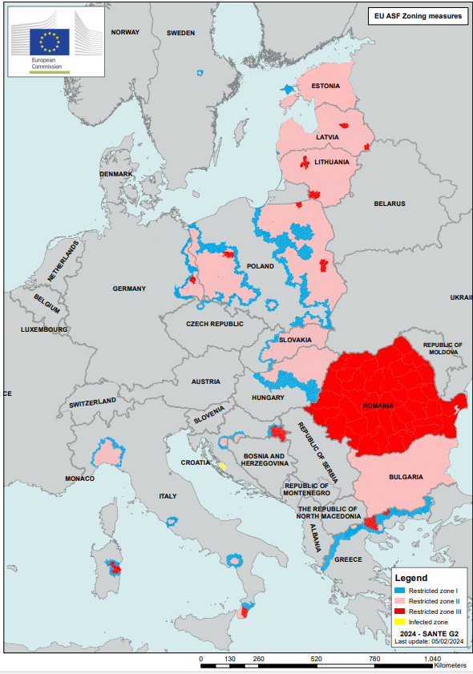
Alignment to WOAH standards
Examples, ASF
Terrestrial Animal Health Code
EU legislation (examples) + guidelines
CHAPTER 4.4.
ZONING AND COMPARTMENTALISATION
Article 4.4.1.
The purpose of this chapter is to provide recommendations on the principles of zoning and compartmentalisation to Member Countries wishing to establish and maintain different subpopulations with specific health status within their territory. These principles should be applied in accordance with the relevant chapters of the Terrestrial Code.
zoning applies to an animal subpopulation defined primarily on a geographical basis.
To facilitate disease control and the continuation of trade following a disease outbreak in a previously free country or zone, zoning may allow a Member Country to limit the extension of the disease to a defined restricted area, while preserving the status of the remaining territory.
A Member Country may thus have more than one zone or compartment within its territory.
Regulation (EU) 2016/429 (AHL)
Delegated Regulation (EU) 2020/687
Implementing Regulation (EU) 2023/594 (ASF)
COMMISSION NOTICE on the guidelines on the prevention, control and eradication of African swine fever in the Union (‘ASF guidelines’)
Indicative map of EU ASF regionalisation

Slide 21
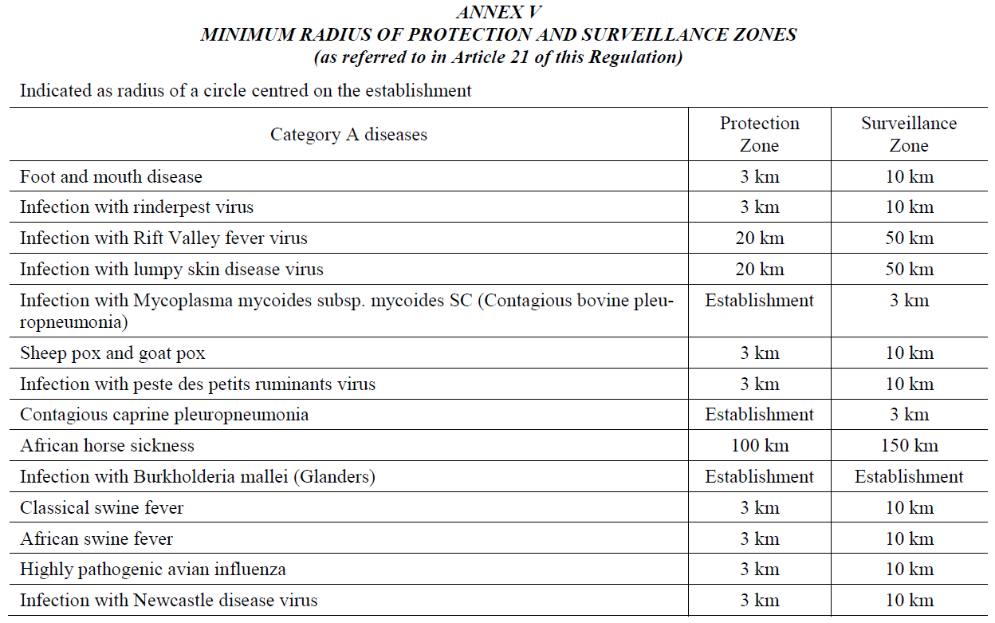
Restricted zone
Delegated Regulation (EU) 2020/687
Article 21: Establishment of a restricted zone
1. In the event of an outbreak of a category A disease in an establishment, food and feed business, animal by–products establishment or other locations, including means of transport, the competent authority shall immediately establish around the affected establishment or location a restricted zone, which comprises:
Restricted zone
Protection zone
(3 km)
Surveillance zone
(10 km)
Further restricted zone (optional)
=
+
+
In addition:
CIR (EU) 2023/594 lays down special control measures for ASF

Slide 22
EU regionalisation measures for ASF
Examples, ASF
Regulation (EU) 2023/594:
Restricted zone I (‘an additional further restricted zone’) – zone, bordering zone II or III, where relevant (no ASF)
Restricted zone II (‘an infected zone’) – ASF in wild boar
Restricted zone III (‘a further restricted zone’, in addition to PZ/SZ) – ASF in domestic pigs (with or without ASF in wild boar)
Principles and criteria available online:
https://ec.europa.eu/food/sites/food/files/animals/docs/ad_control-measures_asf_wrk-doc-sante-2015-7112.pdf
Online interactive map:
https://santegis.maps.arcgis.com/apps/webappviewer/index.html?id=45cdd657542a437c84bfc9cf1846ae8c

Slide 23
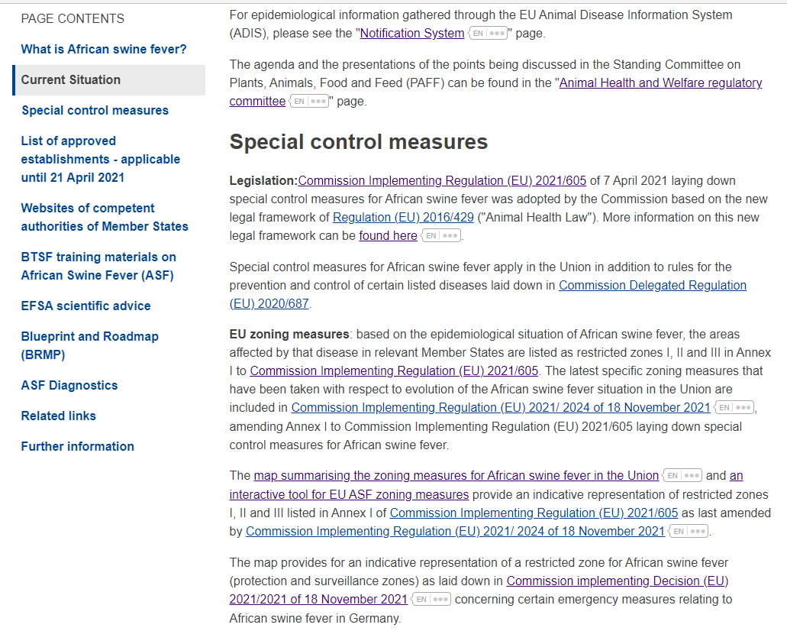
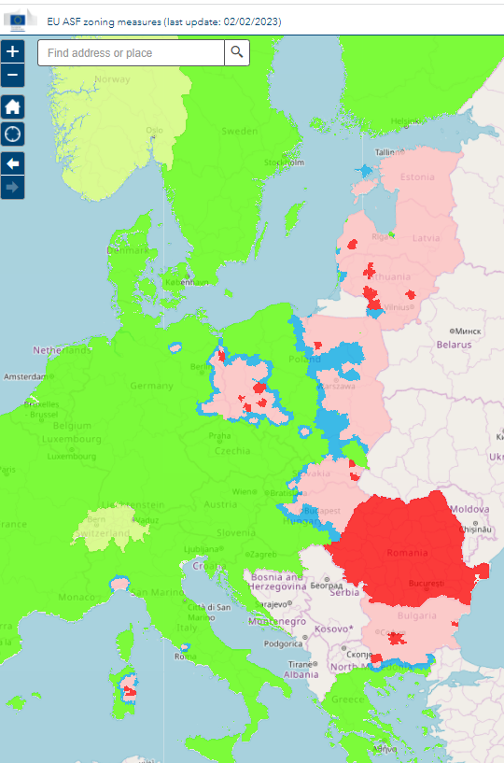
ASF interactive tool
Examples (ASF)
Provides for indicative visualisation of Annex I of Regulation (EU) 2021/605 (updated immediately)
Allows to:
  Zoom in/out
  Find exact place on the map
  Measure
  Choose base maps

Slide 24

Main principles of Regulation (EU)
2023/594 (special ASF control measures)
Examples, ASF
Prohibitions in relation to the dispatch of certain commodities out of restricted zones (the cornerstone of ASF regionalisation is on the origin of the pigs and the measures in the holdings)
Safe derogations from prohibitions under specific conditions and risk mitigation measures
Special designation of establishments and requirements
Information and training obligations and public awareness
List of restricted zones categorised by the epidemiological situation (regionalisation) (Annex I)
Reinforced biosecurity measures (Annex II)
EU regionalisation

Slide 25
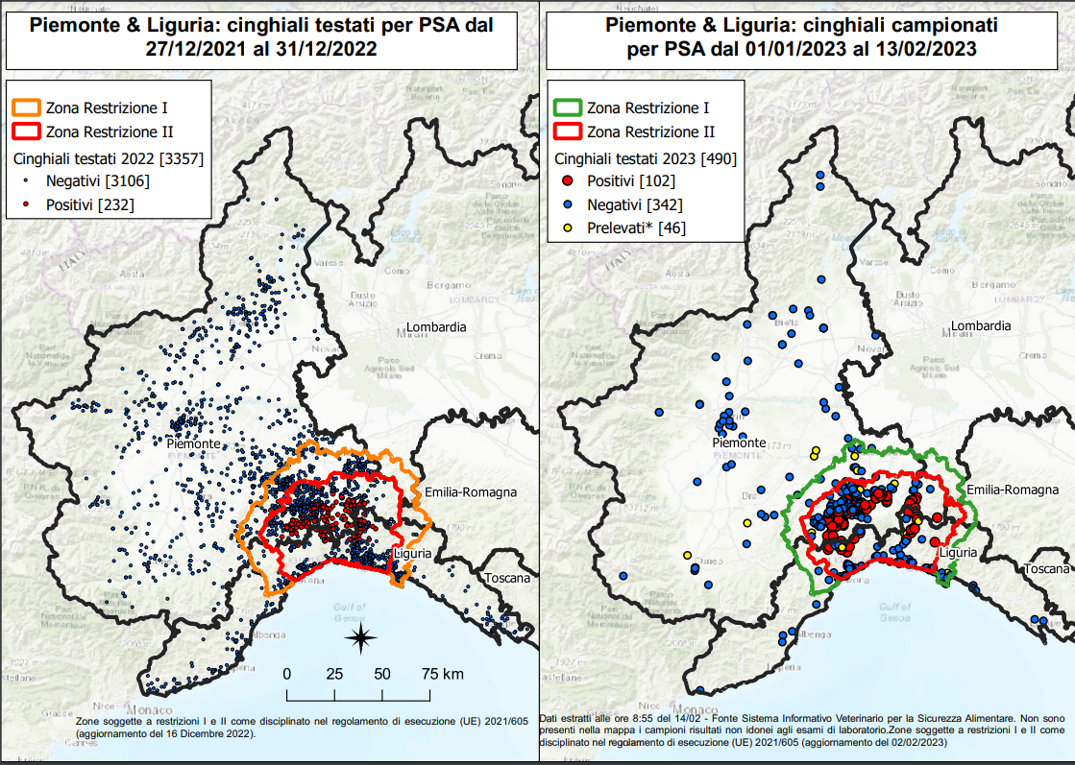
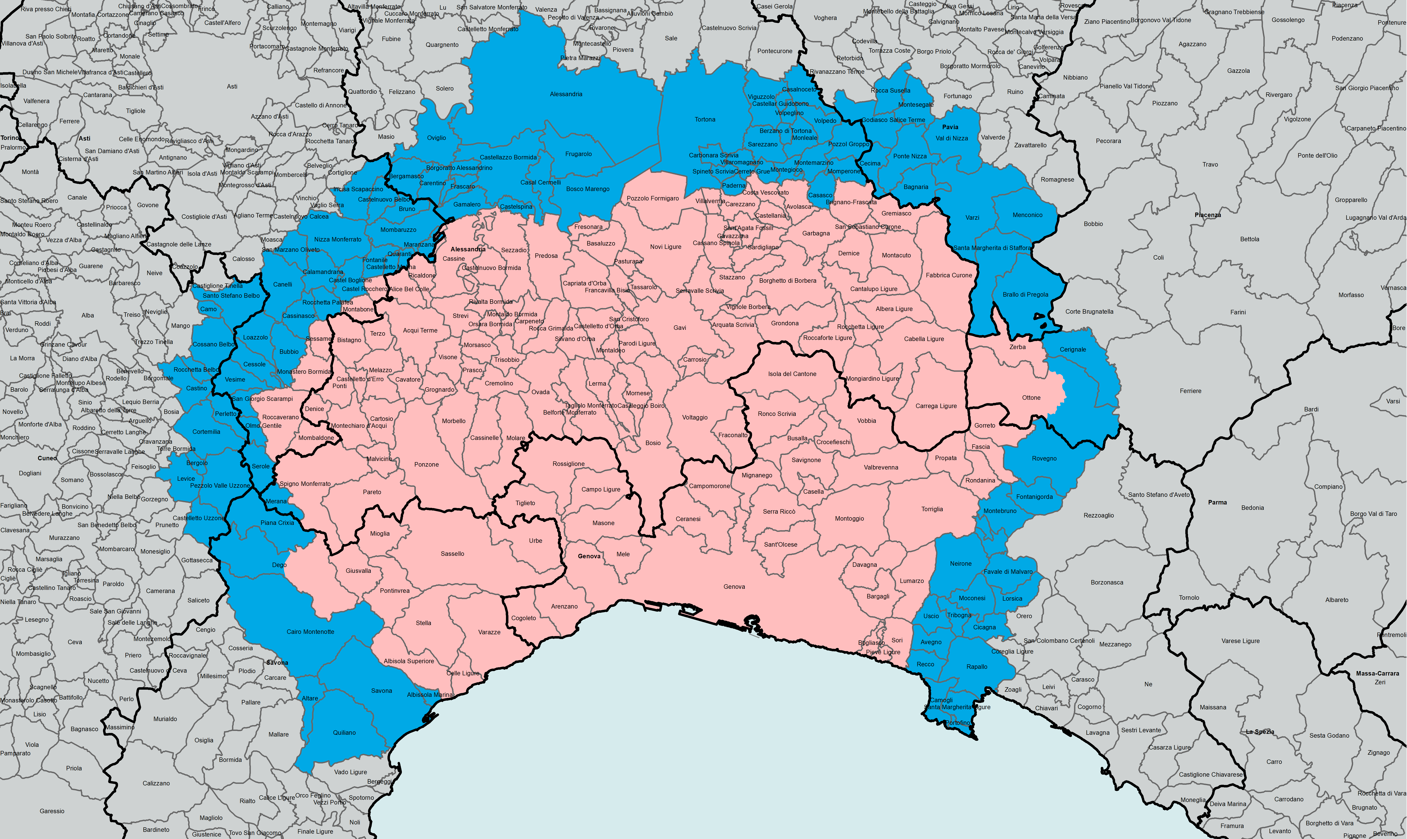
EU regionalisation measures for ASF – Italy (Piedmont and Liguria regions) 2023
Wild boars tested from 27/12/2021 to 31/12/2022
Wild boars tested from 01/01/2023 to 13/02/2023
Restriction zone I
Restriction zone I
EU regionalisation measures as per
Annex I to Implementing Regulation (EU) 2021/605
Restriction zone II
Restriction zone II
tested in 2022
tested in 2023
Examples, ASF

Slide 26
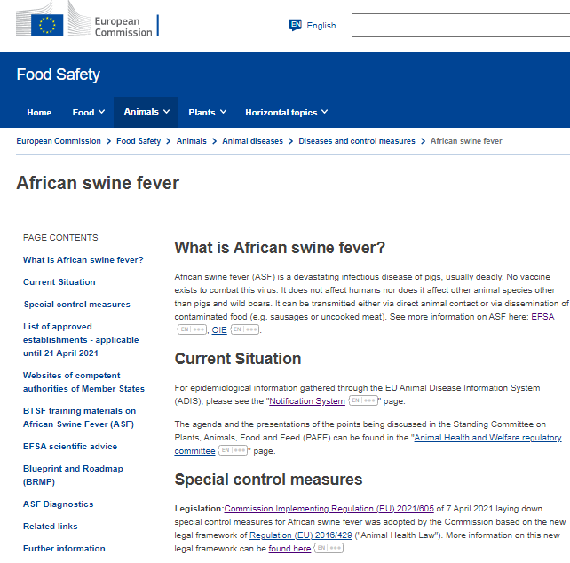

Urgent information and transparency (ASF)
Examples, ASF
Official Journal of the EU (legislation)
EC website
  Guidelines
  Overview reports (ADIS weekly tables + distribution maps)
  Regionalisation maps + an interactive tool + animation
  EFSA (scientific assessments, reports) ; BTSF (training material)
  Audit reports
  Events / factsheets / videos
Info notes (maps/update of the measures/adoption of legal acts)
Chronology of main initiatives
Standing Committee on Animal Health and Welfare (publicly available regular updates from affected MS or non-affected MS on the preparedness)
Other meetings and events

Slide 27
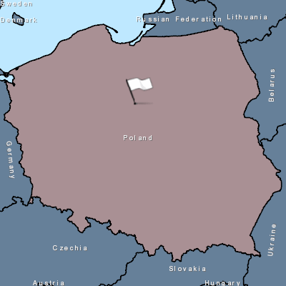
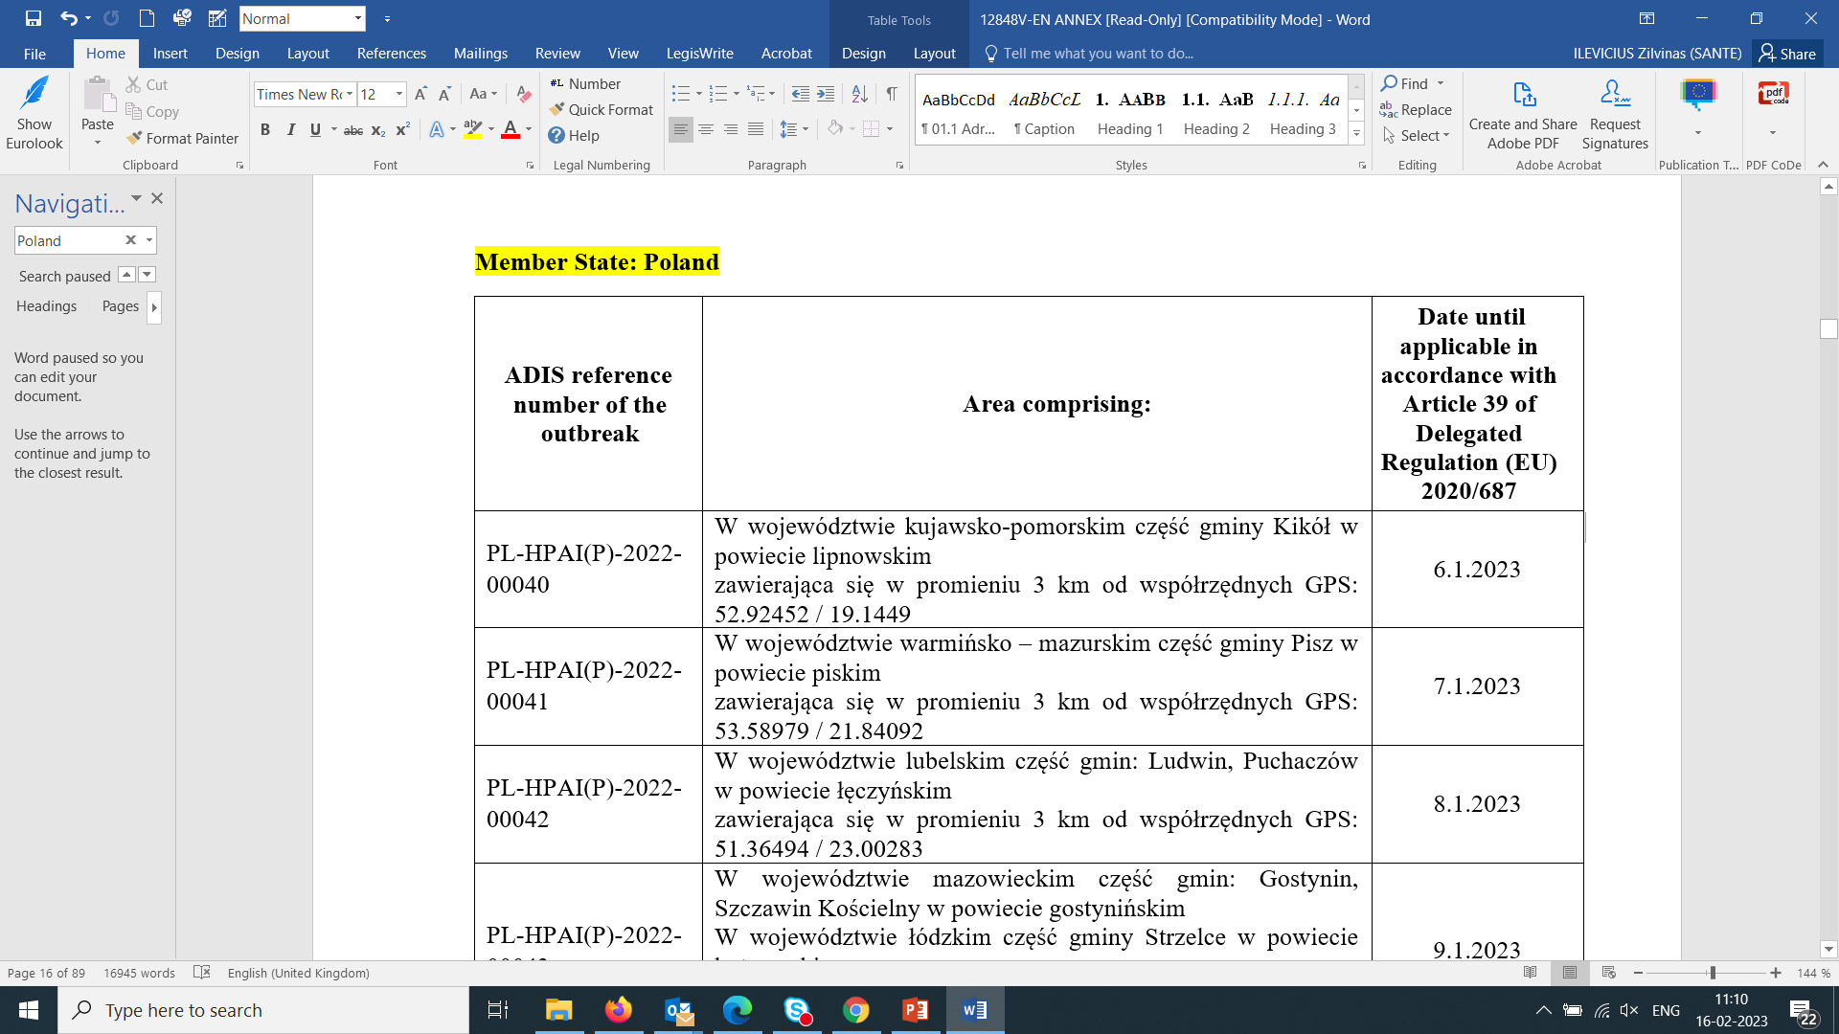
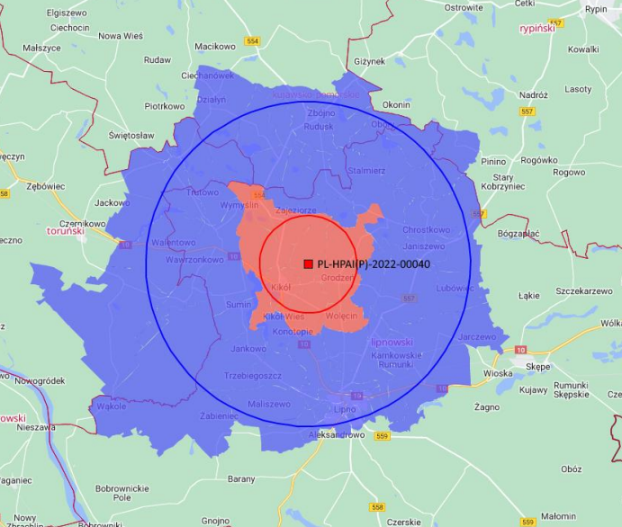
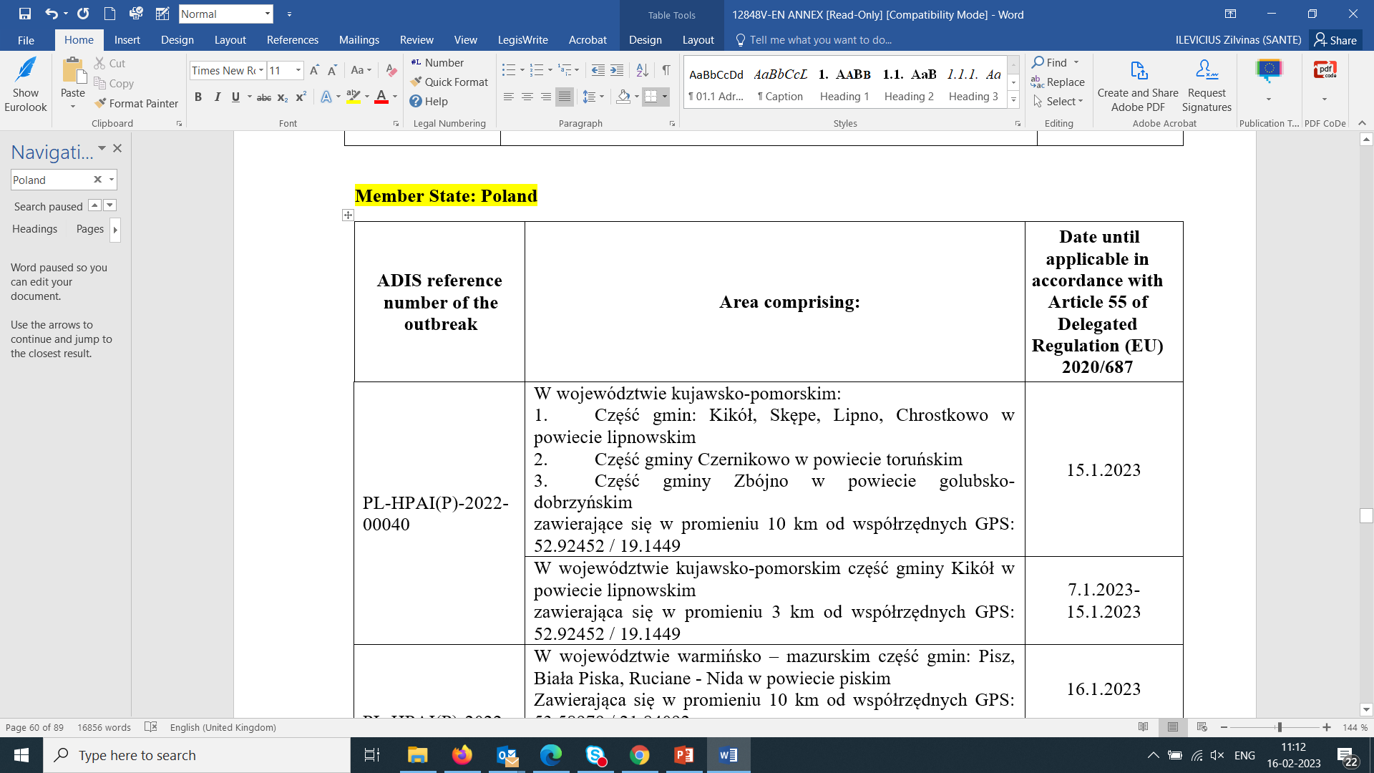
HPAI regionalisation in the EU:
40# outbreak in Poland, December 2022
Examples (HPAI)
Protection zone
Part A of Annex to
Implementing Decision (EU) 2021/641
ADIS notification
Surveillance zone
Part B of Annex to
Implementing Decision (EU) 2021/641
In line with Delegated Regulation (EU) 2020/687

Slide 28
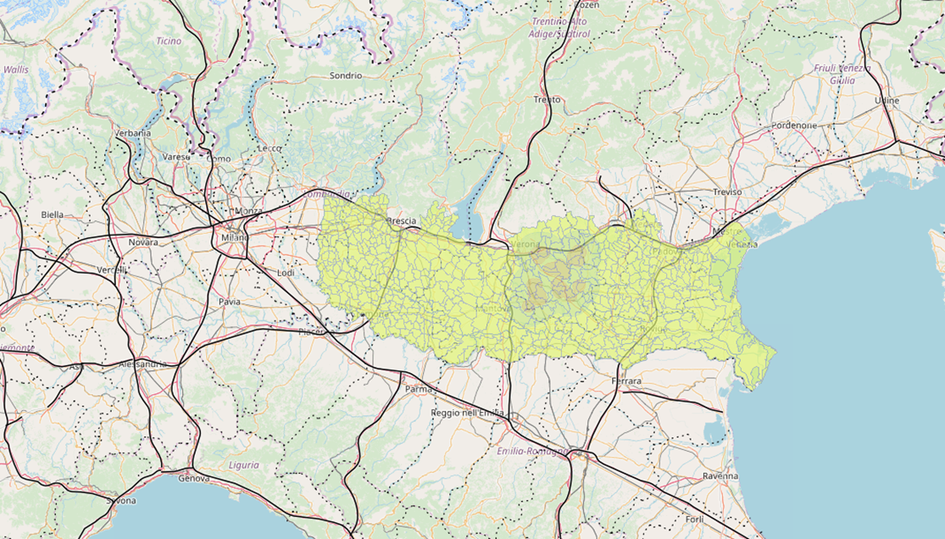
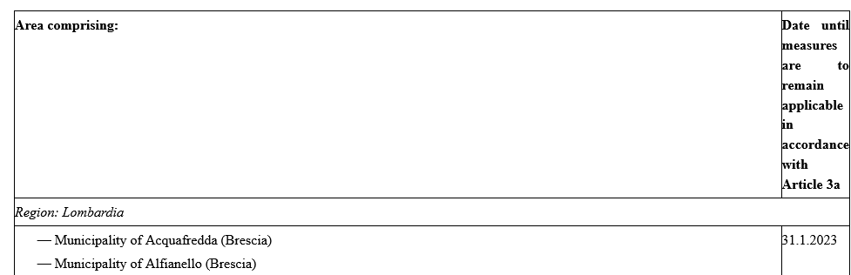
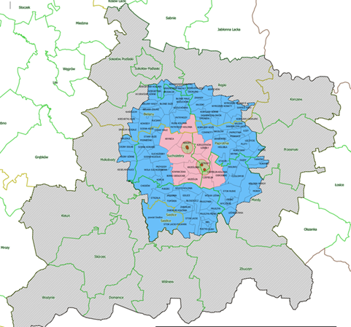
HPAI regionalisation in the EU: examples of further restricted zones 2022-23
Examples (HPAI)
Further restricted zones
Part C of Annex to
Implementing Decision (EU) 2021/641

Slide 29
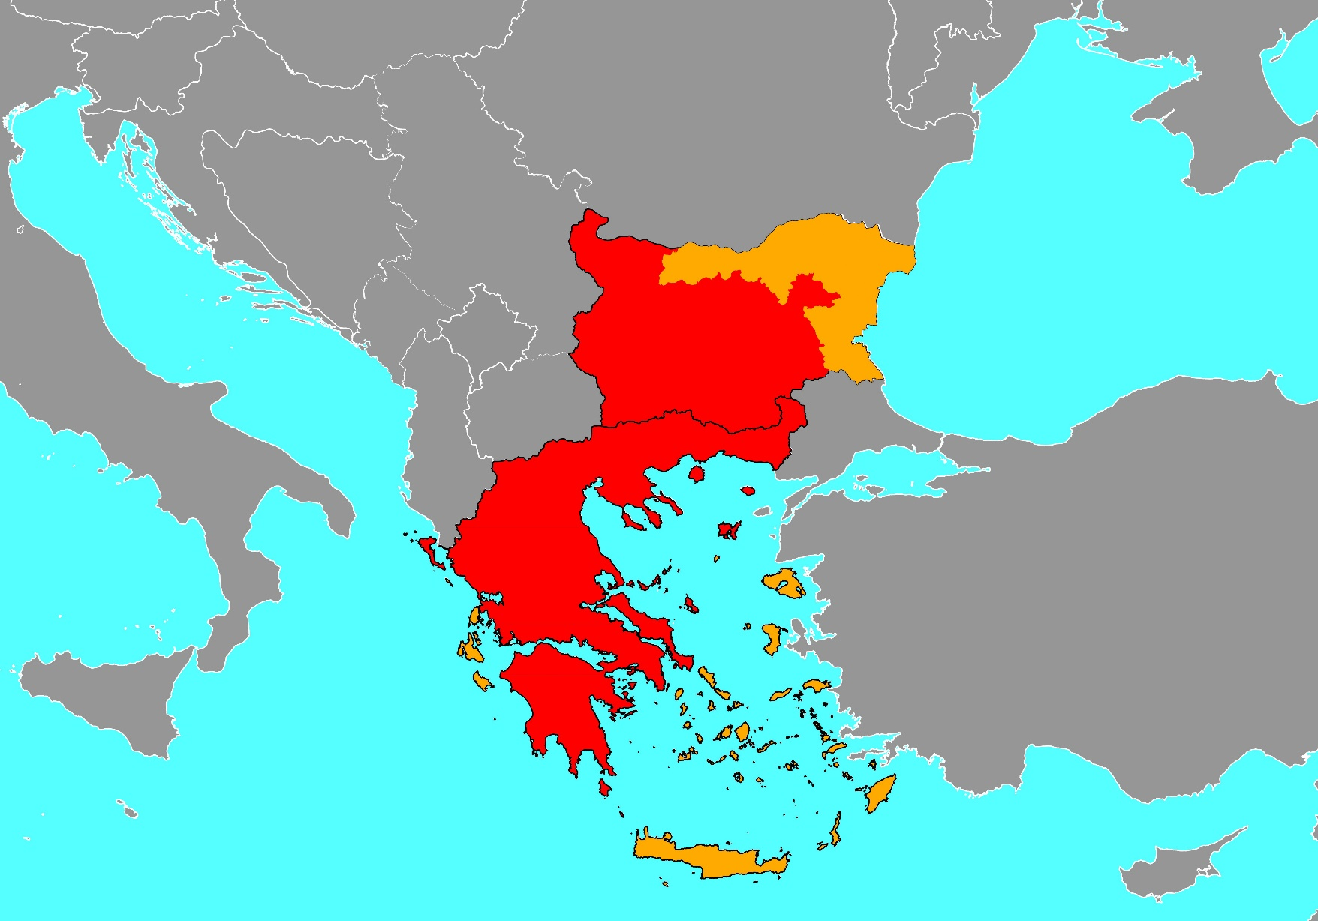
LSD regionalization: CID (EU) 2016/2008 (replaced in 2021 by CIR (EU) 2021/1070)
Examples (LSD)
Free zones with Vaccination (Part I):
Bulgaria (certain areas in the North and East part)
Greece (islands except Kerkyra and Limnos)
Infected zones (Part II):
Continental Greece (including the islands of Limnos and Kerkyra )
Bulgaria (excluding the ''free with vaccination'' zones
Bulgaria
Greece
Free with
Vaccination zone
Infected zone

Slide 30
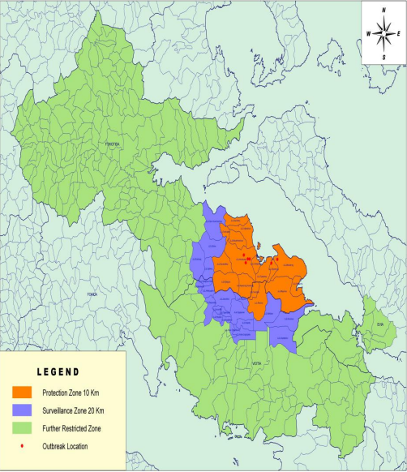
Sheep and Goat Pox regionalization: COMMISSION IMPLEMENTING DECISION (EU) 2024/400
Examples (LSD)

Slide 31
Conclusions
Key messages

Slide 32
EU regionalisation (zoning) measures: concluding remarks
The EU considers disease prevention, control and eradication as a major priority
The EU has been investing systematically on preparedness and emergency response tools for their proper control
The EU supports transparency in disease reporting and sharing of scientific knowledge globally
Regionalisation can only be a highly efficient instrument if it is part of a comprehensive veterinary control system (as it is a case in the EU)
The EU accepts regionalization in third countries exporting to the EU on the base of the principles explained and if justified

Slide 33
EU regionalisation (zoning) measures = guaranty for safe trade
The EU legislation foresees strict measures to apply regionalisation:
  based on science;
  in line with the WOAH international standards
  in the areas affected – establishment of restricted zones and risk mitigation measures
Business continuity:
  the negative impact of animal diseases is reduced (safe trade from non-restricted areas, safe derogations for affected areas, if relevant, etc.)
Proven to be effective to prevent / control / slow down the spread of diseases and eradicate them, where feasible, enabling safe trade
Recognized internationally (e.g. WTO cases) and by certain trading partners
In case of EU regionalisation measures in place - countrywide bans by trading partners, targeting also areas of the EU that are not affected by the disease, are unnecessary and disproportionate

Slide 34


Thank you for your attention
Questions?
© European Union 2020

